Slide 1
5.4 Cladistics
Nature of science:
Falsification of theories with one theory being superseded by another: plant families have been reclassified as a result of evidence from cladistics
Understanding:
A clade is a group of organisms that have evolved form the same ancestor
Evidence for which species are part of a clade can be obtained from the base sequences of a gene or the corresponding amino acid sequence of a protein
Sequence differences accumulate gradually so there is a positive correlation between the number of differences between two species and the time since they diverged from a common ancestor
Traits can be analogous or homologous
Cladograms are tree diagrams that show the most probably sequence of divergence in clades
Evidence from cladistics has shown that classifications of some groups based on structure did not correspond with the evolutionary origins of a group of species.
Applications
Cladograms including humans and other primates
Reclassification of the figwort family using evidence from cladistics
Skills
Analysis of cladograms to deduce evolutionary relationships

Slide 2
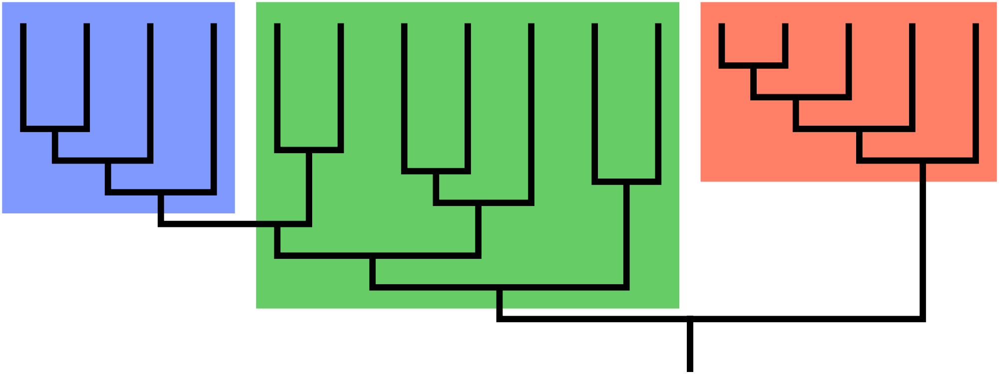
Clades
Group of organisms that have evolved from a common ancestor

Slide 3
Clades
Species evolve over time to from a new species
Happens repeatedly so many groups of species have derived from one common ancestor

Slide 4
Include all species that are alive today
Include the common ancestral species
Species that did evolve from the ancestral species but became extinct
4. Can be very large and contain thousands of species. Can be very small with just a few.

Slide 5
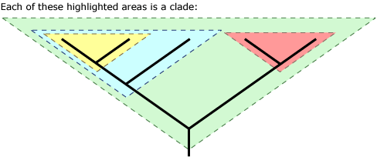
Clades
You can also have a clade within a clade

Slide 6
Identifying members of a clade
Not always obvious. How would you decide which clade an organism belongs to?
base sequences of genes, or amino acid sequences of proteins.
Those with recent common ancestors will have little differences in base/amino acid sequences – molecular phylogeny

Slide 8
Draw a cladogram to show the evolutionary history of these 4 species

Slide 9
Molecular clocks
Mutations cause differences in base sequences.
Mutations accumulate gradually over time.
Use mutations as a molecular clock
Number of differences in sequence can be used to deduce how long ago a species split from a common ancestor
Molecular clocks

Slide 11
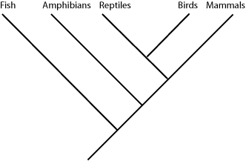
Cladograms
Nodes = branching points
(usually splits into two, but can be three or more)
The node represents ancestral species. Modern cladograms based on DNA/AA sequences. Old ones based on fossil record. Very often they match. Sometimes they don’t and need to be changed.

Slide 13
How are organisms put in clades?
DNA/AA sequences (molecular phylogeny
Homologous traits
Analogous traits

Slide 14
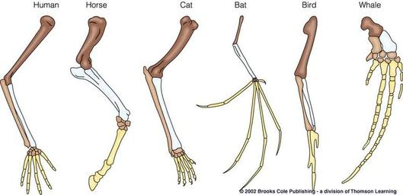
Traits
Homologous traits:
Similar traits due to similar ancestry.
Pentadactyl limb/vertebrate forearm

Slide 15
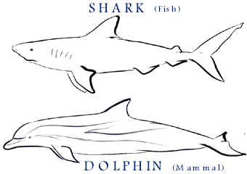
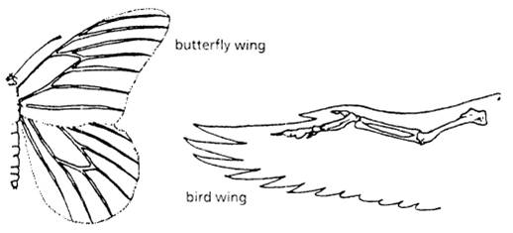
Traits
Homolgy v Analogy
Analogous Traits:
Similar due to convergent evolution
Evolved independently from different common ancestors

Slide 16
Primitive characteristics – same structure and function evolved at the start of a clade
Derived characteristics - same structure and function evolved later in the clade

Slide 19
Cladograms
Tree diagram based on similarities and differences between the species in a clade.
Base sequences/amino acid sequences
Principle of parsimony
Computer programs calculate how species in a clade could have evolved with the smallest number of changes of base/amino acid sequences
Does not prove how a clade actually evolved – but shows the most probable sequence

Slide 20
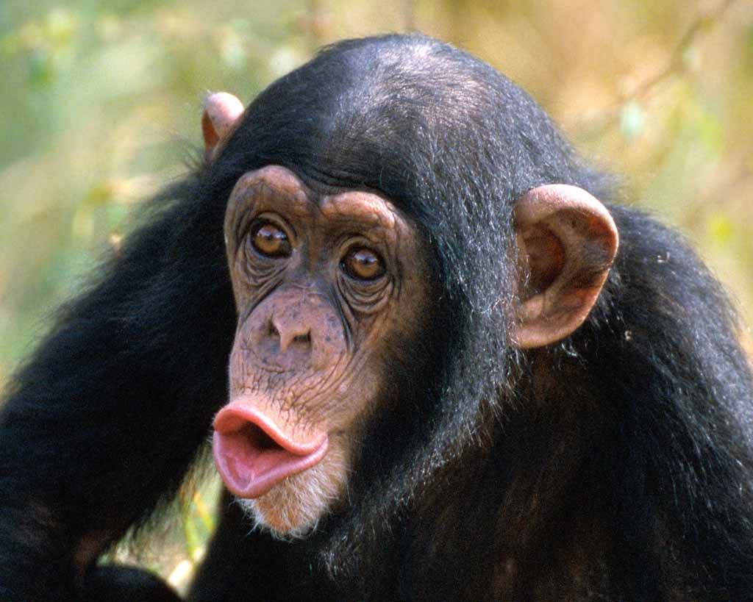
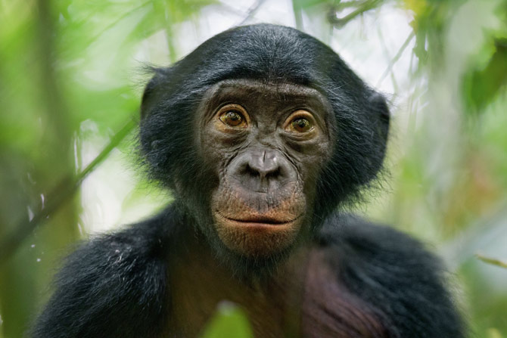
Cladograms
Humans, chimpanzees and bonobos are closely related

Slide 21
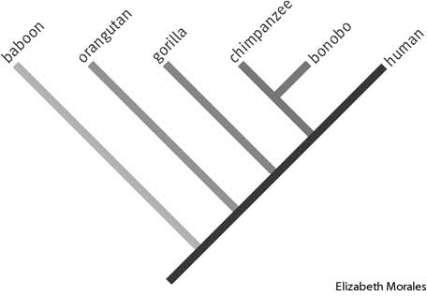
Cladograms
Genomes have been sequenced giving strong evidence for a cladogram.
5MYA human-chimpanzee/bonobo split
1MYA Chimpanzee-bonobo split

Slide 22
Technology
Using base sequences only became possible at the end of the 20th century.
Sequence data and computer software not available to analyse sequences.
Cladistics = creating clades using sequences

Slide 23
Technology
Caused revolutions in classification
Morphology does not always match evolutionary origins of groups of species
Groups split
Groups merged
Species transferred to different groups

Slide 24
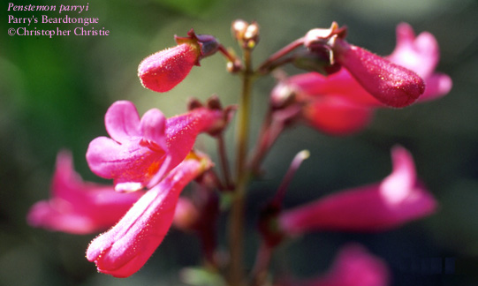
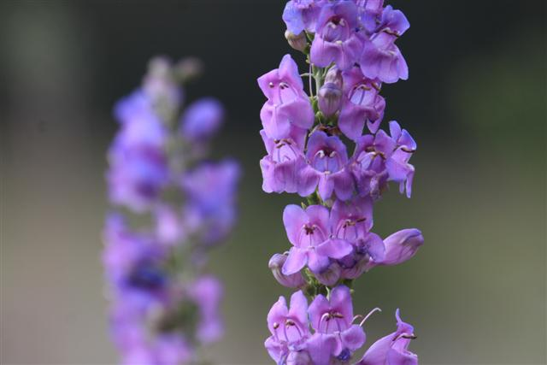
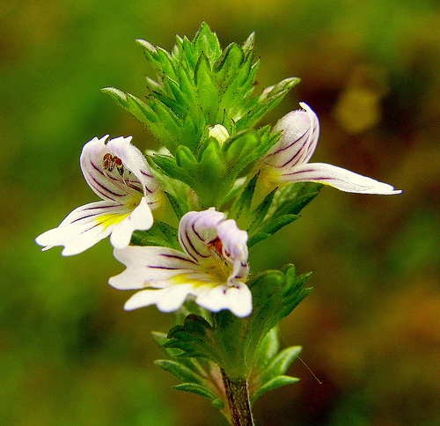
Figwort Family
One of the hundreds of families of angiosperms

Slide 25
Figwort Family
Included 16 genera originally based on morphology
Grew to 275 genera with 5000+ species
Recently investigated evolutionary origins using cladistics…
Found species in figwort family were not a true clade and had been incorrectly put into the same family. (Many differences between base sequences)

Slide 26
Figwort Family
2 small families were merged
50 genera moved to plantain family
12 genera moved to boomrape family
13 genera moved to a newly created family
2 genera moved to another newly created family
Less than half of the species have been retained in the family
Was the 8th largest family, not the 36th largest among angiosperms

