Slide 1
What are dichotomous keys?
A method of identifying an unknown organism into a taxa

Slide 2
Dichotomous keys
Identify the fungus
cap
Stalk does not have a frill go to 2
Stalk has a frill go to 3
Stem is brown Fungus A
Stem is yellow Fungus B
Cap has spots go to 4
Cap does not have spots Fungus C
Cap is red Fungus D
Cap is brown Fungus E
frill

Slide 3
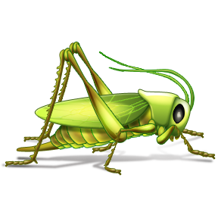
Making a dichotomous key
Go to step 2
Go to step 3
a. wings covered by exoskeleton
b. wings not covered by exoskeleton
Statements that will identify the ladybug from the grasshopper
a. body has round shape
b. body has elongated shape
ladybug
grasshopper
Statements that will identify the fly from the dragonfly
a. wings point to back of body
b. wings point to side of body
fly
dragonfly
*There is always one less step than the number of organisms involved!

Slide 4
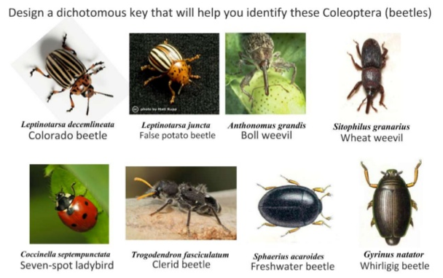

Slide 5
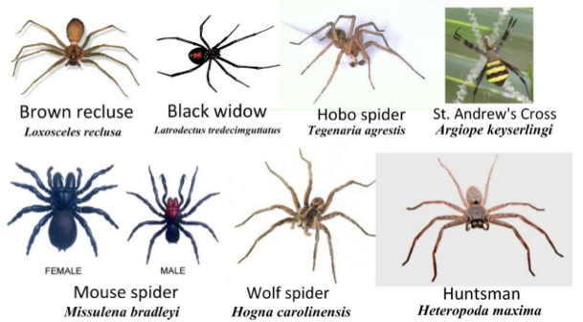

Slide 6
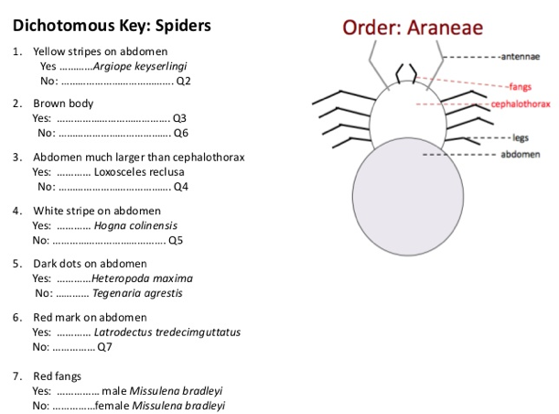

Slide 7
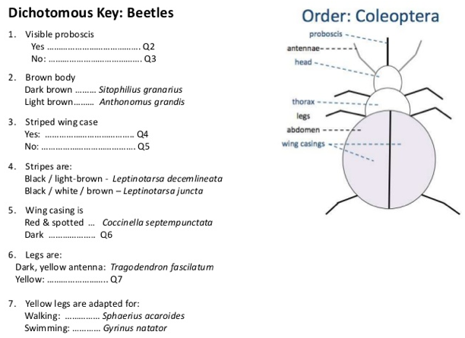

Slide 8
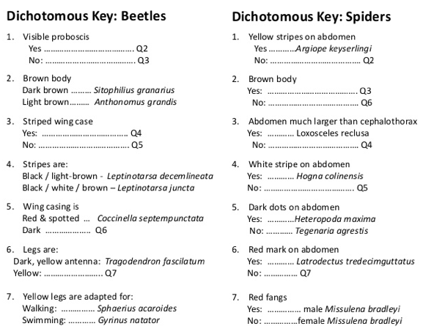

Slide 9
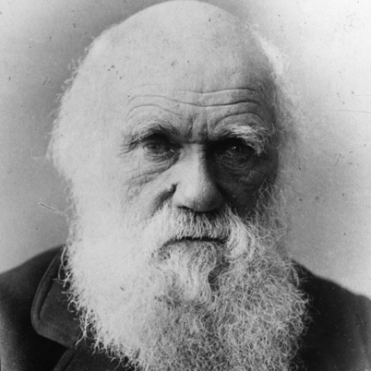
Let’s play taboo!
Word you want them to guess: Natural selection
Words you can’t use: Charles Darwin, evolution, theory

Slide 10
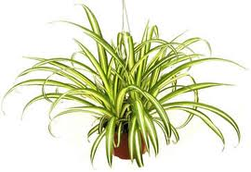
Let’s play taboo!
Word you want them to guess: autotroph
Words you can’t use: Plants, photosynthesis, producer

Slide 11
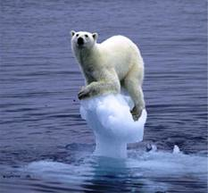
Let’s play taboo!
Word you want them to guess: Greenhouse effect
Words you can’t use: temperature, global warming, UV rays

Slide 12
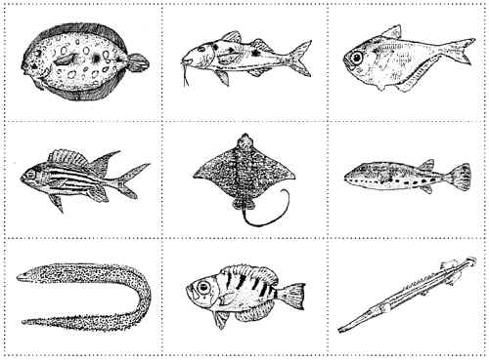
Let’s play taboo!
Word you want them to guess: dichotomous keys
Words you can’t use: two, identify, unknown

Slide 13
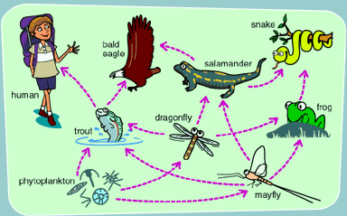
Let’s play taboo!
Word you want them to guess: food web
Words you can’t use: ecosystem, food chain, consumers

Slide 14
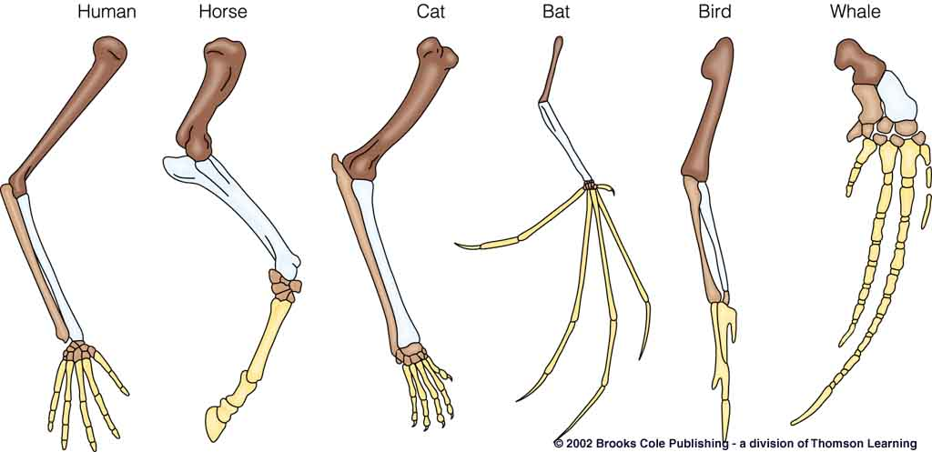
Let’s play taboo!
Word you want them to guess: homologous structures
Words you can’t use: evidence, evolution, pentadactyl

Slide 15
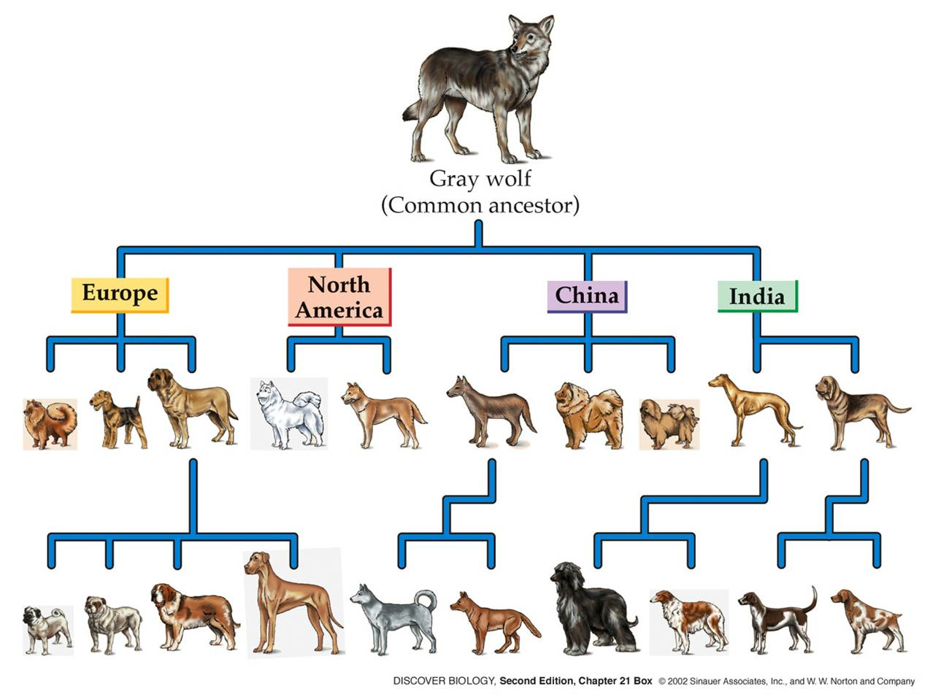
Let’s play taboo!
Word you want them to guess: artificial selection
Words you can’t use: evidence, evolution, dogs

