Slide 1
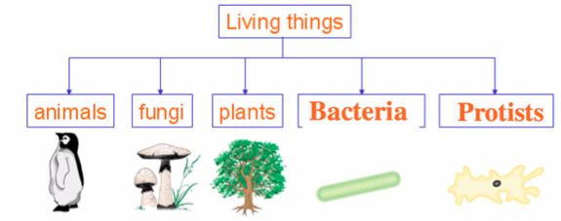
The old method…
prokaryotes
With modern scientific methods the bacteria kingdom was found to be extremely diverse

Slide 2
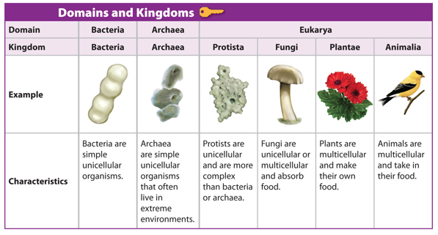
The 3 Domains
Split into bacteria and archaea
The three domains are now Bacteria, Archaea and Eukarya

Slide 3
All organisms are classified into three domains
 | Eubacteria | Archaea | Eukarya
Histones | none | Histone-like | present
Introns | none | In some DNA | present
Ribosomes | 70S | 70S | 80S
Cell membrane Lipids | Unbranched hydrocarbons | Branched hydrocarbons | Unbranched hydrocarbons
Peptidoglycan in cell walls | present | absent | absent
Membrane bound organelles | none | none | present

Slide 4
Common
Ancestry
Natural
Classification
What do you think is meant by artificial classification?

Slide 5
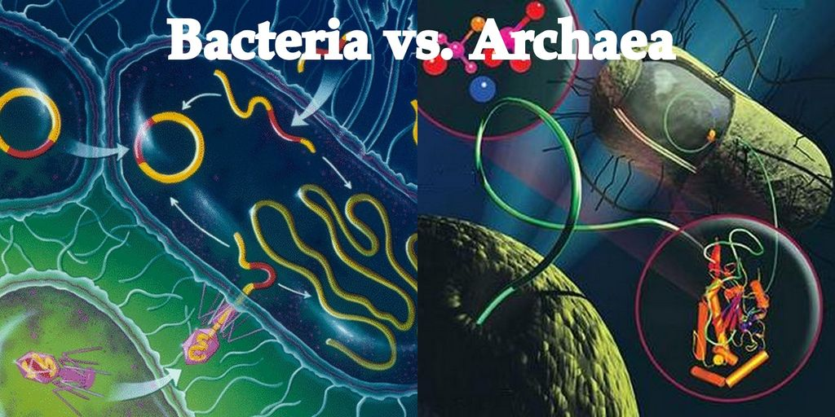
Classifications can change
Classification can change based on new evidence. Molecular biology shows natural classification more clearly.
Two similar visually species may have evolved from different ancestral species

Slide 6
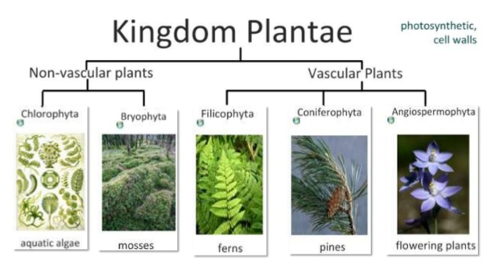

Slide 7
Plants phyla: bryophyta, filicinophyta, coniferophyta and angiospermophyta
HW

Slide 9
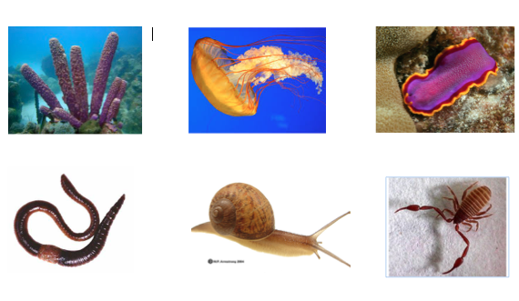
Animal phyla - Invertebrates
Use the cards to classify the invertebrate phyla

Slide 10
Vertebrates/Chordata
Classsifying vertebrates

Slide 11
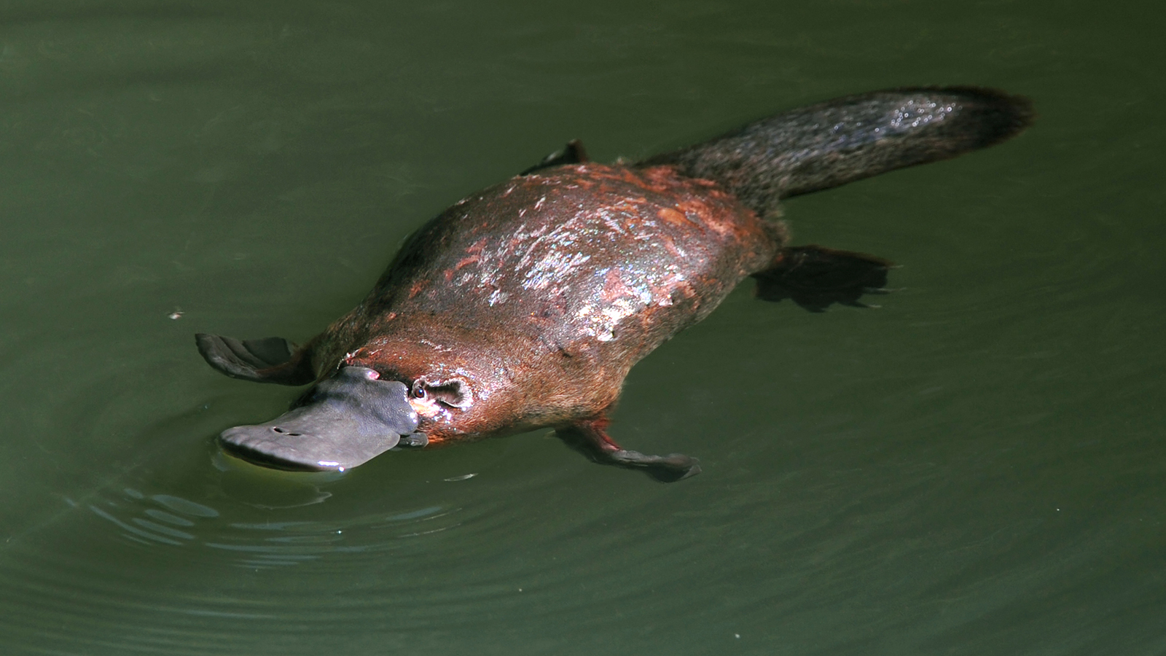
Platypus
Platypus
How would you classify the platypus?

