Slide 1
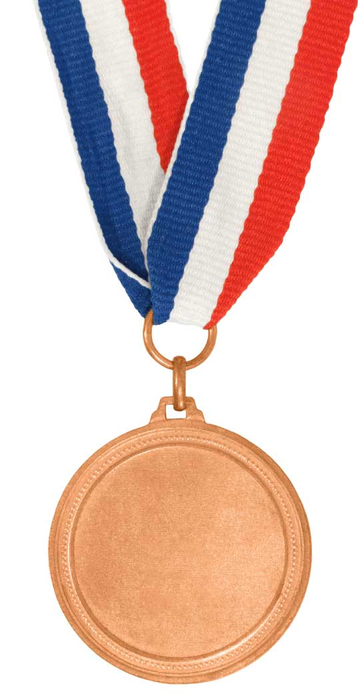
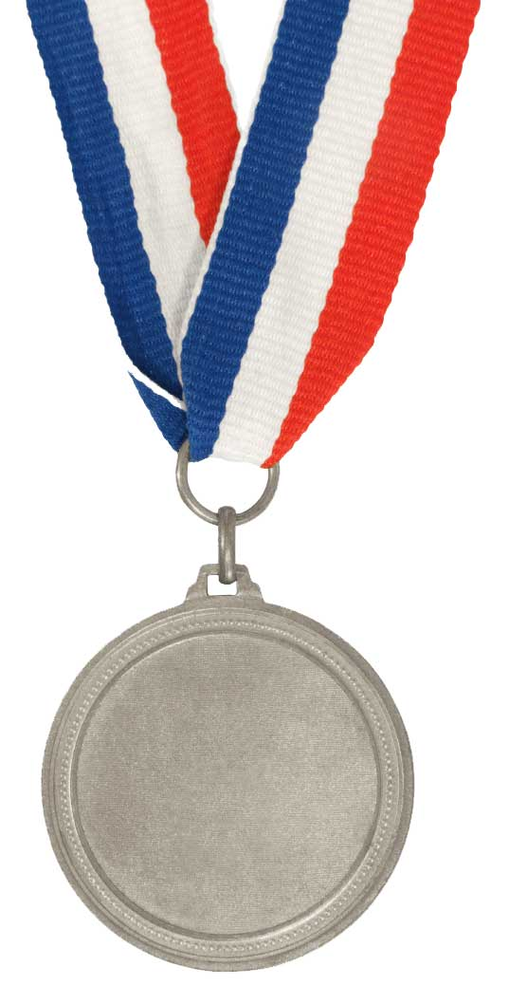
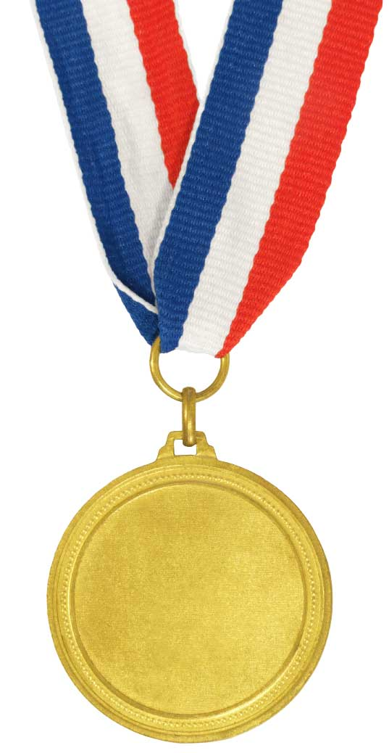
Understand how light is dispersed
Recall that white light is made up of a spectrum of colours
Bronze
Describe how filters work
Explain how a prism splits light into a spectrum
Gold

Slide 2
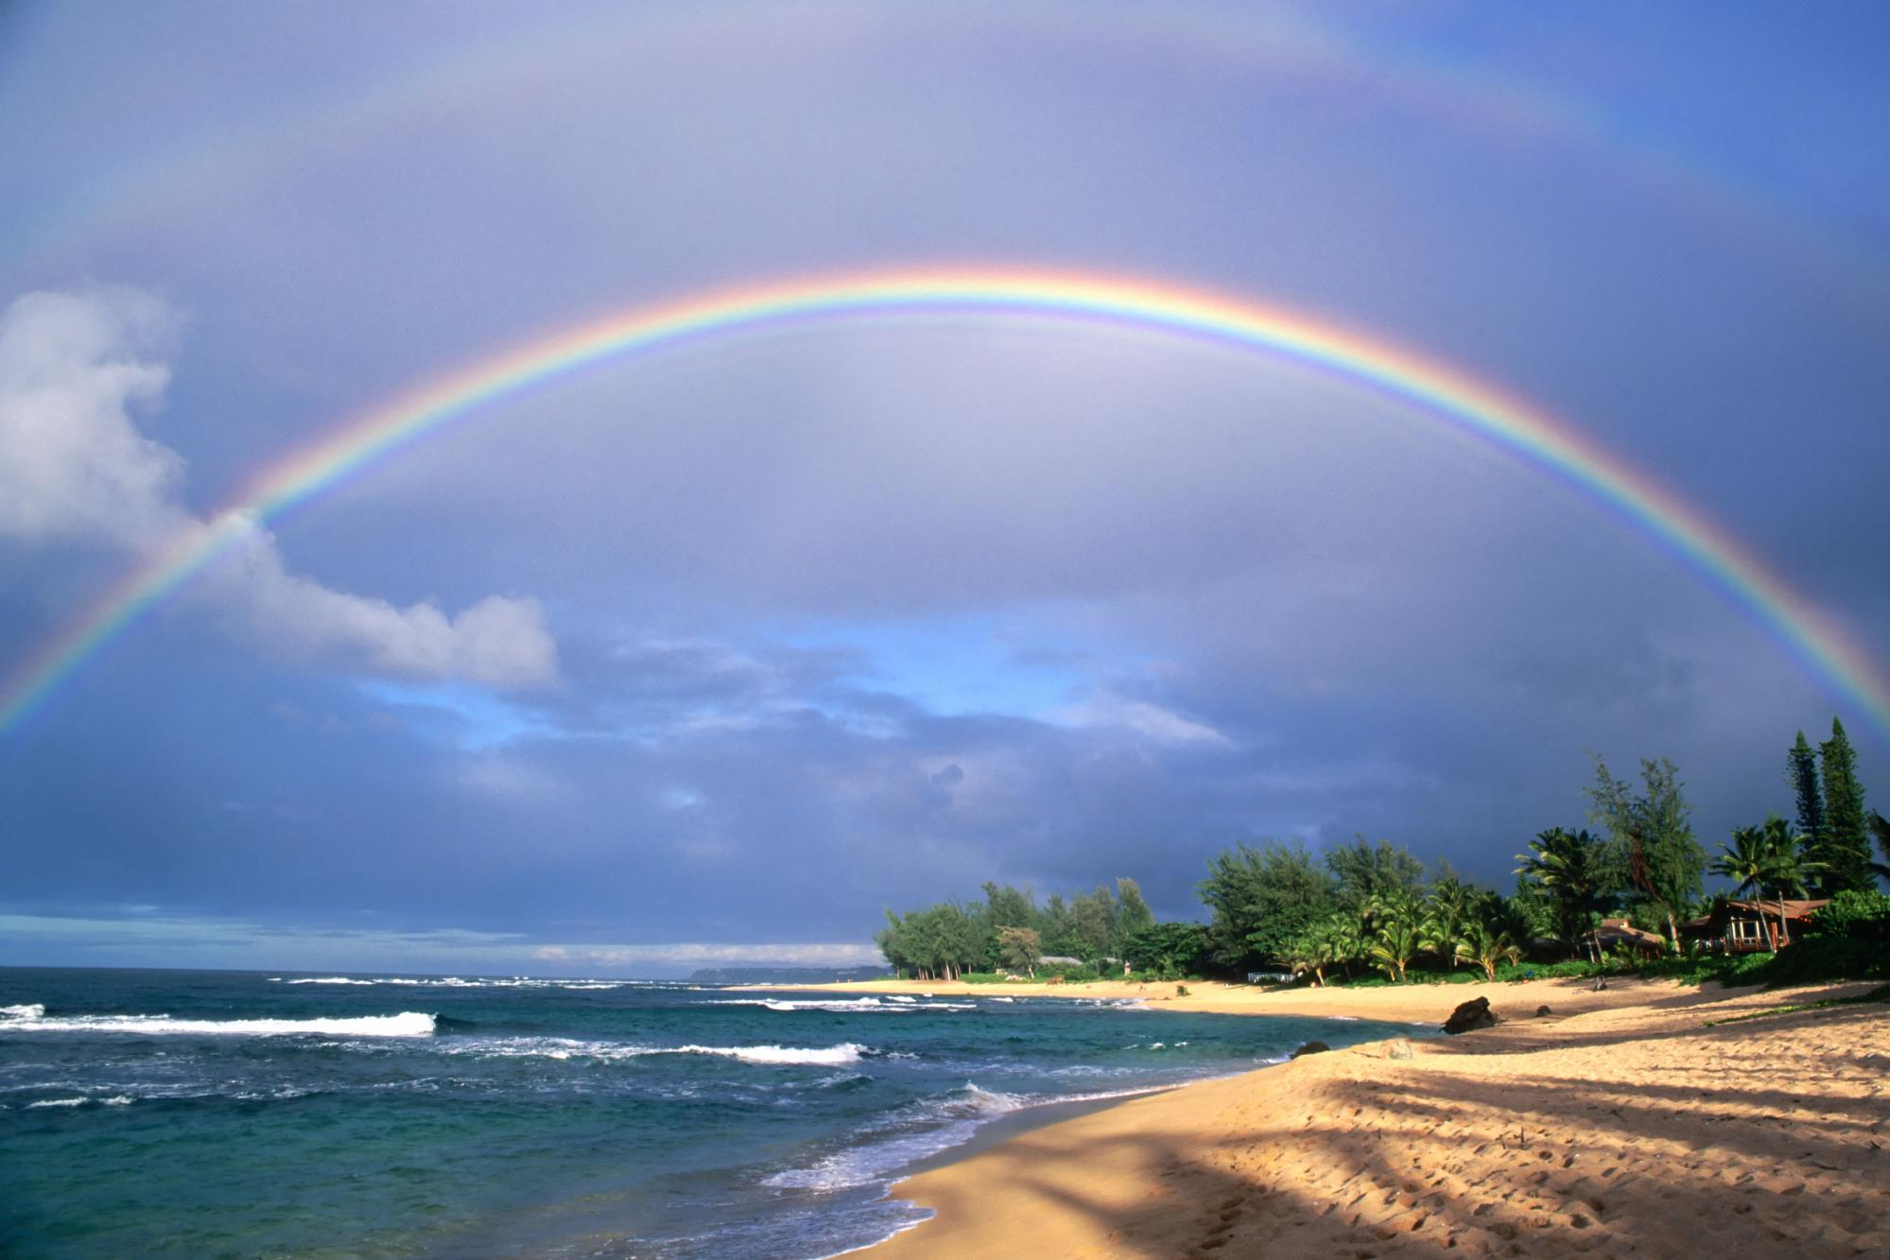
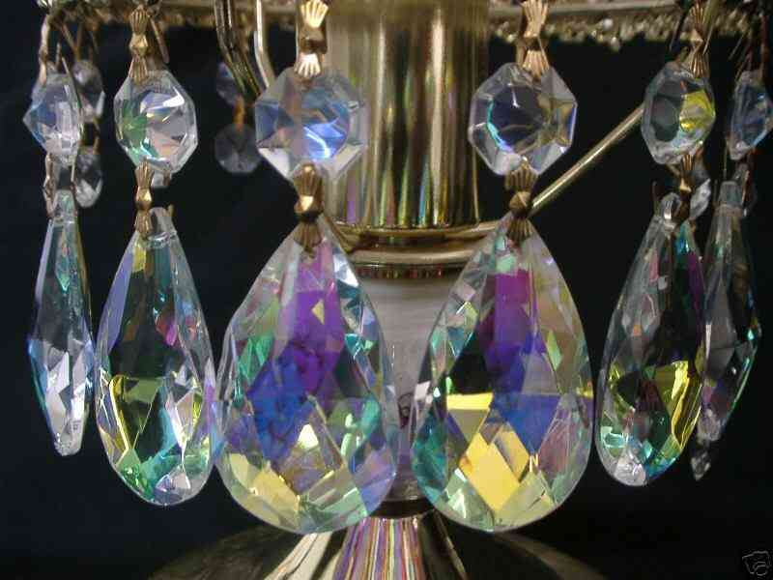
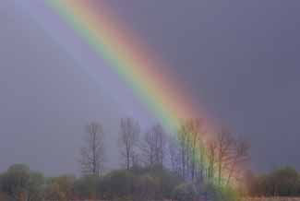
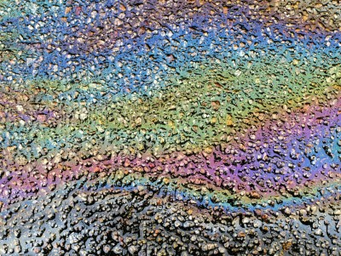
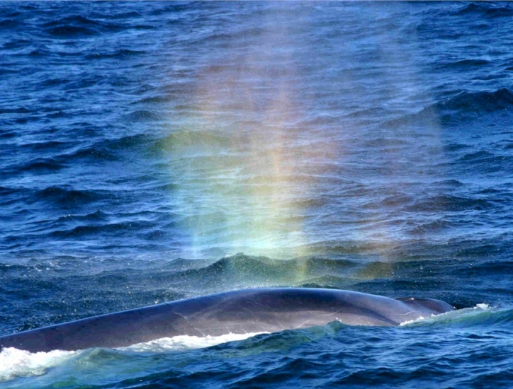
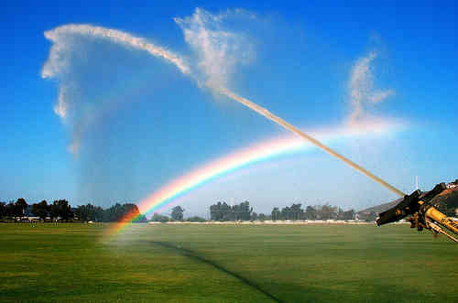
Making Rainbows
When do you get rainbows?
Why do rainbows occur?
Where have you seen a similar spread of colours?

Slide 3
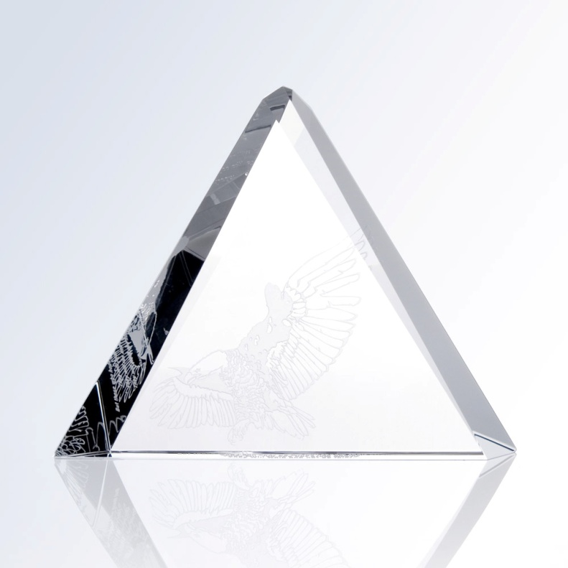
Investigation
Shine a ray of light at a prism and move the prism until colours appear.
What colours do you see?
Are the colours always in the same order as you move the prism around
Which colours are refracted the most?

Slide 4
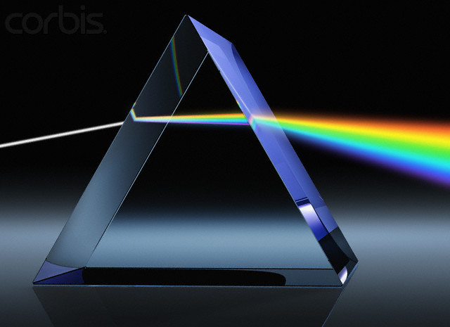
When white light is refracted through a prism the colours separate out because different colours are refracted different amounts. This separating of the colours is called dispersion

Slide 5
Dispersion

Slide 6
Dispersion

Slide 7
Dispersion

Slide 8
Dispersion

Slide 9
Dispersion

Slide 10
Dispersion
White light

Slide 11
Dispersion
White light contains the colours
Red

Slide 12
Dispersion
White light contains the colours
Red
Orange

Slide 13
Dispersion
White light contains the colours
Red
Orange
Yellow

Slide 14
Dispersion
White light contains the colours
Red
Orange
Yellow
Green

Slide 15
Dispersion
White light contains the colours
Red
Orange
Yellow
Green
blue

Slide 16
Dispersion
White light contains the colours
Red
Orange
Yellow
Green
Blue
Indigo

Slide 17
Dispersion
White light contains the colours
Red
Orange
Yellow
Green
Blue
Indigo
violet

Slide 18
Dispersion
White light contains the colours
Red
Orange
Yellow
Green
Blue
Indigo
violet

Slide 19
Dispersion
White light contains the colours
Red
Orange
Yellow
Green
Blue
Indigo
violet
Red is refracted the least

Slide 20
Dispersion
White light contains the colours
Red
Orange
Yellow
Green
Blue
Indigo
violet
Red is refracted the least
Violet is refracted the most
Notes:
Annotate onto your diagram

Slide 21
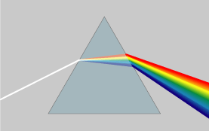
All the colours are refracted by different amounts
Questions:
Which colour is refracted the most?
Which colour is refracted the least?
What is the name of this shape of glass?
What is it called when light is split into separate colours?

Slide 22
Why do you see rainbows?
Droplets of water in the air act like prisms and split the white light from the Sun into a spectrum of different colours.

Slide 23
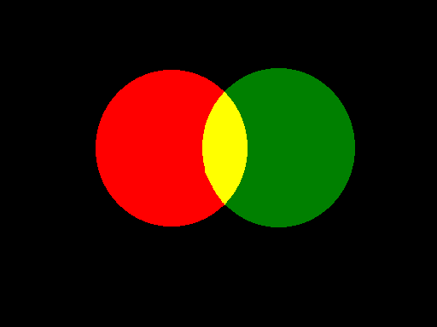
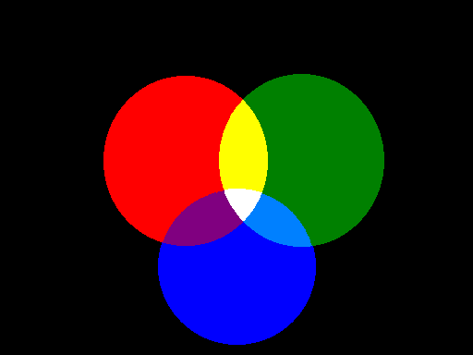
Mixing Coloured Light
Red light
Yellow light
Green light
Mix all three and you get...
...White light
Magenta light
Cyan light
Blue light

Slide 24
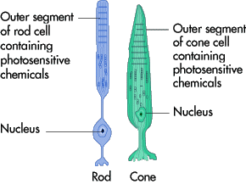
In your eye
In your eye you have rods and cones
Cones = sensitive to colour
Rods = sensitive to light
Blue, red and green sensitive cones
Red light = red cones activated
Blue light = blue cones activated
Green light = green cones activated
All other colours are created when you mix together these
primary colours

Slide 25
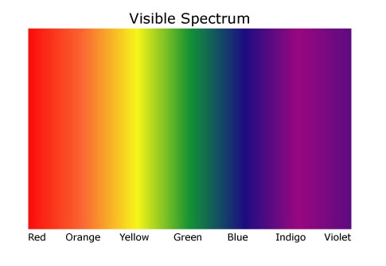
In your eye
These are the primary and secondary colours
All colours in the visible spectrum are made from these

Slide 26
Confusing!
Colours in the visible
spectrum:
Red
Orange
Yellow
Green
Blue
Indigo
Violet
Mixing light:
Primary colours:
Red
Blue
Green
Secondary colours:
Yellow
Magenta
Cyan

Slide 27
Filters
coloured
Filters are used to make
light from white light.
How do they work?
White light
Red light
is made up of 3 primary colours
Red Filter
The green and blue light is absorbed.
The red light is transmitted.

Slide 28
Red
Green
?
+
Yellow
+
Blue
Red
?
+
Magenta
+
?
Green
Blue
Cyan
+
White
?

Slide 29
Try These
what colour will the transmitted light be?

Slide 30
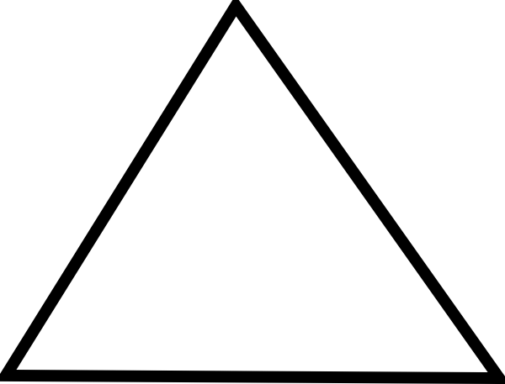
Dispersion
Light: primary colours

Slide 31
Understand how light is dispersed
Recall that white light is made up of a spectrum of colours
Bronze
Describe how filters work
Silver
Explain how a prism splits light into a spectrum
Gold

