Slide 2
Antibiotics and Antibiotic Resistance
Define antibiotic
Explain how antibiotics work
Summerise Florey and Chain’s experiments testing penicillin
Explain how bacteria can become resistant to antibiotics

Slide 3
Would an antibiotic be effective in treating HIV?

Slide 4
Florey and Chain
Describe Florey and Chain’s experiments with penicillin.
Summerise!!

Slide 5
Antibiotic Resistance
Antibiotic Resistance

Slide 6
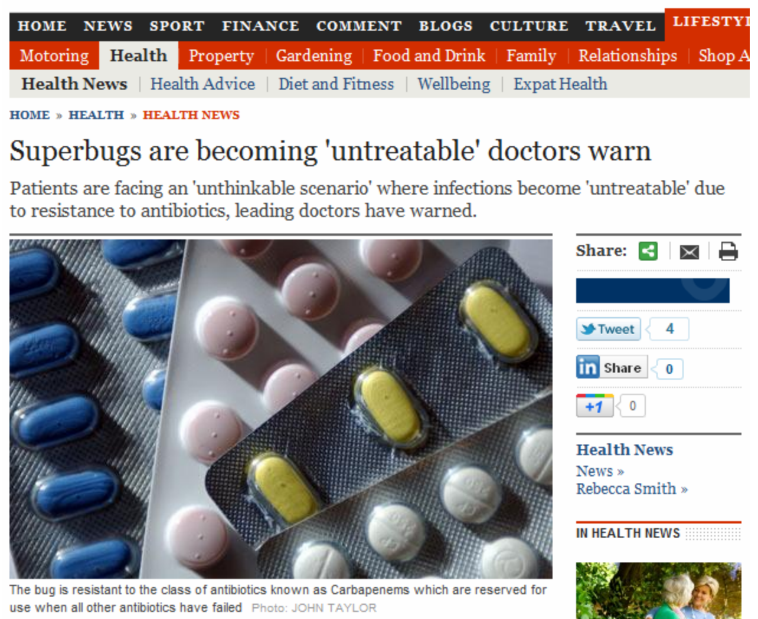

Slide 7
SUPERBUGS

