Slide 1
Draw covalent bonding in water

Slide 2
Water – Vital to Life
Describe the structure of water and how this enables hydrogen bonding.
Describe how the structure of water determines its properties and makes it important for life

Slide 3
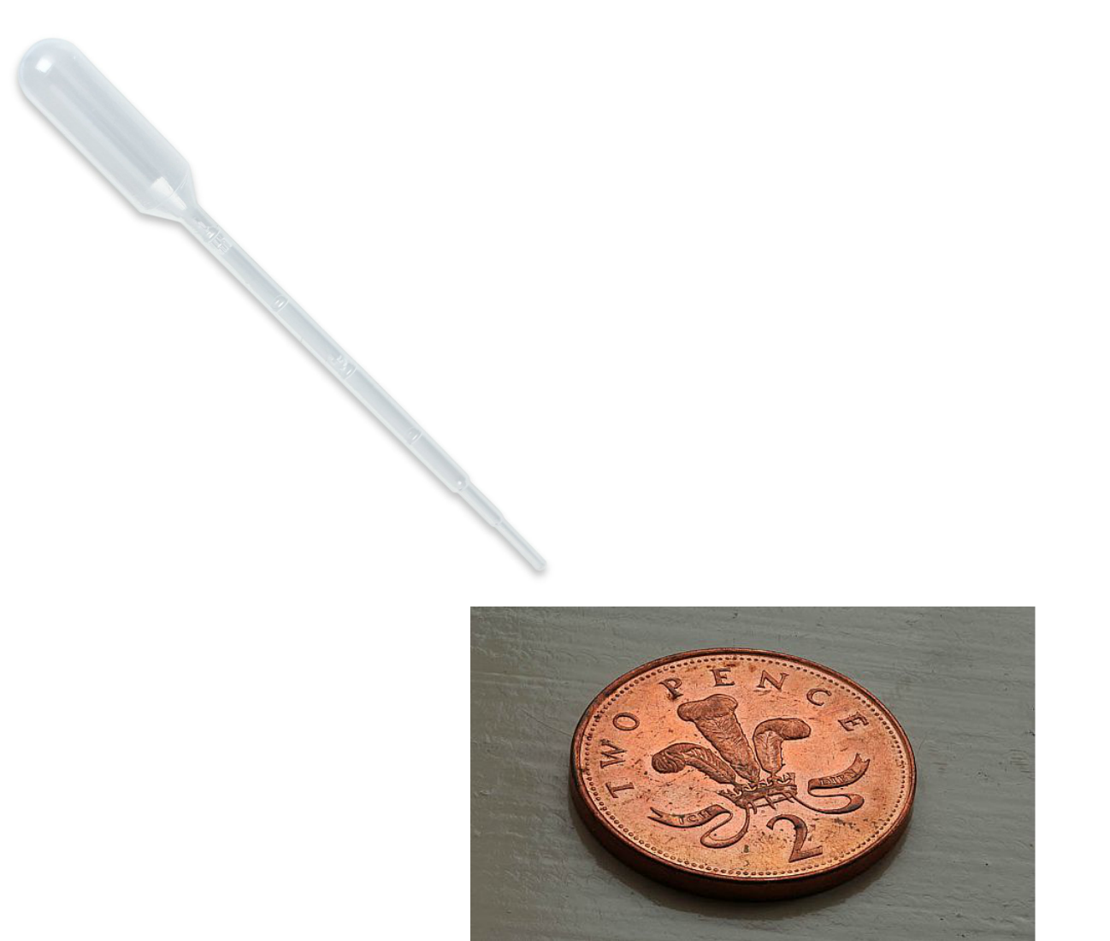

Slide 5
Water

Slide 6
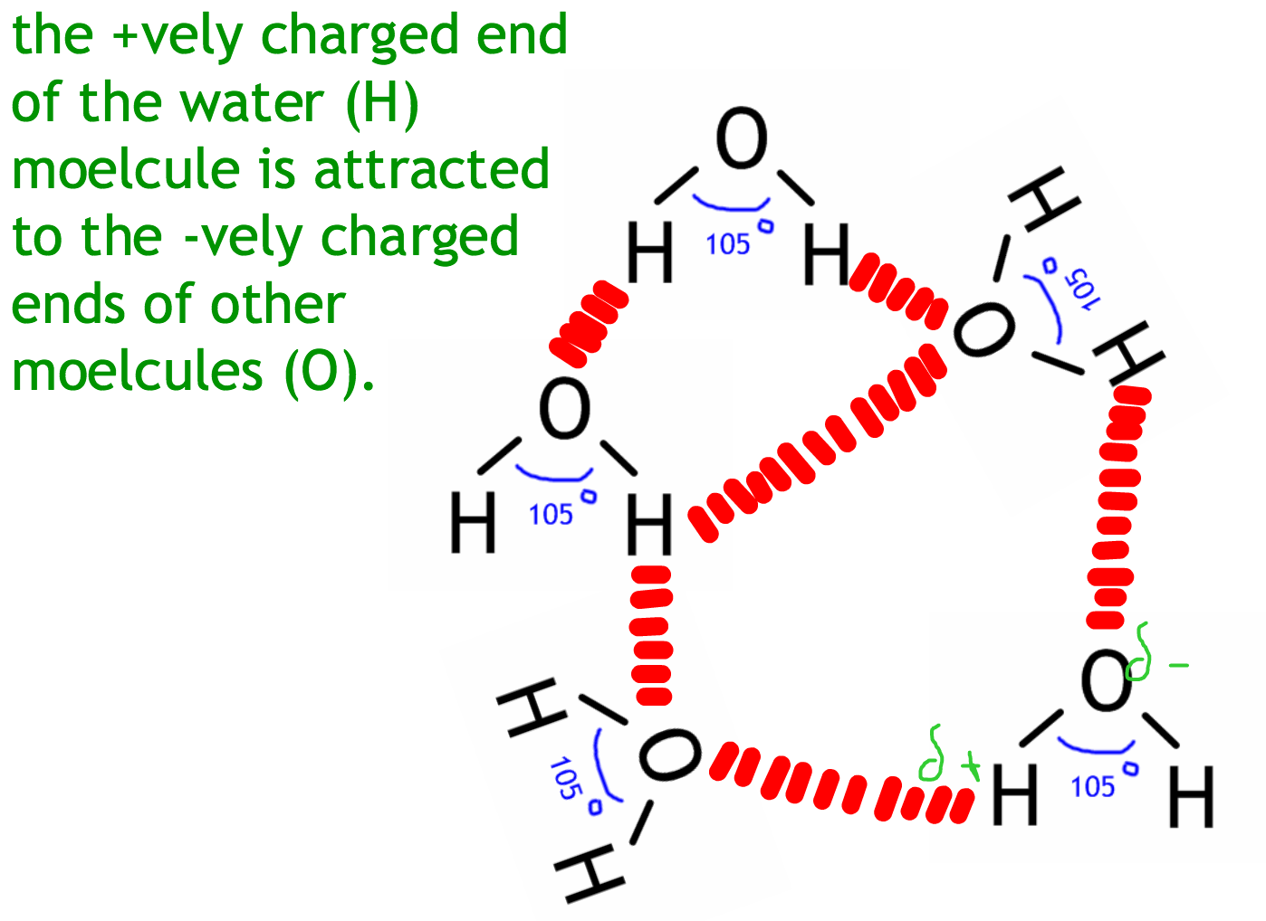

Slide 7
Properties of Water
Water has these properties..
Cohesive properties
Adhesive properties
Thermal properties:
High specific heat capacity
High latent heat of vaporization
High boiling point
Solvent properties

Slide 8
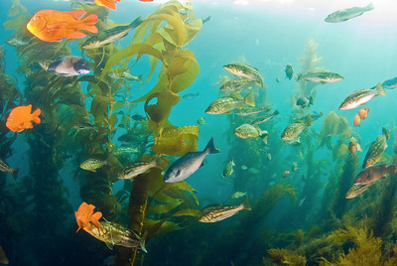
Other things about water..
Why is it good for living things that ice is less dense than water?
Why is it good for living things that water is transparent?
Cohesion gives it surface tension so living things can live on top

Slide 9
Demo 1 – Adhesion and Cohesion
Demo:
water drops on a coin, paper clip on water
Explanation:
Define adhesion and cohesion
Explain how the structure of water gives it cohesive and adhesive properties
Give biological examples

Slide 10
Demo 2 – High specific heat capacity
Demo:
Water bath with water and oil
Explanation:
What does specific heat capacity mean?
Why does water have a high specific heat capacity?
Why is this an advantage to living things?

Slide 11
Demo 3 – High latent heat of vaporization and high boiling point
Demo:
Water and ethanol on a hot plate
Explanation:
What do these terms mean?
What is the advantage of these being high to living things?
Mention water as a coolant in sweating

Slide 12
Demo 4 – Solvent properties
Demo:
Dissolving salt in ethanol and water
Explanation:
Why is water a good solvent?
Why is this important in living things?
What do the terms hydrophilic and hydrophobic mean?

Slide 13
Cohesive Properties
Adhesive Properties
Solvent Properties
Structure of Water
Hydrophilic and hydrophobic
High Specific Heat Capacity
High Latent Heat of Vaporization
High Boiling Point

Slide 15
water is transparent / light passes through water; this allows organisms to live below the surface / plants to photosynthesize;
hydrogen bonds between water molecules make water cohesive; this gives water a high surface tension allowing animals to live on the surface; helps in water movement through plants/transpiration;
water has a high latent heat of vaporization evaporation/sweating/transpiration leads to cooling;
water has a high specific heat capacity / OWTTE; this provides a stable environment for water organisms;
water is a universal solvent; can transport materials around organisms/plants/animals;
can be a solvent for chemical reactions in organisms;
ice is less dense than water / water has a maximum density at 4°C; surface (pond/lake/ocean) freezes first, allowing organisms to survive in the water below;
9 max

Slide 16
Transport around the body in water
NaCl – Polar so dissolves in plasma
Amino acids - Solubility depends on R group but all are soluble enough dissolve in plasma
Glucose – Polar so dissolves in plasma
Fats and cholesterol – insoluble so are transported in lipoproteins

Slide 17
D

Slide 18
A

Slide 19
C

Slide 20
B

Slide 21
B

Slide 22
C

