Slide 2
Specialised Cells
State some specialised cells
Describe the structure of some specialised cells
Explain how the structure of specialised cells relates to their function

Slide 3
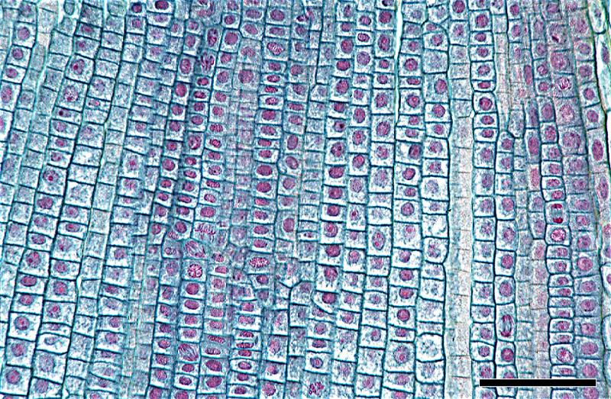
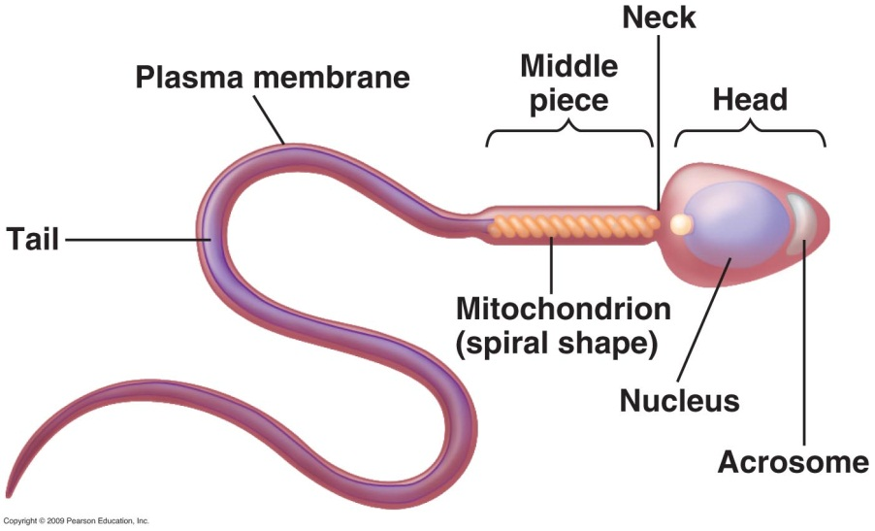
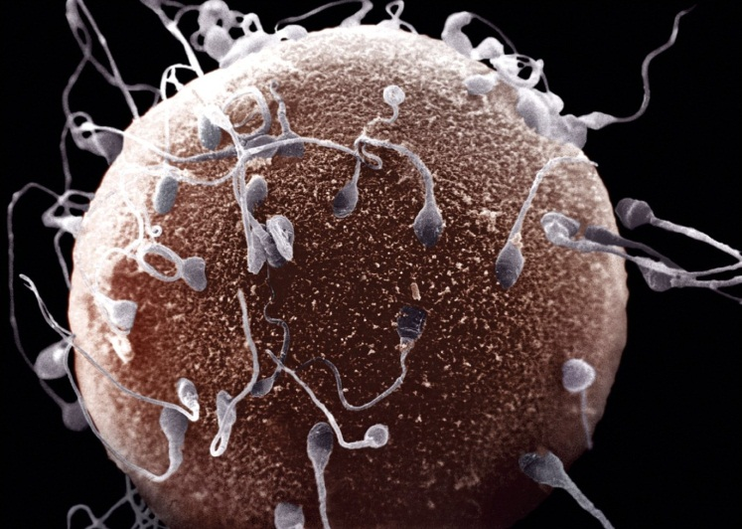
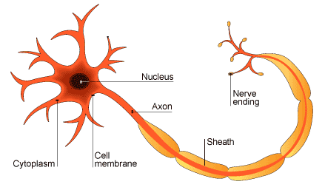
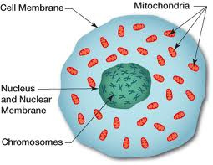
A specialised cell is a cell that performs a specific function. The structure of the cell helps it to carry out this function.

Slide 4
There are over
220 different types of cells in our body!

Slide 5
Specialised Cell
You are each going to be given a specialised cell, e.g. sperm cell.
You will have 5 minutes to ‘find out more about yourself’
You will then go on a series of dates to get to know all of the other specialised cells.
Each date will last for 6 mins
In that time you must swap information for both cells

Slide 6
Specialised Cell
Don’t feel nervous and remember to make eye contact with your date.
Listen carefully to what your partner is saying.
Test each other to see how much you have remembered.
Ask lots of questions
Make notes in your table
Ensure you have notes for all 7 cells

Slide 7
Specialised Cell
How much have you been learning?

Slide 8
Specialised Cells
State some specialised cells
Describe the structure of some specialised cells
Explain how the structure of specialised cells relates to their function

Slide 9
Name of cell | Labeled Drawing | Where is it found? | How is it specialised?
Sperm Cell
Red Blood Cell
Palisade Leaf Cell
Root Hair Cell
Ciliated Cell
Nerve Cell (Neuron)

