Slide 1
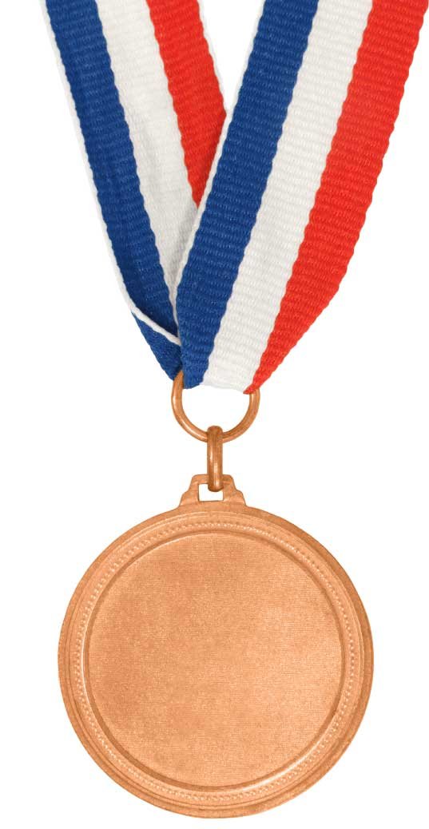
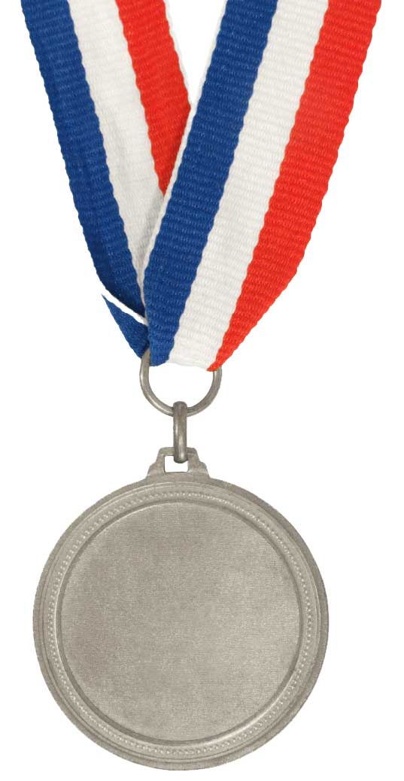

Understand what reflection and refraction are
State what is meant by reflection and refraction of light
Bronze
Investigate what happens when we shine light into a mirror and Perspex box
Silver
Measure the angles involved in refraction and reflection
Gold

Slide 2
Refraction
Explain why light bends as it travels through different objects
Label a ray diagram of light travelling through a glass block
Investigate the relation ships between the angle of incidence and the angle of emergence

Slide 3
Get a beaker on your table filled with water
Put a pen or pencil into it
Why does the pencil appear bent in the water?

Slide 4
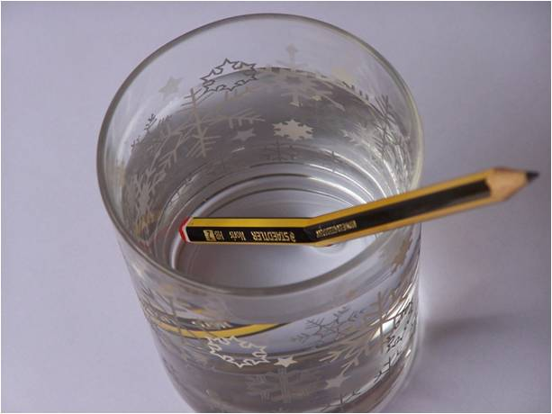
The pencil appears bent because light travels at different speeds in different materials.
This causes the light to bend/refract.
Refraction is the change in the direction of light.

Slide 5
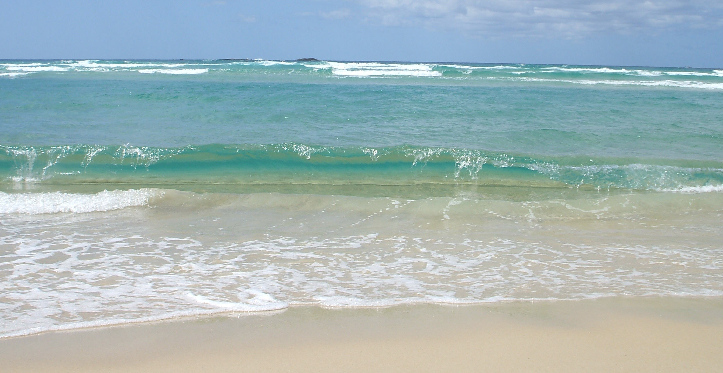
Imagine you’re running along this beach and then into the water. Would you be moving slower in the water or on the beach?

Slide 6
Refraction
Refraction is when a wave changes direction. It does this because it changes speed going through materials with different densities.

Slide 7
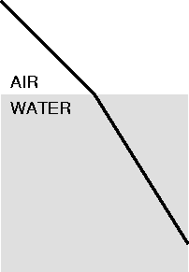

Slide 8

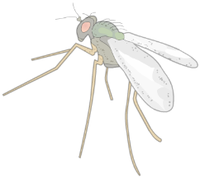

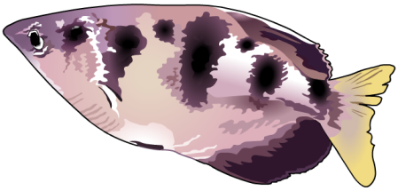
Effects of refraction – the Archer fish
The Archer fish is a predator that shoots jets of water at insects near the surface of the water.
The Archer fish allows for the refraction of light at the surface of the water when aiming at its prey.
image of prey
The fish does not aim at the refracted image it sees but at a location where it knows the prey to be.
prey location

Slide 9
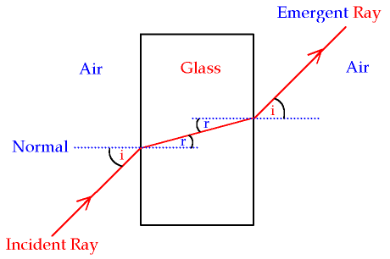
i2
r2
r1
i1
Angle of refraction = angle of refraction (r)
Angle of incidence = angle of emergence (i)

Slide 10
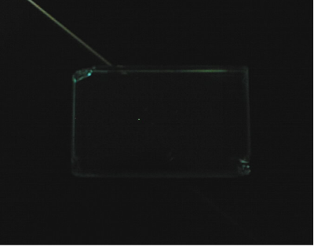
Refraction investigation
1. Place a rectangular glass block on a sheet of paper and draw around it. Remove block
angle i
2. Draw a normal at 90° to the top surface of the block. Continue the line to inside the block. Replace block.
angle r
3. Shine light rays, with different angles of incidence, into the block at the point where the normal meets the glass surface. Record the angle of refraction [r]. You will need to record where the light ray starts and where it leaves the block.
4. Repeat the investigation for rays leaving the glass block.
5. What do the results show?

Slide 11
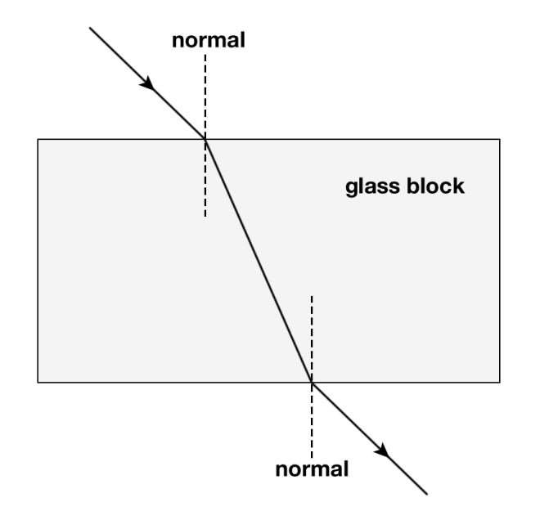
Refraction
A:
R:
E:
P:
q:
A
P
q
R
E

Slide 12
Refraction
A: Incident ray
R: Refracted ray
E: Emergent ray
P: Angle of incidence
q: Angle of refraction

Slide 13
Understand what reflection and refraction are
State what is meant by reflection and refraction of light
Bronze
Investigate what happens when we shine light into a mirror and Perspex box
Silver
Measure the angles involved in refraction and reflection
Gold

Slide 14
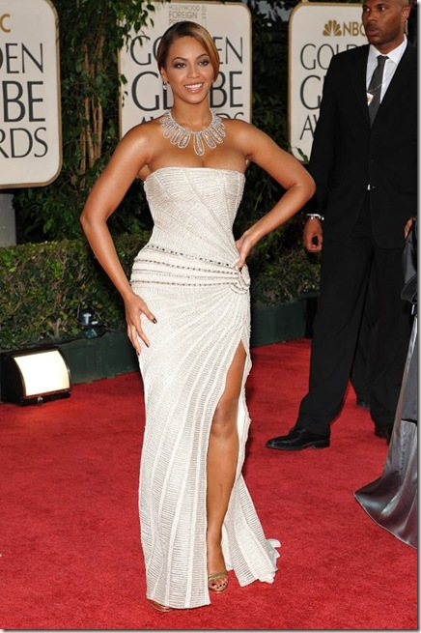
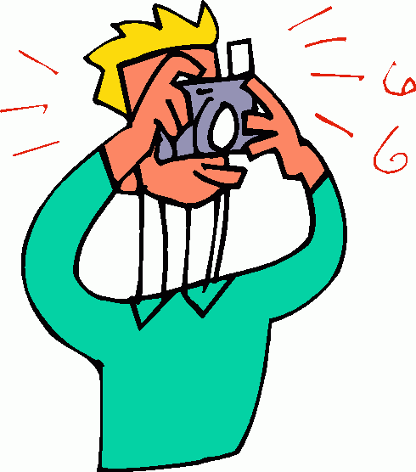
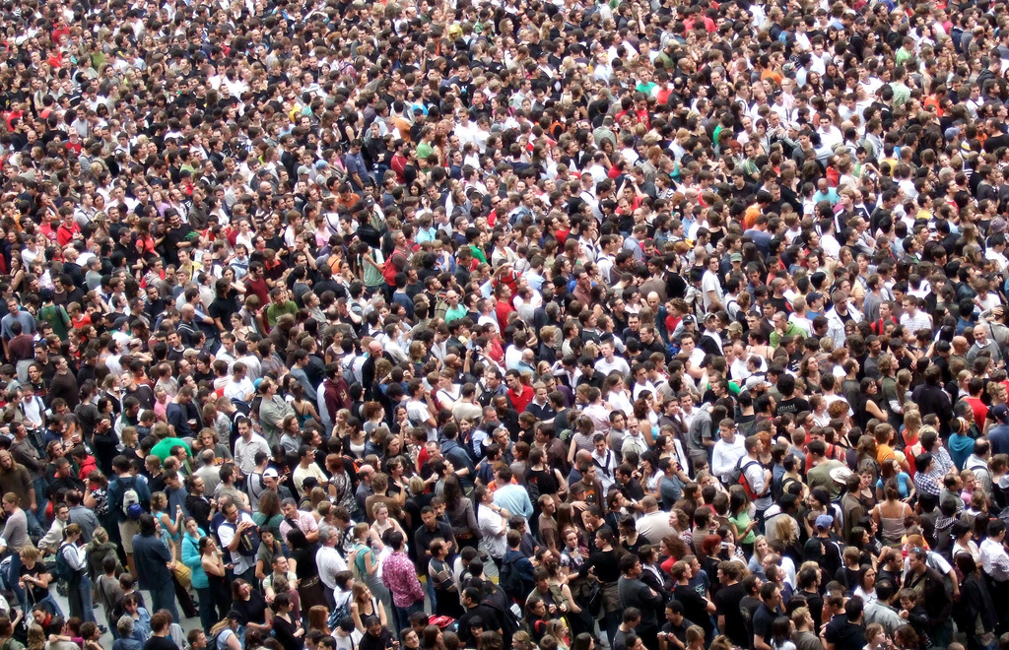
How could Jack use mirrors to help him see over the crowd to Beyonce?

Slide 15
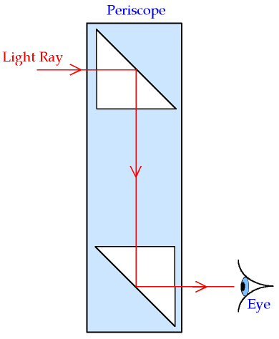
Use a periscope

Slide 16

Copy and complete the diagram to show how the fox can see the rabbit
TICK
Remember the rules!!!
Light travels in straight lines
Use a ruler and pencil
Reflect from the surface of the mirror
Angle of reflection = angle of incidence
Add arrows to show light ray
The ray must start at the object and enter the eye

