Slide 1
HIV and AIDS
Distinguish between HIV and AIDS
Describe the consequences of infection by HIV
Describe AIDS
State how HIV is transmitted

Slide 2
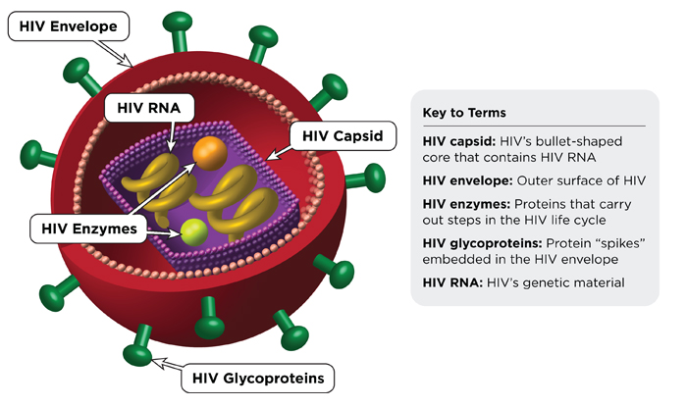
HIV

Slide 3
HIV infects (T-Helper) Lymphocytes
If lymphocytes are destroyed by HIV what will be the consequence?
HIV infects lymphocytes (T-Helper)
HIV destroys lymphocytes
Fewer antibodies can be produced
Person becomes susceptible to opportunistic infections (person gets ill more)
A collection of lots of diseases together is a syndrome
The person has Acquired Immunodeficiency Syndrome
How is HIV transmitted?

Slide 4
How does it infect the lymphocyte?
HIV contains RNA (retrovirus)
RNA uses host cell to make DNA
DNA is added to the lymphocyte DNA
DNA is transcribed and translated to make the proteins to make more HIV
New viral RNA is made also

Slide 5
What are the social impacts of AIDS?

Slide 6
1. D
[1]
2. B
[1]
3. (a) Must have both for [1]. antigen is a substance / molecule that causes antibody formation; antibody is a (globular) protein / molecule that recognizes an antigen; 1
(b) antigen causes an immune response to produce antibodies specific for that antigen; antibodies produced in B-lymphocytes; B-lymphocytes produced in bone marrow; carried in blood; antigen presenting cell / helper T cell present antigen to B cell; 3 max
(c) Must name two for [1]. CO2; O2; hormones; named nutrient; urea / excess ions; platelets; bicarbonate; 1 max
[5]

Slide 7
Responses must include reference to cause, transmission and social implications to receive full marks.
cause: human immunodeficiency virus / HIV / HIV 1 and HIV 2; retrovirus / RNA to DNA; enters T-helper cells; immune system becomes disabled / weakened; greater chance for opportunistic infections;
transmission: sexually transmitted; can be transmitted from man to woman / man to man contact / woman to man / mother to fetus; breast milk / saliva and other body fluids; use of dirty needles; blood transfusions;
social implications of AIDS: many orphaned children; social stigma / discrimination; problems obtaining employment / life insurance; impact / costs on health systems of treating people; early death reduces number of adults / reduces workforce / reduces family income; drug treatment expensive; reduces promiscuity / encourages use of condoms; 8 max (Plus up to [2] for quality)
[8]

