Slide 1
Label U,V,W,X,Y,Z
What is a gene?
All living organisms have DNA............true or false?
How could we give the characteristic/phenotype for one organism to a different organism?
How do organisms turn this DNA into ‘characteristics’
V
W
U

Slide 2
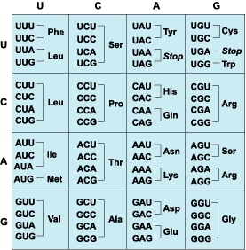
Genetic modification
GM
Transfer of genes between species
Genetic code is universal = amino acid sequences translated from genetic code is unchanged
Same polypeptide is produced
ALL life is DNA based

Slide 3
Genetic Modification – producing insulin
Cut the insulin gene from a healthy person’s DNA.
Take a bacterium. Remove a plasmid from the bacterium. Cut the plasmid.
Insert the human insulin gene into the plasmid.
The plasmid is inserted into a different bacterium.
This bacterium will use the human gene to make human insulin (think about how).
The bacteria divide and divide and divide………………..
Lots of insulin is made.
Draw this process out……

Slide 4
Insulin Production
Key words:
Genetic Engineering
Plasmid
Vector
Restriction enzymes
Sticky ends
Ligase
Recombinant DNA
Transgenic organism

Slide 5
Genetic Modification – producing insulin
Remove the insulin gene from a healthy person. The gene is cut from the DNA using restriction enzymes.
Take a bacterium. Remove a plasmid from the bacterium. Cut the plasmid using restriction enzymes.
Insert the human insulin gene into the plasmid using ligase enzymes.
The mixture of human and bacterial DNA is called recombinant DNA.
This recombinant DNA is inserted into a different bacterium.
This bacterium will use the human gene to make human insulin (think about how).
The bacteria divide and divide and divide………………..
Lots of insulin is made.

Slide 6
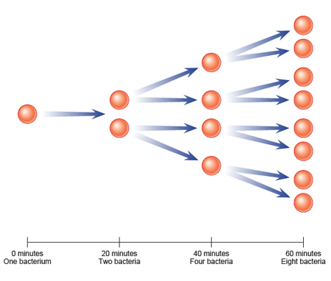
Multiply bacteria containing gene
In a fermenter

Slide 7
Gene transfer
Plasmids can be used as a vector to deliver genes into other animals.
Viruses can also be used

Slide 8
Creating a Gentically Modified Organism (GMO)
Let’s assume that all characteristics are coded for by a single gene.
Design and GMO.
Interesting pet?
An organism to solve pollution problems?
Make sure you include all the science…!

Slide 9
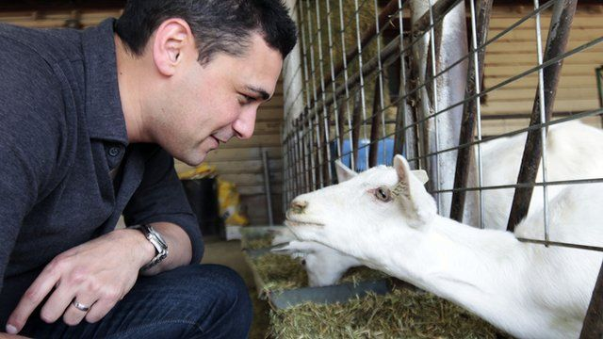
Spider's Silk

Slide 10
Benefits and Risks of GM
GM Crops
Use pages 193 and 194 to answer the exam Q
IDU

