Slide 1
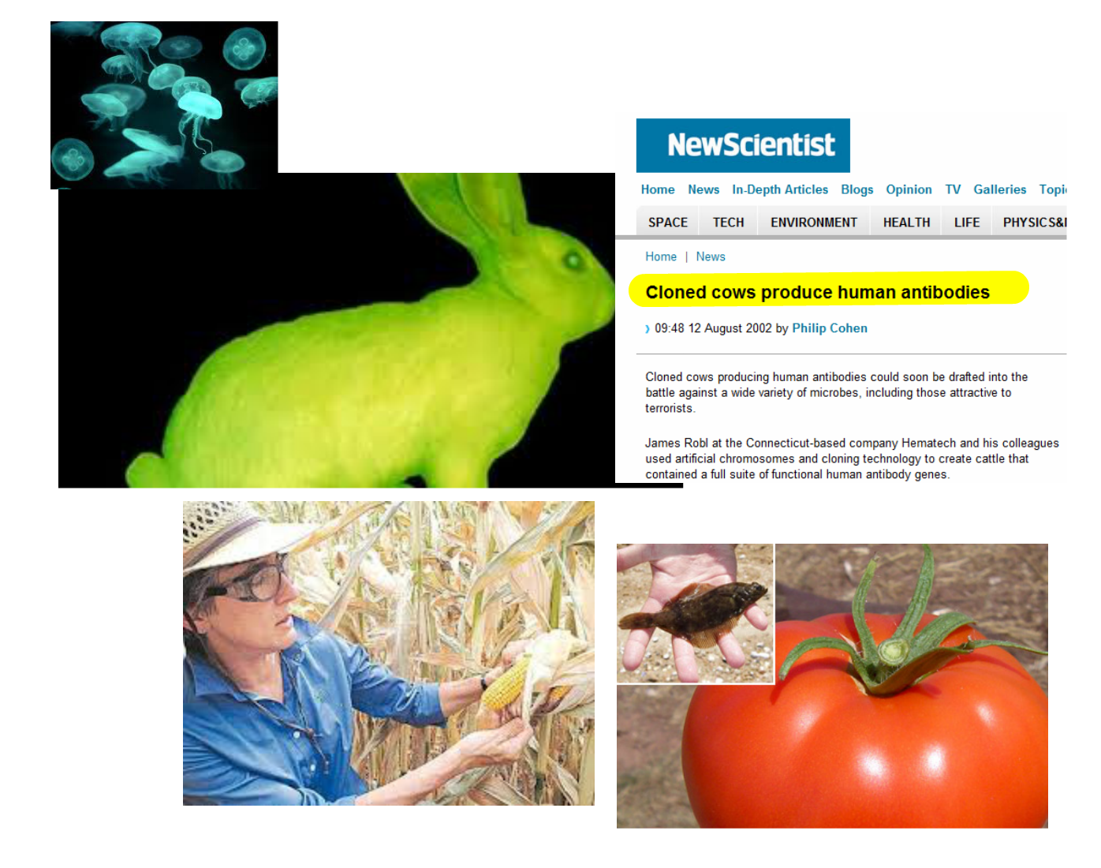
GM

Slide 2
3.5 Genetic modification and biotechnology
Applications:
Use of DNA profiling in paternity and forensic investigations
Gene transfer to bacteria with plasmids using restriction endonucleases and DNA ligase
Assessment of the potential risks and benefits associated with genetic modification of crops
Production of cloned embryos by someatic cell nuclear transfer
Understanding:
Gel electrophoresis is used to separate proteins of fragments of DNA according to size
PCR can be used to amplify small amounts of DNA
DNA profiling involves comparison of DNA
Genetic modification is carried out by gene transfer between species
Clones are groups of genetically identical organisms, derived from a single original parent cell
Many plant species and some animal species have natural methods of cloning
Animals can be cloned at the embryo stage by breaking up the embryo into more than one group of cells
Methods have been developed for cloning adult animals using differentiated cells
Skills:
Design of an experiment to assess one factor affecting the rooting of stem cuttings
Analysis of examples of DNA profiles
Analysis of data on risks to monarch butterflies of Bt crops
Nature of science:
Assessing risks associated with scientific research: scientists attempt to assess the risks associated with genetically modified crops or livestock

Slide 3
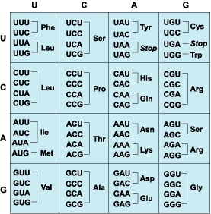
Genetic modification
Transfer of genes between species
Genetic code is universal = amino acid sequences translated from genetic code is unchanged
Same polypeptide is produced
ALL life is DNA based

Slide 4
There is a gene that makes an enzyme that breaks down plastic!!

Slide 5
Genetic Modification – producing insulin
Remove the insulin gene from a healthy person. The gene is cut from the DNA using restriction enzymes.
Take a bacterium. Remove a plasmid from the bacterium. Cut the plasmid using restriction enzymes.
Insert the human insulin gene into the plasmid using ligase enzymes.
The mixture of human and bacterial DNA is called recombinant DNA.
This recombinant DNA is inserted into a different bacterium.
This bacterium will use the human gene to make human insulin (think about how).
The bacteria divide and divide and divide………………..
Lots of insulin is made.

Slide 6
Insulin Production
Sometimes mRNA is collected from the human and reverse transcriptase is used to made cDNA
Key words:
Genetic Engineering
Plasmid
Vector
Restriction enzymes
Sticky ends
Ligase
Recombinant DNA
Transgenic organism

Slide 7
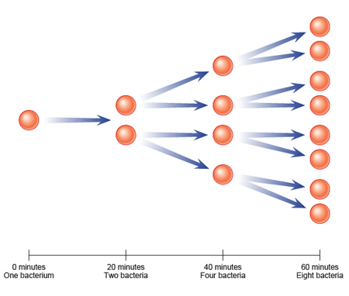
Multiply bacteria containing gene
In a fermenter

Slide 8
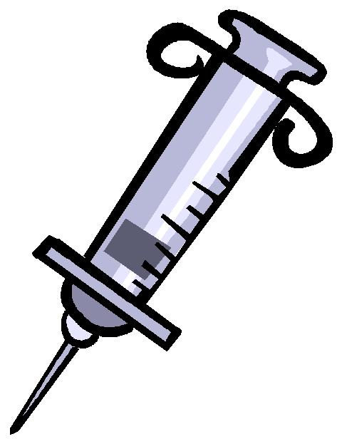
Separate and purify human insulin
Human insulin can then be used by diabetic patients

Slide 9
Gene transfer
Plasmids can be used as a vector to deliver genes into other animals.
Viruses can also be used

Slide 10
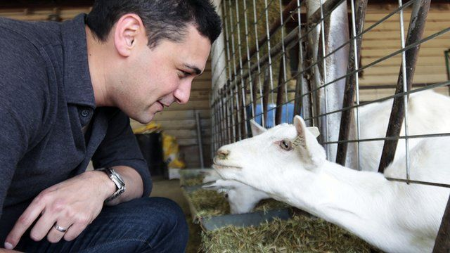
Spider's Silk

Slide 11
Benefits and Risks of GM
GM Crops
Use pages 193 and 194 to answer the exam Q
IDU

