Slide 1
3.5 Genetic modification and biotechnology
Applications:
Use of DNA profiling in paternity and forensic investigations
Gene transfer to bacteria with plasmids using restriction endonucleases and DNA ligase
Assessment of the potential risks and benefits associated with genetic modification of crops
Production of cloned embryos by someatic cell nuclear transfer
Understanding:
Gel electrophoresis is used to separate proteins of fragments of DNA according to size
PCR can be used to amplify small amounts of DNA
DNA profiling involves comparison of DNA
Genetic modification is carried out by gene transfer between species
Clones are groups of genetically identical organisms, derived from a single original parent cell
Many plant species and some animal species have natural methods of cloning
Animals can be cloned at the embryo stage by breaking up the embryo into more than one group of cells
Methods have been developed for cloning adult animals using differentiated cells
Skills:
Design of an experiment to assess one factor affecting the rooting of stem cuttings
Analysis of examples of DNA profiles
Analysis of data on risks to monarch butterflies of Bt crops
Nature of science:
Assessing risks associated with scientific research: scientists attempt to assess the risks associated with genetically modified crops or livestock

Slide 2
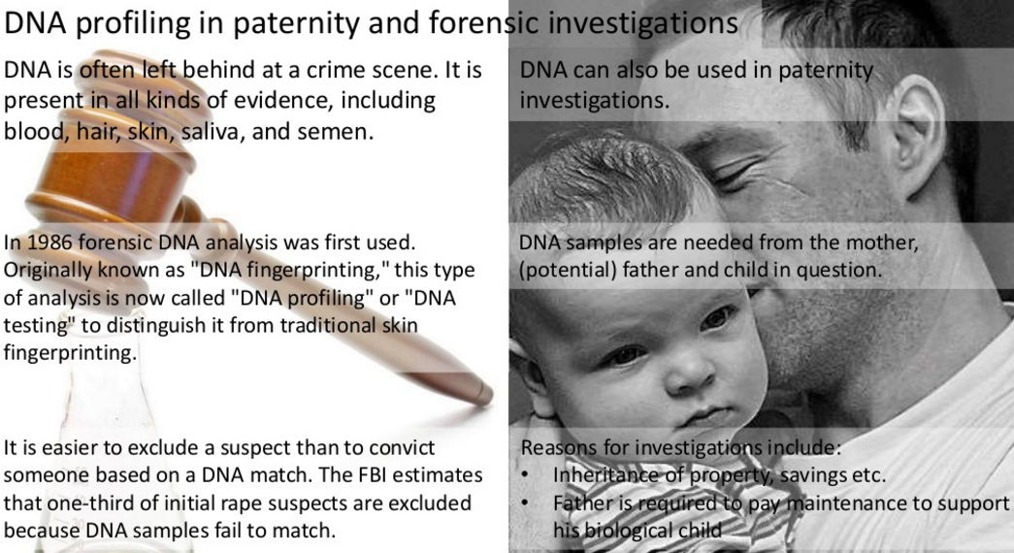

Slide 3
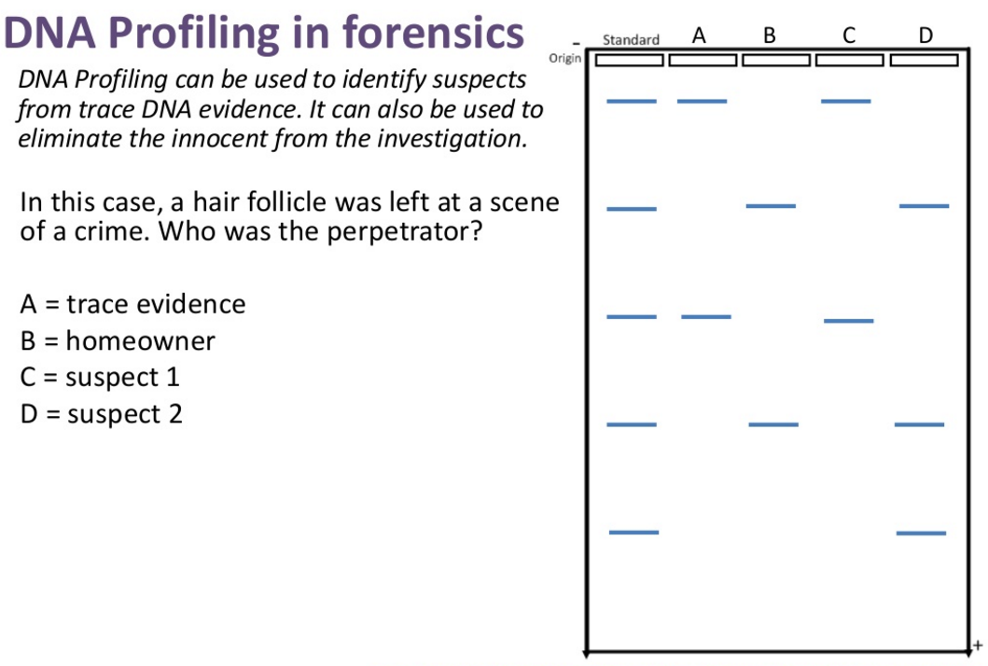

Slide 4
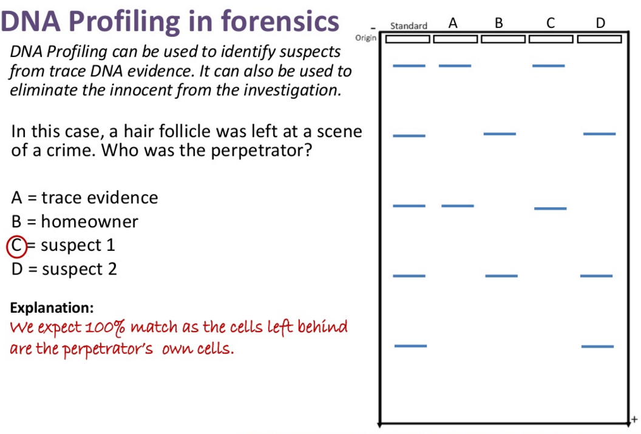

Slide 5
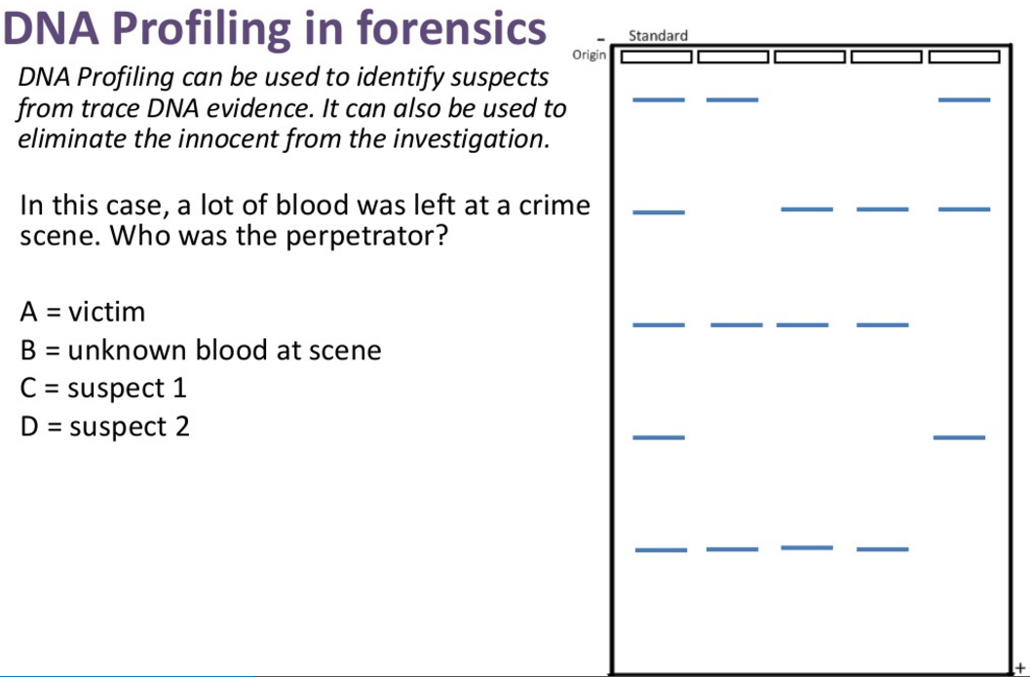

Slide 6
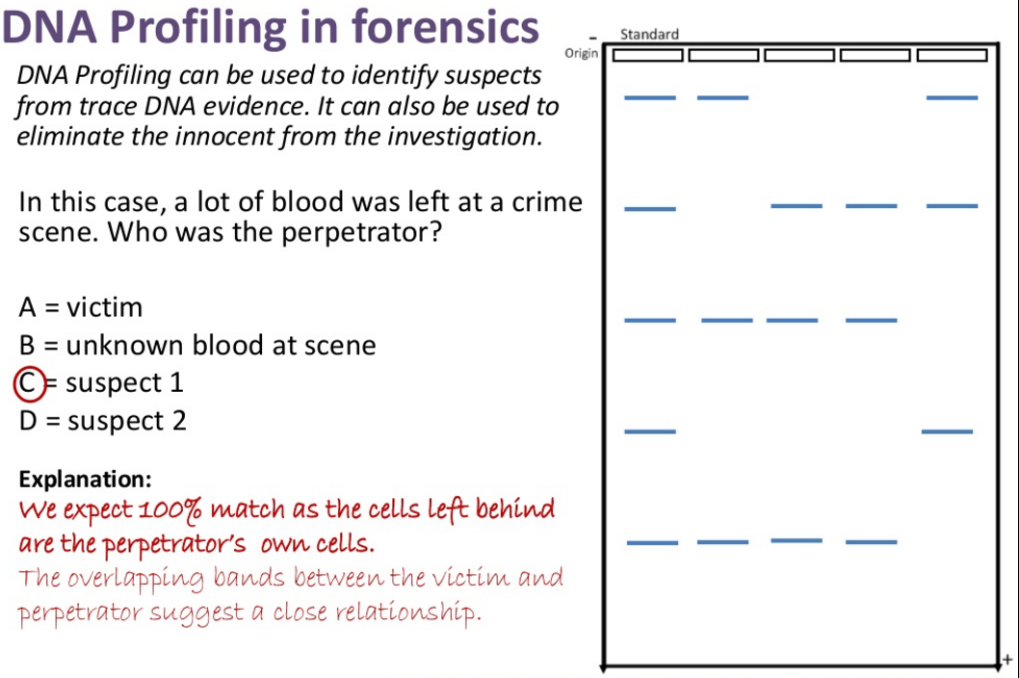

Slide 7
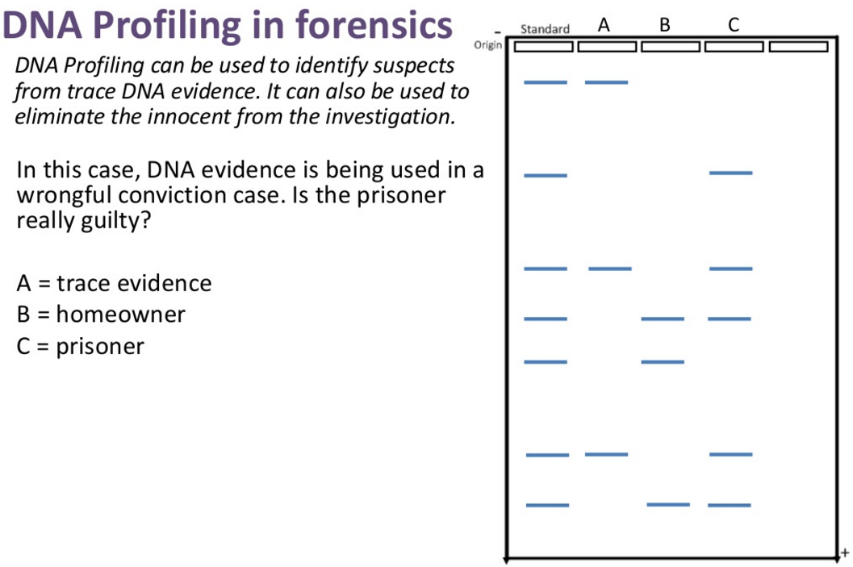

Slide 8
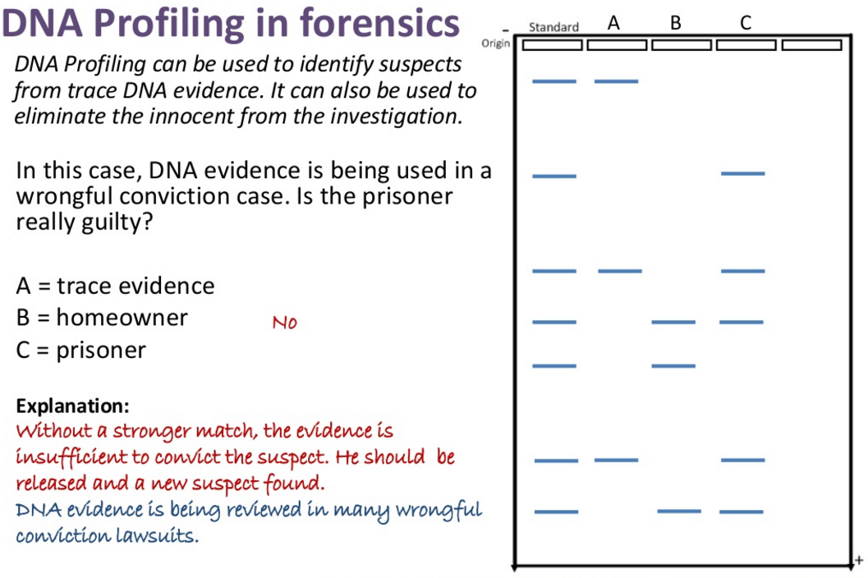

Slide 9
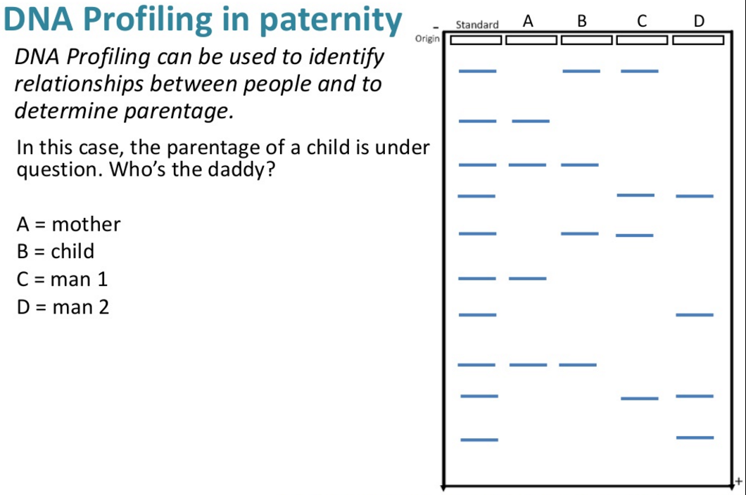

Slide 10
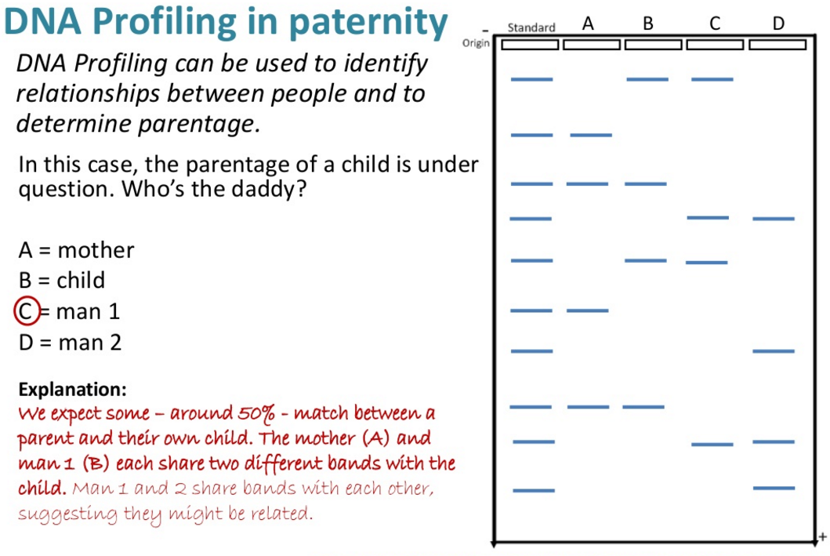

Slide 11
DNA profiling summery
Sample of DNA obtained
Sequences selected and copied by PCR
Copied DNA split into fragments using enzymes
Fragments separated using gel electrophoresis
Produces a pattern of bands that is always the same with DNA from an individual
Compare profiles of individuals to see which bands are similar or different

