Slide 1
3.4 Inheritance
Applications:
Inheritance of ABO blood groups
Red-green colour blindness and haemophilia as examples of sex linked inheritance
Consequences of radiation after nuclear bombing of Hiroshima and Nagasaki and the nuclear accidents at Chernobyl
Understanding:
Mendel discovered the principles of inheritance with experiments in which large numbers of pea plants were crossed
Gametes are haploid so contain one allele of each gene
The two alleles of each gene separate into different haploid daughter nuclei during meiosis
Fusion of gametes results in diploid zygotes with two alleles of each gene that may be the same allele or different alleles
Dominant alleles mask the effects of recessive alleles but co-dominant alleles have joint effects
Many genetic diseases in humans are due to recessive alleles
Some genetic diseases are sex-lined
The pattern of inheritance is different with sex-linked genes due to their location on the sex chromosome
Many genetic diseases have been identified in humans but most are very rare
Radiation and mutagenic chemicals increase mutation rate and can cause genetic disease and cancer
Skills:
Construction of Punnett grids for predicting the outcomes of monohybrid genetic crosses
Comparison of predicted and actual outcomes of genetic crosses using real data
Analysis of pedigree charts to deduce the pattern of inheritance of genetic diseases
Nature of science:
Making quantitative measurements with replicates to ensure reliability: Mendel’s genetic crosses with pea plants generated numerical data

Slide 2
Sex-linked diseases
Mutated alleles carried on sex chromosomes (usually X)
If the X chromosome usually carries the mutation, are males or females more likely to have sex-linked disorders??
Haemophilia
Red-green colour blindness

Slide 3
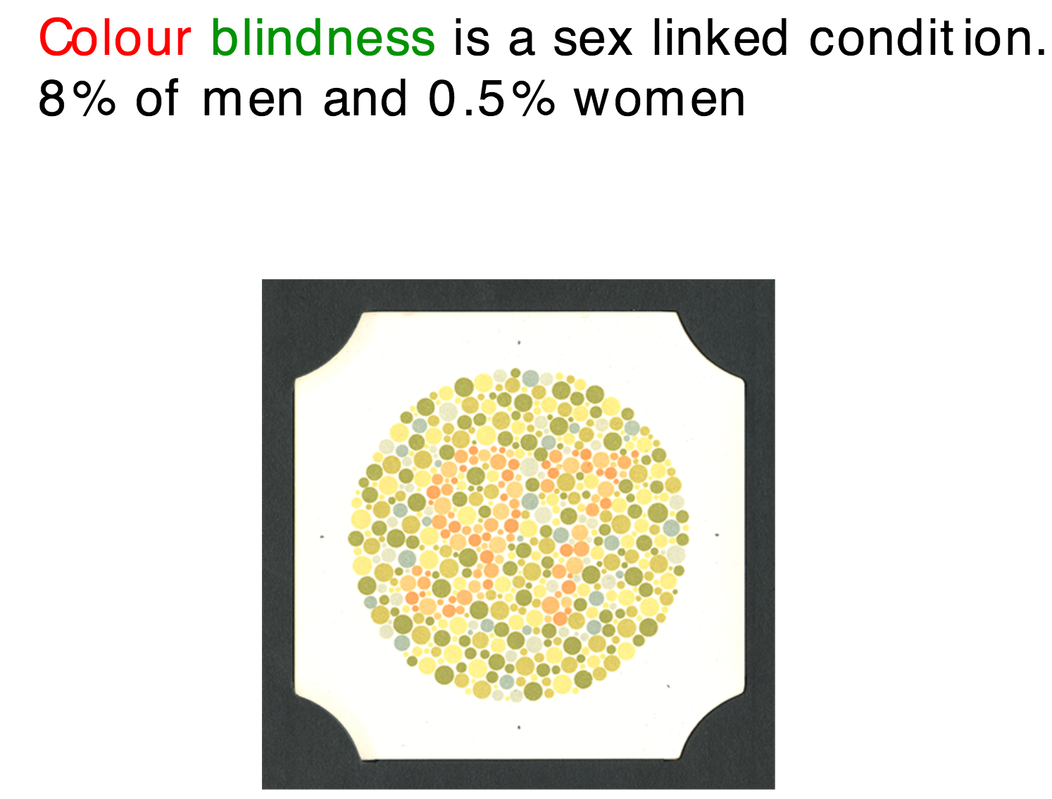
Colour Vision

Slide 5
vision

Slide 7
Show how it would be possible for a colour blind girl to occur.

Slide 8
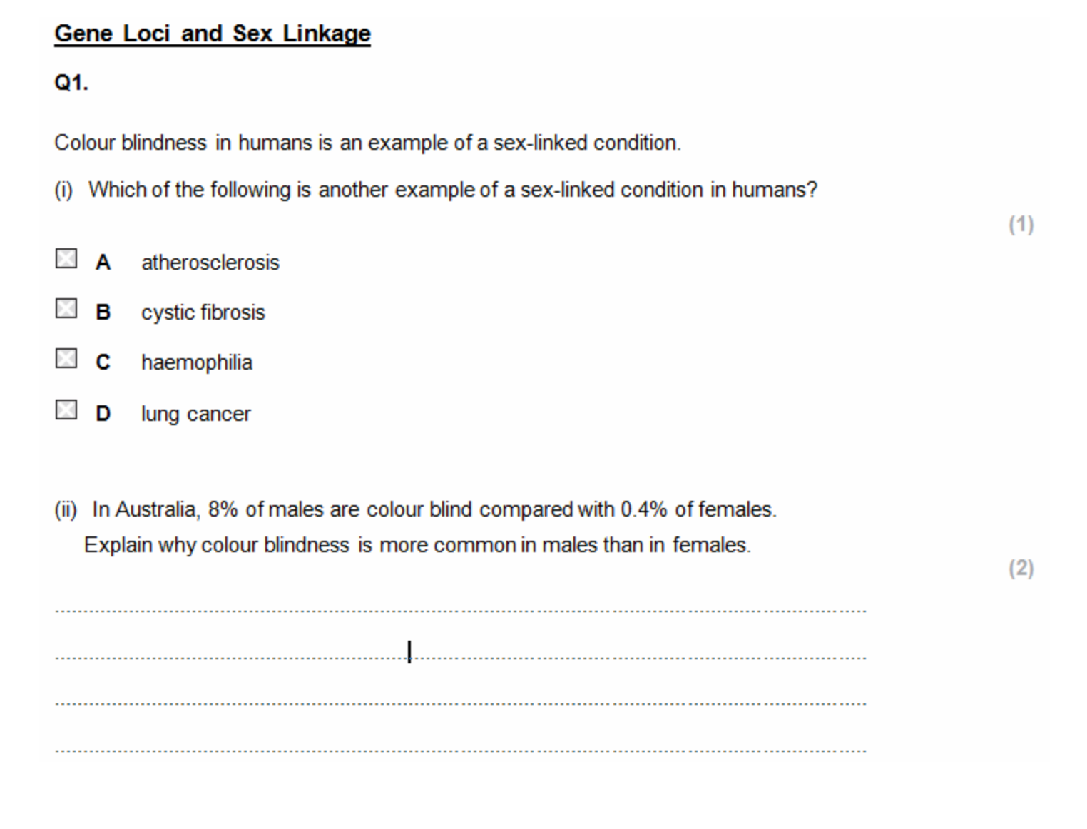

Slide 10
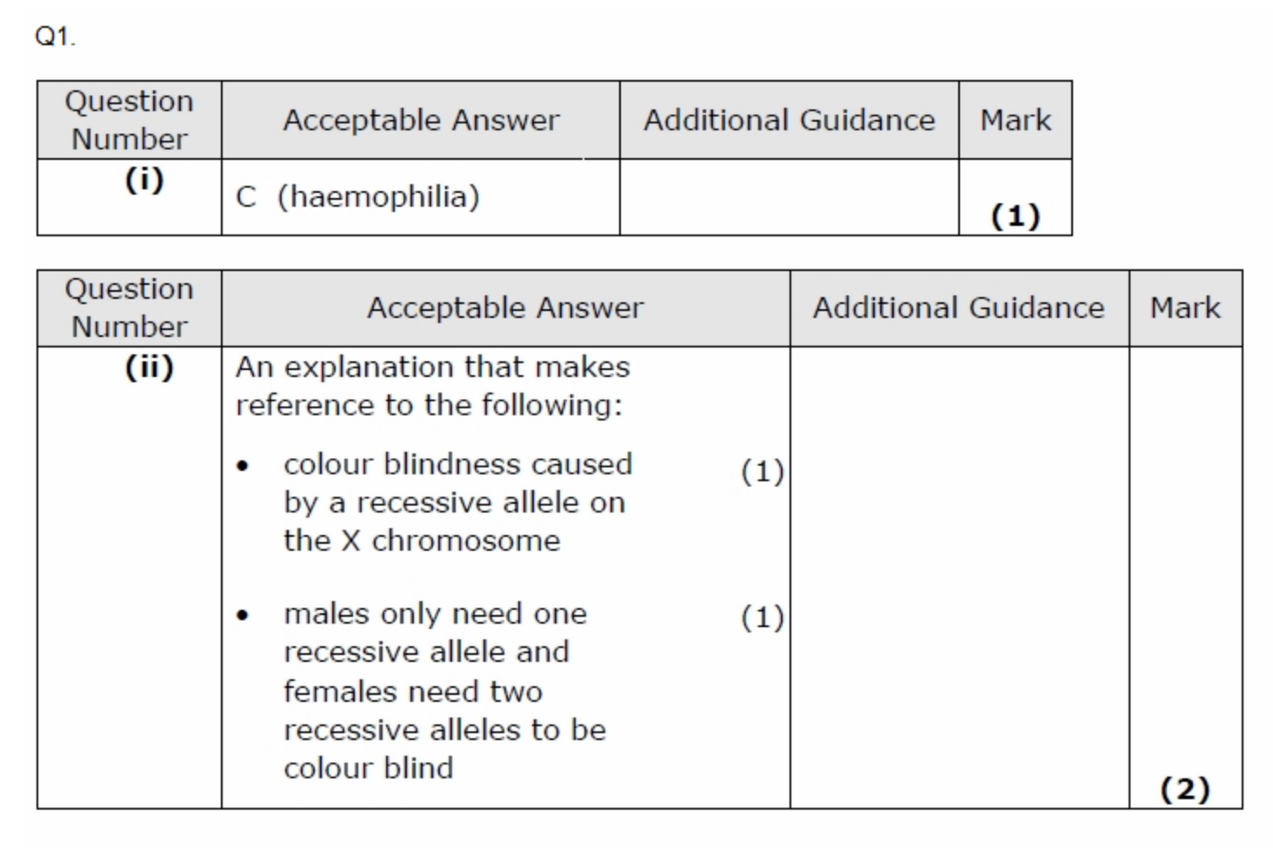

Slide 11
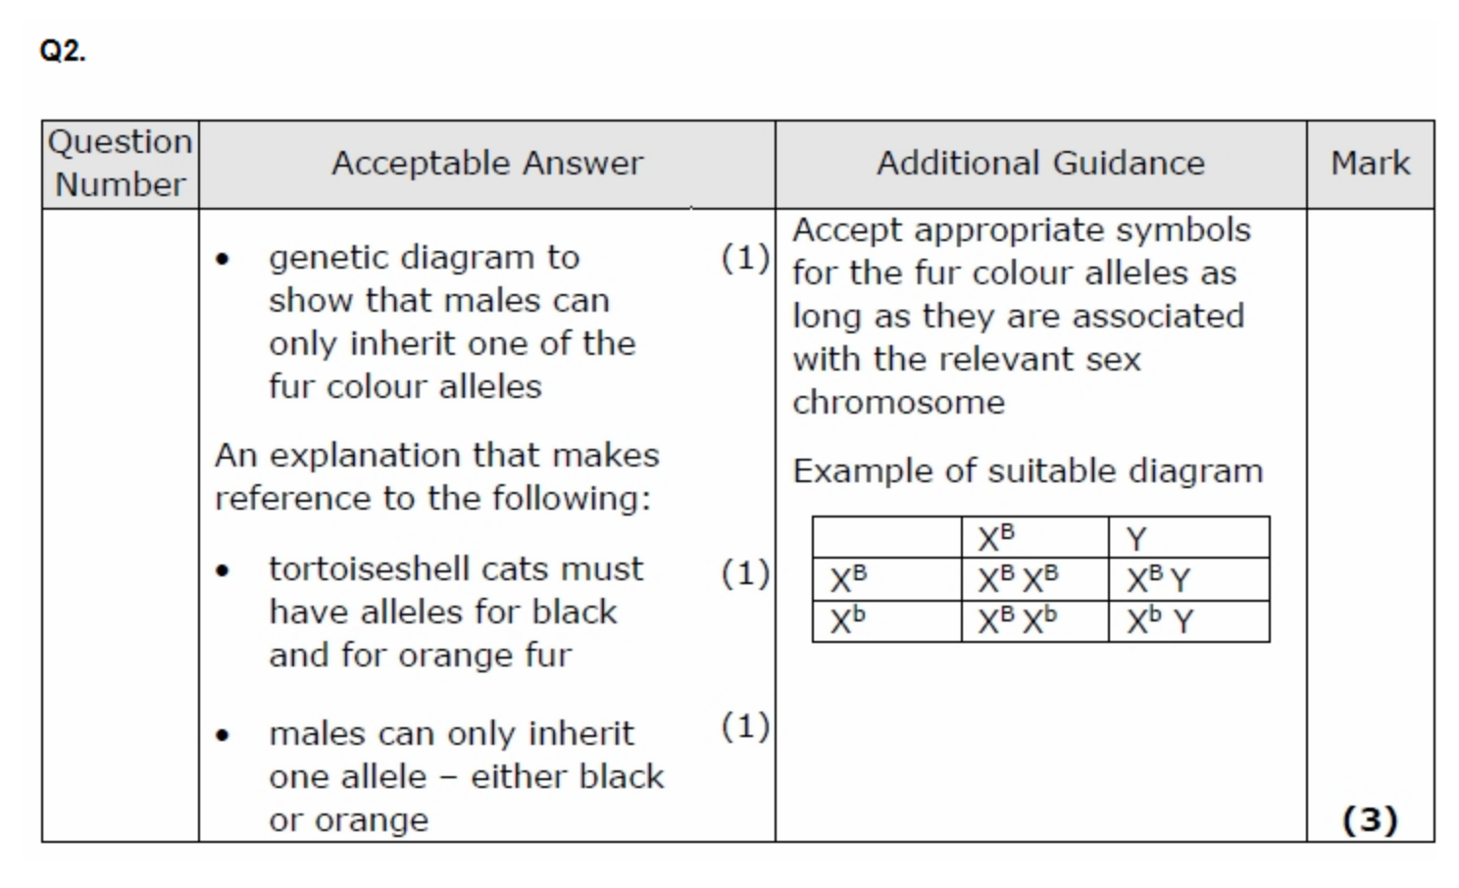
O
O
O

Slide 12
Haemophilia
Inability to make Factor VIII, an important blood clotting protein. Mutated allele is recessive and found on the X chromosome.
A heterozygous female has a child with a healthy male. What is the % chance of having a child who is a carrier?

Slide 13
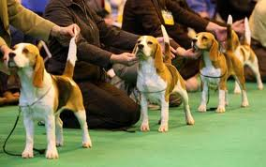
Pedigrees
Punnett squares look at the theoretical probability that a child will inherit a trait
We use pedigrees to show inheritance of a disease/trait in a family

Slide 14
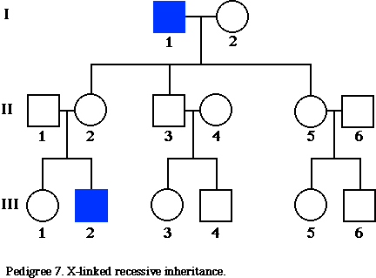
Pedigree Legend
Male
Female
Horizontal line between male and female indicates a mating
Shaded symbols stand for individuals with the trait being traced; they are the affected ones.

Slide 15
Pedigree
I
II
III
Which female(s) have inherited the disease?
Which male(s) have inherited the disease?
Is this disease dominant or recessive?

Slide 16
Pedigree Challenge!
D = normal
d = disease
 | Genotype |  | Genotype
A |  | F
B |  | G
C |  | H
D |  | #
E

Slide 17
Pedigree Challenge!
recessive disease
D = normal
d = disease
 | Genotype |  | Genotype
A | Dd | F | dd
B | dd | G | Dd
C | dd | H | dd
D | Dd | # | Dd
E | dd

Slide 18
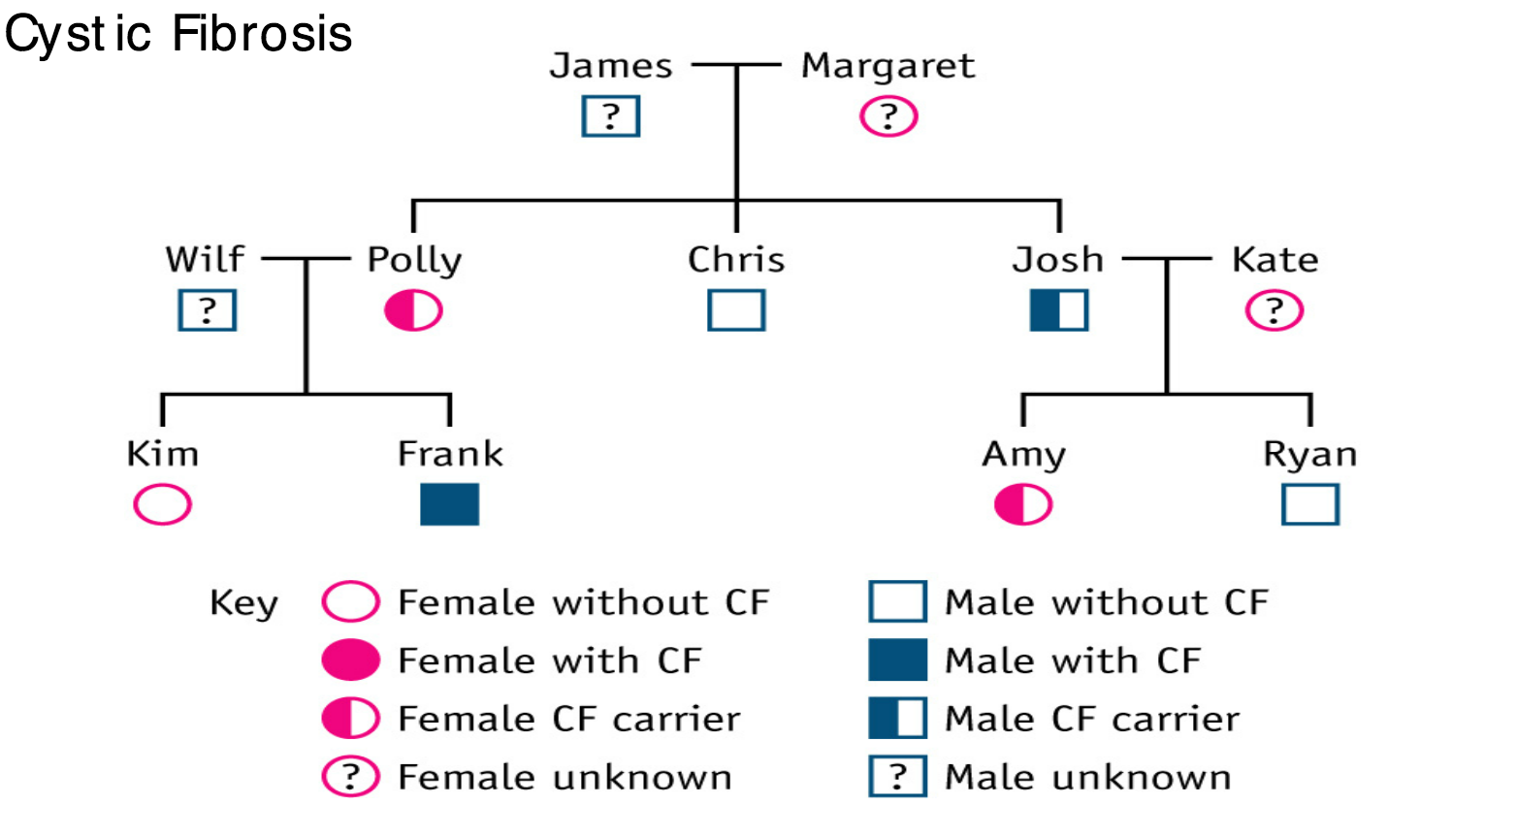
State the missing phenotypes
Show how frank inherited CF

Slide 19
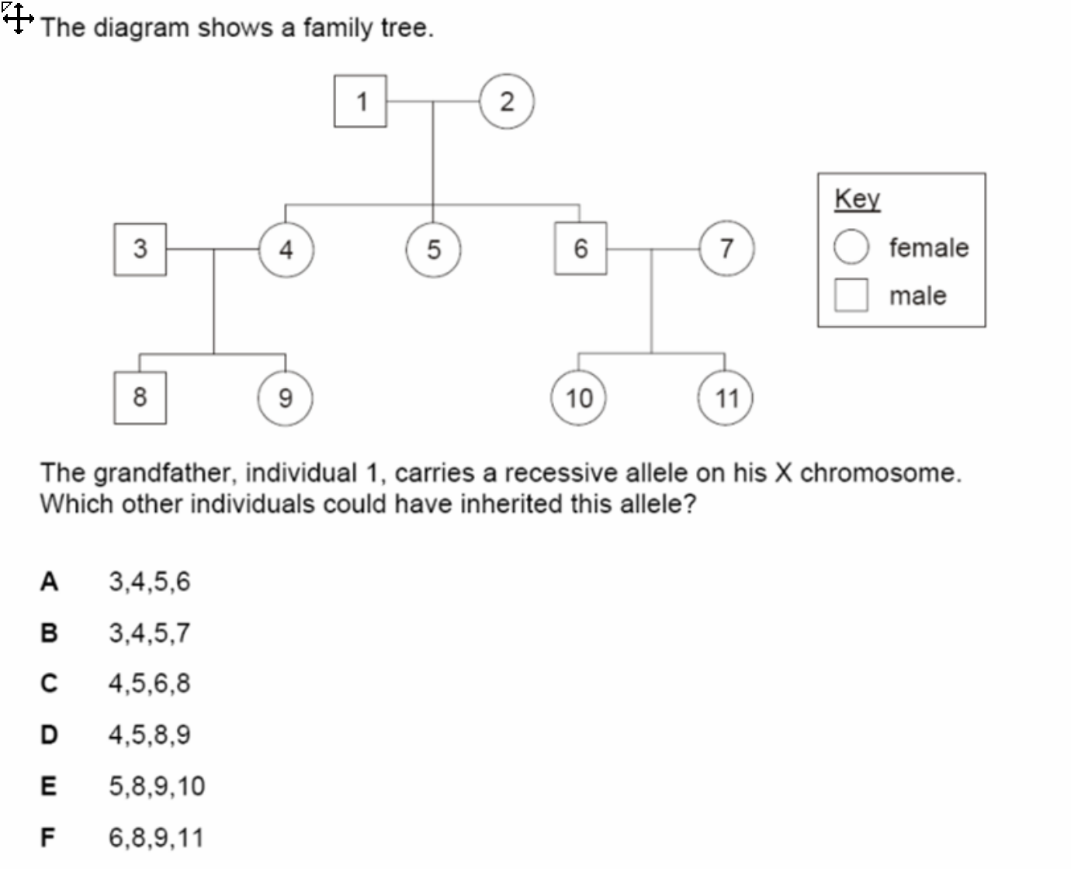

Slide 20
Q – pg 183

