Slide 1
3.4 Inheritance
Applications:
Inheritance of ABO blood groups
Red-green colour blindness and haemophilia as examples of sex linked inheritance
Consequences of radiation after nuclear bombing of Hiroshima and Nagasaki and the nuclear accidents at Chernobyl
Understanding:
Mendel discovered the principles of inheritance with experiments in which large numbers of pea plants were crossed
Gametes are haploid so contain one allele of each gene
The two alleles of each gene separate into different haploid daughter nuclei during meiosis
Fusion of gametes results in diploid zygotes with two alleles of each gene that may be the same allele or different alleles
Dominant alleles mask the effects of recessive alleles but co-dominant alleles have joint effects
Many genetic diseases in humans are due to recessive alleles
Some genetic diseases are sex-lined
The pattern of inheritance is different with sex-linked genes due to their location on the sex chromosome
Many genetic diseases have been identified in humans but most are very rare
Radiation and mutagenic chemicals increase mutation rate and can cause genetic disease and cancer
Skills:
Construction of Punnett grids for predicting the outcomes of monohybrid genetic crosses
Comparison of predicted and actual outcomes of genetic crosses using real data
Analysis of pedigree charts to deduce the pattern of inheritance of genetic diseases
Nature of science:
Making quantitative measurements with replicates to ensure reliability: Mendel’s genetic crosses with pea plants generated numerical data

Slide 2
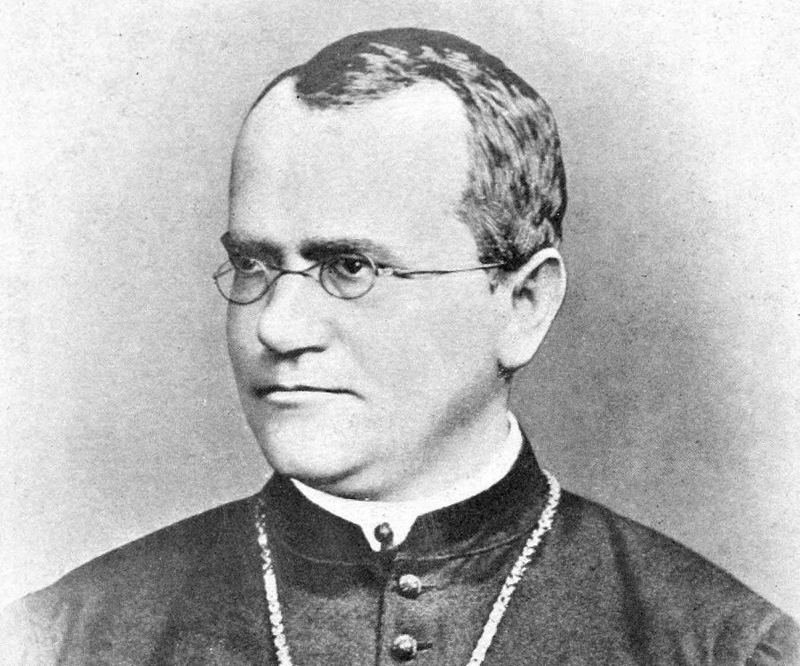
Gregor Mendel
Loved gardening
Crossed pea plants and looked at the characteristics of the offspring
1000’s of trials/lots of data – he was one of the first scientists to do many repeats
Noticed that characteristics can skip a generation
Noticed that some characteristics are dominant and some are recessive
DID NOT know anything about DNA or genes
1882-1884

Slide 3
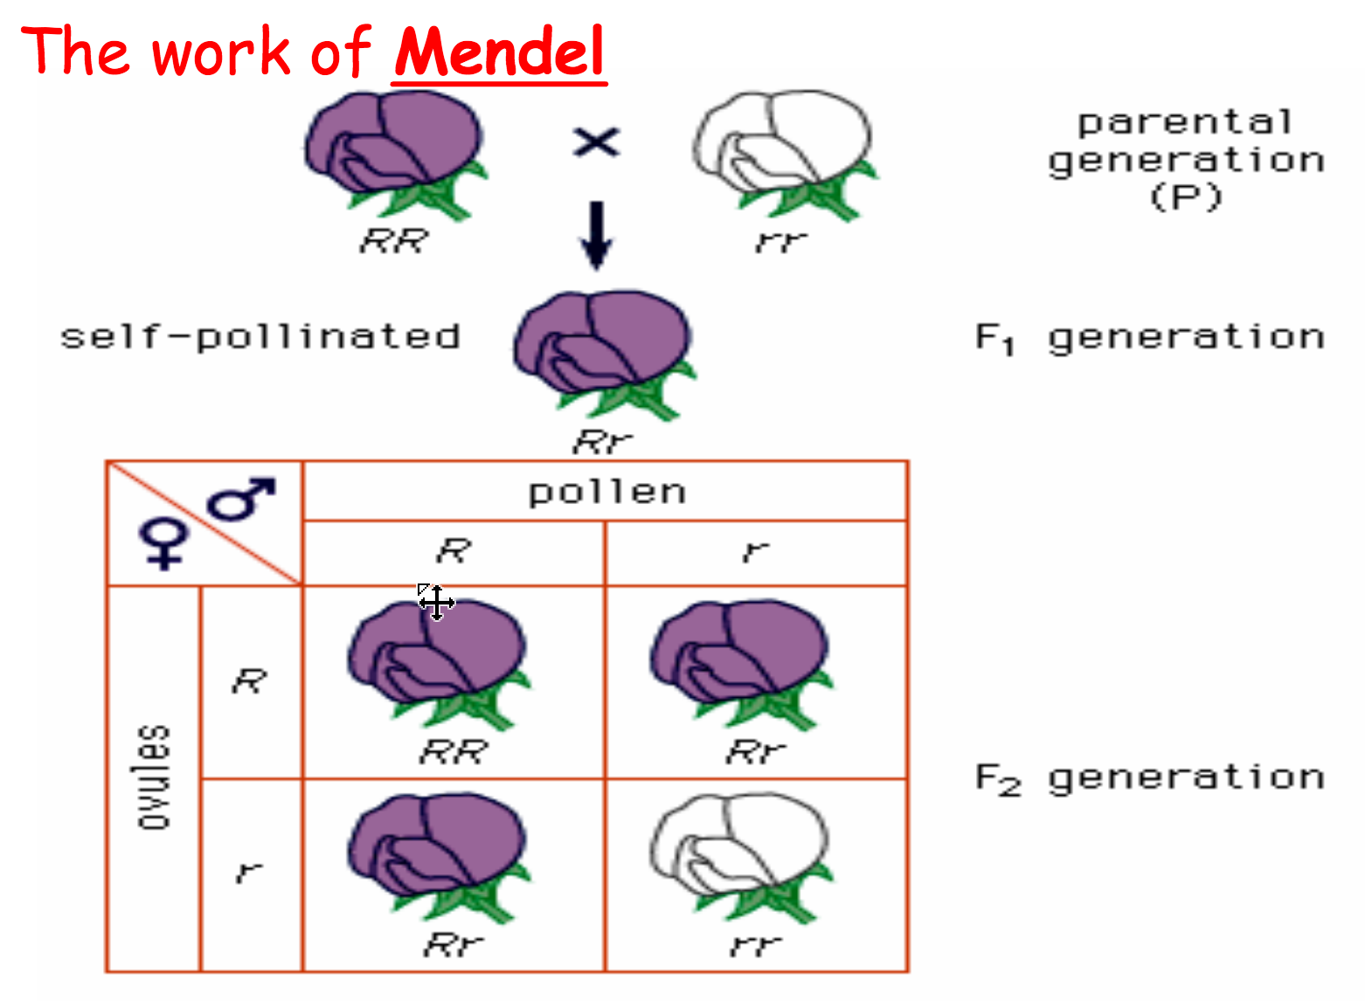
3:1 ratio
Mendel

Slide 4
Why not perfect 3:1?
Why is it important to have lots of repeats?

Slide 5
Inheritance
Life Cycle
Meiosis halves the number of chromosomes (haploid) when forming gametes. Segregation of alleles.
Fertilisation restores the number of chromosomes (diploid) for the next generation. The zygote will contain one copy of each allele from each parent
In sexually reproducing organisms the next generation will inherit genes (2 alleles) from two parents.

Slide 6
Chromosomes
and alleles
What is the name of this?

Slide 7
Locus for characteristic gene
Allele for characteristic from male parent
Locus for characteristic gene
Allele for characteristic from female parent
Allele - A different form of the same gene

Slide 8
Dominant and Recessive Alleles
Co-dominant Alleles
C^{R}
C^{w}
C^{R}C^{W}
C^{R}C^{W}
x
C^{R}C^{W}
C^{R}
C^{w}
C^{R}C^{R}
C^{R}C^{W}
C^{R}
C^{R}C^{W}
C^{W}C^{W}
C^{w}
What will a dominant allele produce?

Slide 9
Key Terms
Genotype – Combination of genes an organism possesses
Phenotype – Description of the physical characteristics
Heterozygous – One dominant and once recessive allele
Homozygous – Both alleles are the same
Purebred – Organism where both alleles are the same for a particular characteristic
Hybrid – Organism where one dominant and once recessive allele are present for a characteristic

Slide 10
What are the parental genotypes?

Slide 11
Ratio:

Slide 12
1. Homozygous dominant woman and heterozygous man have a baby. What are the chances (%) of having a baby with blue eyes? 2. My mum has blue eyes and my dad has brown eyes. Show how I ended up with blue eyes. What was the % chance?
Big sheet
B = Brown
B = blue

Slide 13
book
3.
In garden peas, purple flower color is dominant over white.
A purebred purple flowered plant is crossed with a white flowered plant.
What are the chances of having a plant with purple flowers?
P = Purple
p = white

Slide 14
book
4.
Achondroplasia is an inherited condition Adults with achondroplasia are much shorter than average height.
This condition is controlled by a gene with two alleles.
The dominant allele (A) codes for shorter than average height and the recessive allele (a) codes for average height.
(a) Two parents both had achondroplasia. They had a child who grew up to be of average height.
Use a genetic diagram to show how. What was the % chance of having a child of average height?

Slide 15
C

Slide 16
C

Slide 17
C

Slide 18
Inheritance of blood groups (Co-dominace)
There is one gene that codes for your blood group.
There are three alleles of the ABO blood group gene.
A person has two of these alleles.
There are two dominant alleles – I^{A} and I^{B}
And one recessive allele – i
I^{A} = A
I^{B} = B
i = O
I^{A} I^{A} =
I^{B} I^{B} =
I^{A} I^{B} =
I^{A} i =
I^{B} I =
ii =

Slide 19
Co-dominance
phenotype | genotype(s)
A | I^{A}I^{A} I^{A}i
B | I^{B}I^{B} I^{B}i
AB | I^{A}I^{B}
O | i i

Slide 20
Inheritance of blood groups(Co-dominance)

Slide 21
A woman is homozygous for blood group A. She has a child with a man who has blood group O.
What is the % chance their child has blood group O?
Write one for your partner

Slide 22
What’s the problem with giving someone the wrong blood group?
Antigen A – acetyl-galactosamine
Antigen B - galactose
Which blood group is the universal donor?
Which blood group is the universal recipient?

Slide 23
Blood groups
Are parents able to have 4 children each with a different blood group?
How?
I^{A}i ^{X} I^{B}i

Slide 24
What do you predict?
Cross | Predicted outcome
Pure breeding parents one with 2 dominant alleles and one with 2 recessive alleles
Pure breeding parents with different co-dominant alleles
Two parents with one dominant and one recessive allele each
A parent with one dominant and one recessive allele and a parent with 2 recessive alleles

Slide 25
What do you predict?
Cross | Predicted outcome
Pure breeding parents one with 2 dominant alleles and one with 2 recessive alleles | All offspring will have same character as parent with dominant allele (will carry recessive allele)
Pure breeding parents with different co-dominant alleles | All offspring will have the same character and the character will be different from both parents (will be a mixture of the two)
Two parents with one dominant and one recessive allele each | Three times as many offspring have the character of the parent with dominant alleles as the recessive
A parent with one dominant and one recessive allele and a parent with 2 recessive alleles | Equal proportions of offspring with the character of an individual with a dominant allele and the character of an individual with recessive alleles

Slide 26
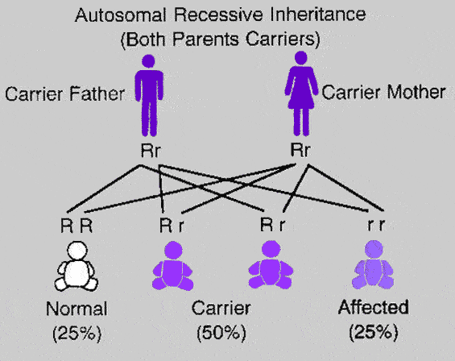
Recessive Diseases (cystic fibrosis)
Most diseases caused by a mutation of a recessive CFTR (autosomal genes (not on sex chromosomes))
Disease in individuals without dominant allele
Have two copies of the recessive allele
If they have one dominant allele and one recessive allele they are able to pass on that disease to offspring
CARRIER

Slide 28
Dominant Diseases (Huntington’s)
Some diseases caused by a dominant allele (HTT) of autosomal genes
One copy of the mutated allele give a person the disease
Show how two parents could have a 50% chance of having a child with Huntington’s
Mum
Dad
Hh x hh
h
h
H
h

Slide 29
Huntington disease is a genetic disorder is caused my a faulty dominant allele (H).
A heterozygous male has a child with a homozygous recessive female. What is the % chance of them having a child with no Huntington’s phenotype?

