Slide 1
3.3 Meiosis
Applications:
Non-disjunction can cause Down’s syndrome and other chromosome abnormalities. Studies showing age of parents influences chances of non-disjunction
Methods use to obtain cells for karyotype analysis
Understanding:
One diploid nucleus divides by meiosis to produce four haploid nuclei
The halving of the chromosome number allows a sexual life cycle with fusion of gametes
DNA is replicated before meiosis so that all chromosomes consist of two site chromatids
The early stages of meiosis involve pairing of homologous chromosomes and crossing over followed by condensation
Orientation of pairs of homologous chromosomes prior to separation is random
Separation of pairs of homologous chromosomes in the first division of meiosis halves the chromosome number
Crossing over and random orientation promotes genetic variation
Fusion of gametes from different parents promotes genetic variation
Skills:
Drawing diagrams to show the stages of meiosis resulting in the formation of four haploid cells
Nature of science:
Making careful observations: meiosis was discovered by microscope examination of dividing germ-line cells

Slide 2
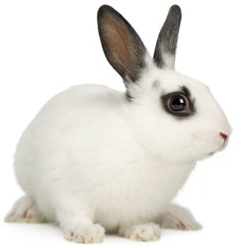
German scientists noticed that there were 2 chromosomes in the nuclei of egg and sperm but the fertilised egg contains 4
Actual sequence of events first discovered in rabbits

Slide 3
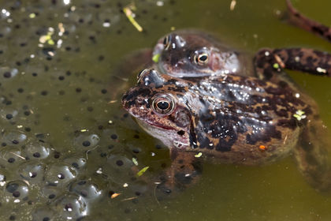
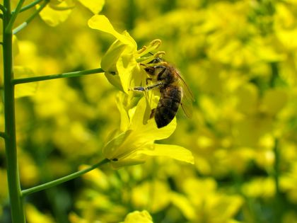
Sexual Reproduction....
....involves gametes
In asexual reproduction the offspring has the same chromosomes as the parents (genetically identical)
In sexual reproduction the offspring has half their chromosomes from each parent which are combined at fertilisation

Slide 4
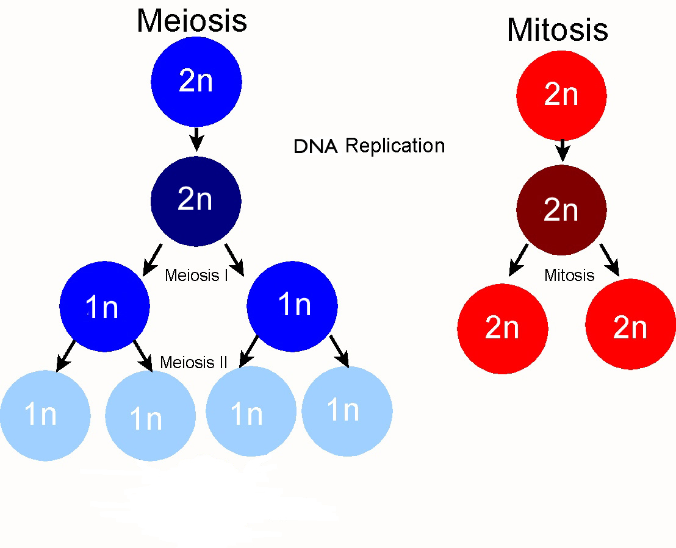
Meiosis – producing gametes
Start with: Diploid nucleus (2n)
Divides twice (meiosis I and II)
Produces: 4 haploid nuclei (n)
How can 1n get halved and still be 1n?

Slide 5
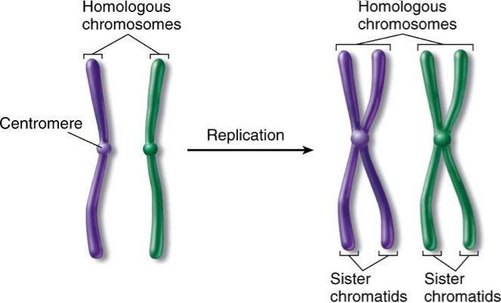
Homologous chromosomes and chromatids
Maternal
Paternal
BIVALENT - Pair of homologous chromosomes containing 4 chromatids all together
KEY POINT....
Notes:
Chromosomes from mother and father. Similar but not identical. Each carries the same genes in the same order, but may have different alleles for each trait.

Slide 6
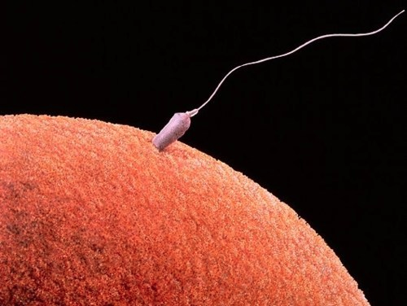
Haploid Nuclei
Has one chromosome of each type
Humans: 23 chromosomes
Gametes (egg and sperm)
Not all eggs/sperm have the same chromosome as meiosis increases variation
Notes:
Alleles are different in each egg and sperm
Gets more complicated than that later

Slide 7
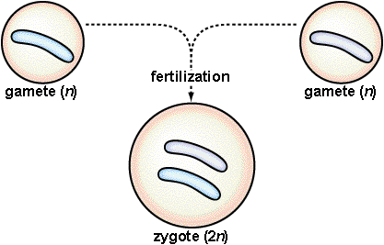
Diploid nuclei
Has two chromosomes of each type
Humans: 46 chromosomes (23 pairs)
Haploid cells fuse together during fertilisation producing a diploid zygote

Slide 8
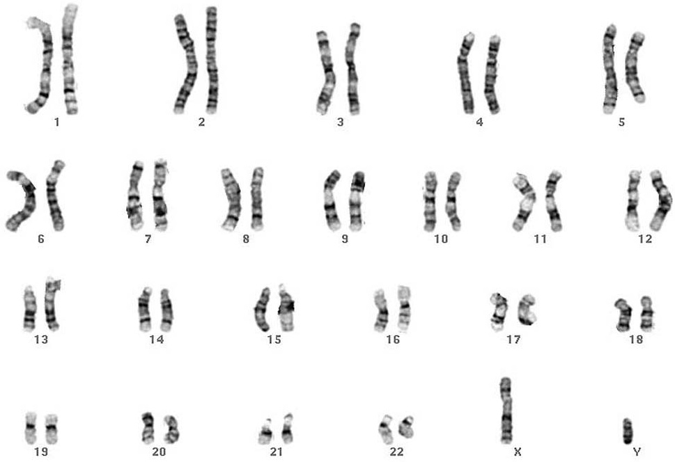

Slide 9
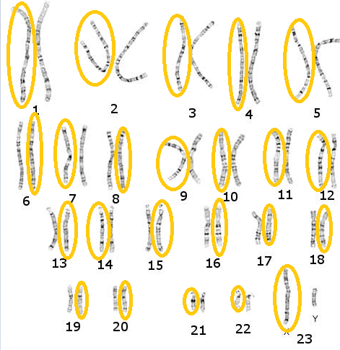
Notes:
In a haploid cell you only get one chromosome

Slide 10
Before Meiosis begins
Meiosis is a normal diploid body cell dividing to form 4 haploid sex cells.
The diploid body cell will contain all chromosomes from both parents.
Gamete
Gamete
Interphase
Meiosis
Gamete
DNA replicated
Gamete

Slide 11
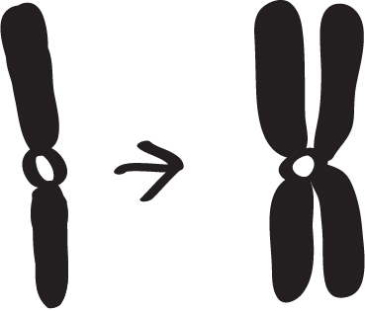
Before Meiosis begins
DNA replicated so chromosomes consist of 2 chromatids
Sister chromatids are identical

Slide 12
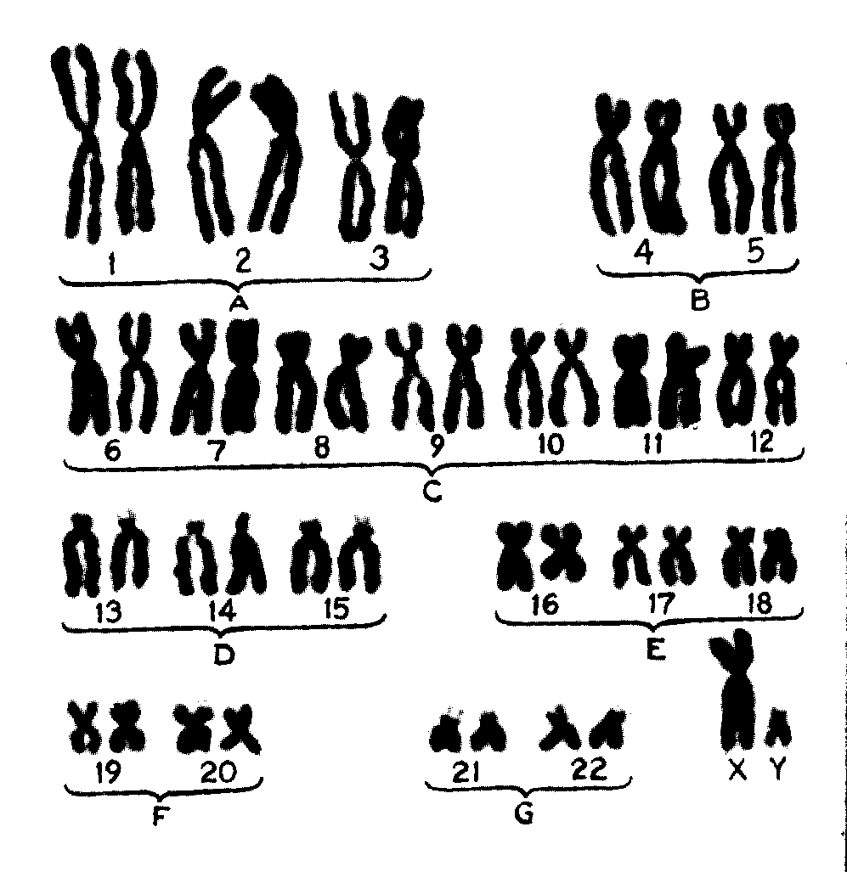
Before Meiosis begins

Slide 13
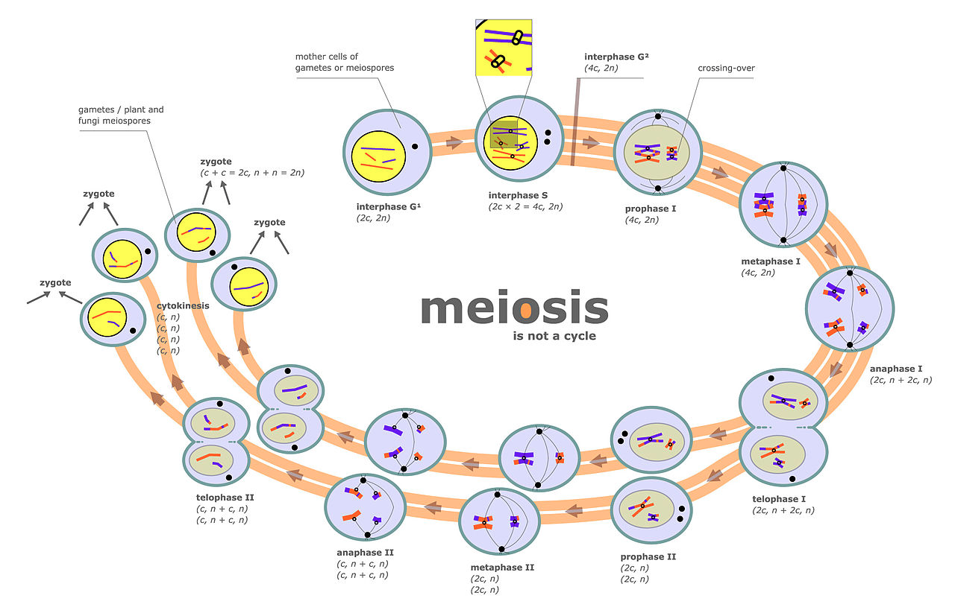
Meiosis
Meiosis
Notes:
Still one chromosome – just made of 1 chromatid

Slide 14
Meiosis stages
Prophase I
Metaphase I
Anaphase I
Telophase I
cytokinesis
Prophase II
Metaphase II
Anaphase II
Telophase II
cytokinesis

Slide 15
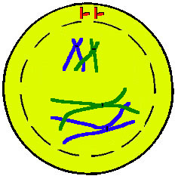
Prophase I
Chromosomes condense and become visible
Homologous chromosomes pair up (synapsis)
Crossing over occurs*
Spindle fibers/microtubules form
Nuclear membrane breaks down

Slide 16
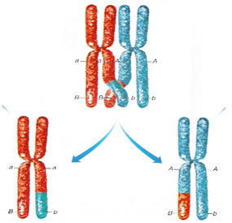
Crossing Over
Homologous chromosomes pair up (synapsis)
Because the DNA has replicated there are 4 chromatids together
(All 4 are called a bivalent)
One chromatid in each of the homologous chromosomes breaks
Then rejoins with a chromatid on the other chromosome
Random positions. Different each time for each chromosome.
Mutual exchange of genes (same loci)
New combinations of alleles are formed

Slide 18
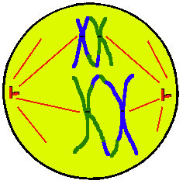
Metaphase I
Homologous chromosomes line up on equator
Moved by spindle fibers attached to centromeres
Random orientation*
Nuclear membrane broken down fully now

Slide 19
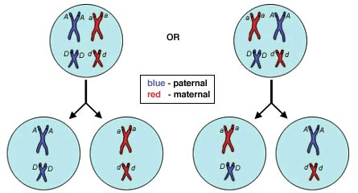
Random Orientation
Chromosomes randomly align on the centre of the cell
Then pulled to different poles during Anaphase I
Could be either of the chromosomes

Slide 20
Random Orientation
Number of possibilities – 2^{n}.
So for humans 2²³ – Over 8 million possibilities!!
Notes:
Chromosomes randomly align on the centre of the cell
Then pulled to different poles during Anaphase I
Could be either of the chromosomes

Slide 21
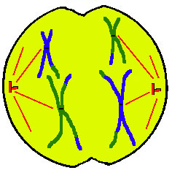
Anaphase I
Spindle fibres attached to centromeres
Pull chromosomes to each pole of the cell
Homologous pairs are separated

Slide 22
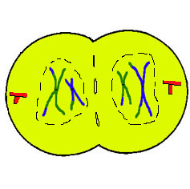
Telophase I
Spindle fibres break down
Chromosomes uncoil/
de-condense
New nuclear membrane forms
Each cell is haploid (n)

Slide 23
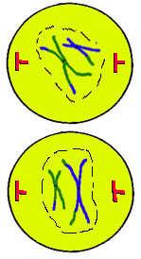
Prophase II
DNA condenses and is visible
Spindle fibres made
Nuclear membrane starts to break down

Slide 24
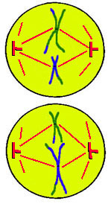
Metaphase II
Nuclear membrane breaken down
Chromosomes line up on equator
Spindle fibres connected to centromeres

Slide 25
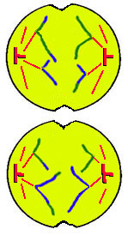
Anaphase II
Chromatids pulled to each pole of the cell – centromeres break
Cell membranes pinch off in the middle

Slide 26
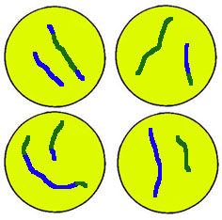
Telophase II
Chromosomes uncoil/de-condense
Nuclear membranes form
4 haploid (n) daughter cells
Genetically different
Cytokinesis

Slide 27
Variation
What aspects of sexual reproduction gives variation in a species?
Crossing over
Random orientation
Fertilisation

Slide 28
Fertilisation
Fusion of gametes from each parent
Combination of alleles unlikely to have existed before
Promotes genetic variation
Essential for evolution

Slide 29
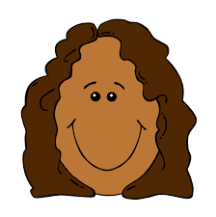
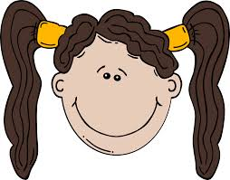
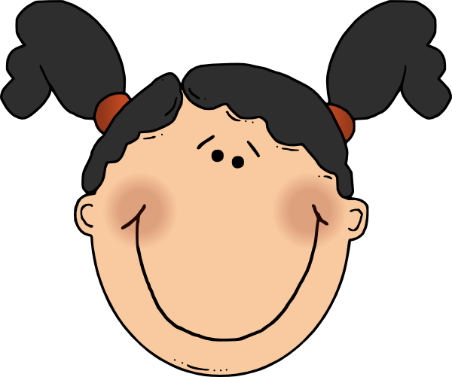
Variation
From crossing over and random orientation
Parents produce offspring that look similar to themselves and each other, but have variation.

Slide 30
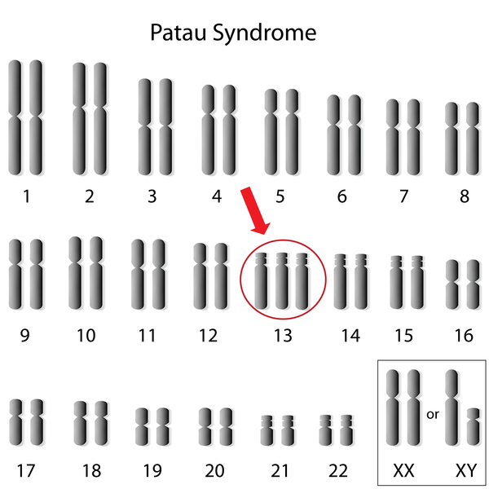
Non-disjunction causing trisomy
Use the plastic sheets to show how a mistake in meiosis can lead to a person having having three copies of one of their chromosomes (trisomy).
Non-distunction

Slide 31
Trisomy disorders
Speed research:
Patau syndrome
Turner syndrome
Klinefelter’s syndrome
Edward syndrome
Triple X syndrome
Trisomy 16
Cause and consequence

Slide 32
Meiosis I
Non-disjunction can happen during meiosis I or meiosis II
Meiosis II
Fertilisation

Slide 33
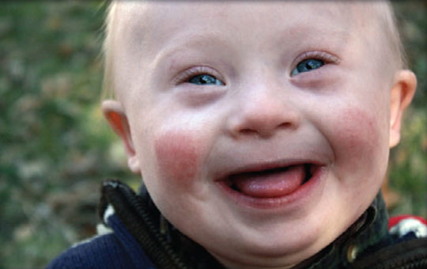
Down syndrome
Hearing loss
Heart disorders
Visual impairment
Slow growth
Poor muscle tone
Slow mental development
Slow learning
Delayed speech development
Short attention span

Slide 34
Down Syndrome

Slide 35
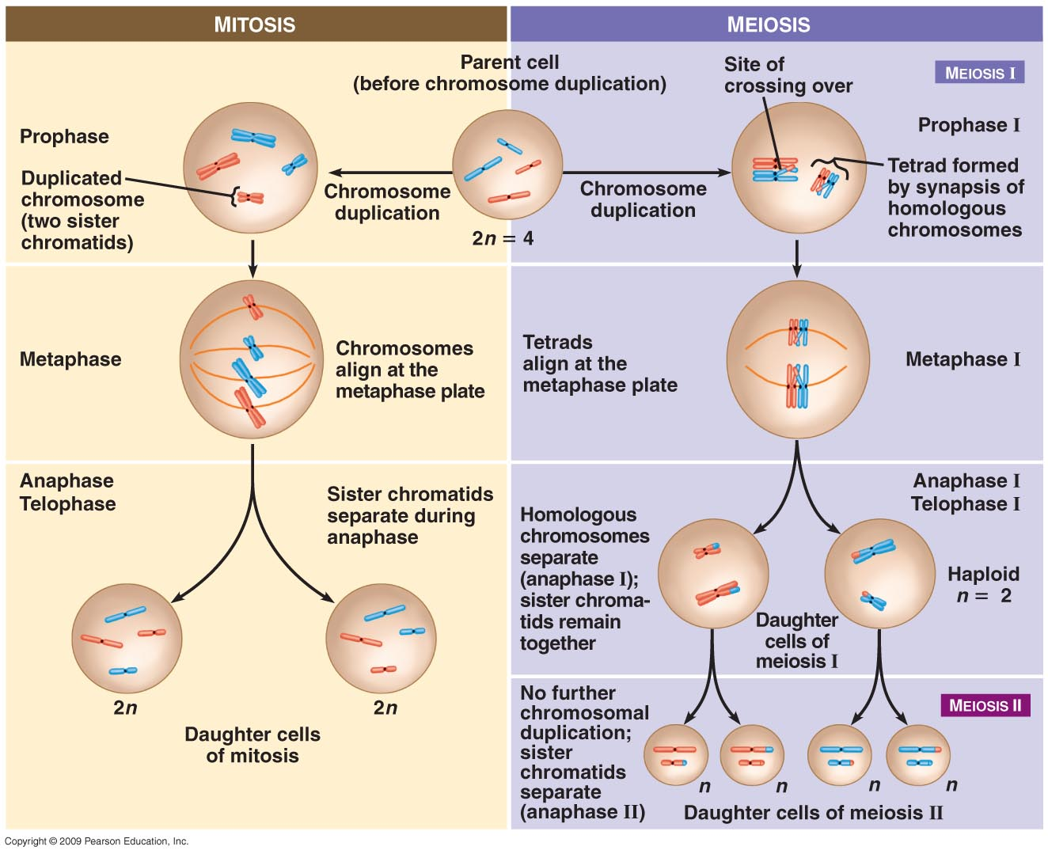

Slide 36
Differences
 | Mitosis | Meiosis
DNA replication before
Crossing over
Random orientation
Number of divisions
Number of cells produced
Role of new cells
Bivalents/tetrads formed

Slide 37
Differences
 | Mitosis | Meiosis
DNA replication before | Occurs before mitosis | Occurs before meiosis
Crossing over | No | Yes – prophase I
Random orientation | No | Yes
Number of divisions | 1 | 2
Number of cells produced | 2 (2n chromosomes) | 4 (1n chromosomes)
Role of new cells | Somatic body cells | Gametes
Bivalents/tetrads formed | No | Yes

