Slide 1
True or False?
1. The location of a gene on a chromosome is called a locus
2. A gene is a different version of the same allele
3. The genome refers to all of the chromosomes an organism has
4. Mutations are always inherited by the next generation
5. Variation in a species is due to poly nucleotide monomorphisms (PNMs)

Slide 2
Recap – Genomes and Chromosomes
Contains plasmids
Naked DNA (not associated with proteins)
Single circular chromosome
DNA in mitochondria
DNA in chloroplasts
Linear chromosomes associated with histones
Plants
Animals
Prokaryotes
Put numbers into relevant columns

Slide 3
3.2 Chromosomes
Applications:
Cairns’s technique for measuring the length of DNA molecules by autoradiography
Comparison of genome size in T2 phages
Comparison of diploid chromosome numbers
Use of karyotyes to deduce sex and diagnose Down Syndrome in humans
Understanding:
Prokaryotes have one chromosome consisting of a circular DNA molecule
Some prokaryotes also have plasmids but eukaryotes do not
Eukaryote chromosomes are linear DNA molecules associated with histone proteins
In a eukaryote species there are different chromosomes that carry different genes
Homologous chromosomes carry the same sequence of genes but not necessarily the same alleles of those genes
Diploid nuclei have pairs of homologous chromosomes
Haploid nuclei have one chromosome of each pair
The number of chromosomes is a characteristic feature of members of a species
A karyogram shows the chromosomes of an organism in homologous pairs of decreasing length
Sex is determined by sex chromosomes and autosomes are chromosomes that do not determine sex
Skills:
Use of online databases to identify the locus of a human gene and its protein product
Nature of science:
Developments in scientific research follow improvements in techniques: autoradiography was used to establish the length of DNA molecules in chromosomes

Slide 4
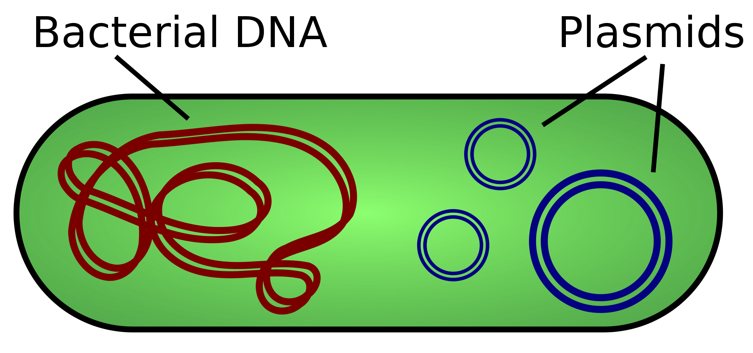
Prokaryotes
Contain a circular DNA molecule plasmids
Bacterial DNA is not associated with proteins (like eukaryotic DNA).
There is only one chromosome so one copy of each gene.
When would there be two copies of each gene?
circular

Slide 5
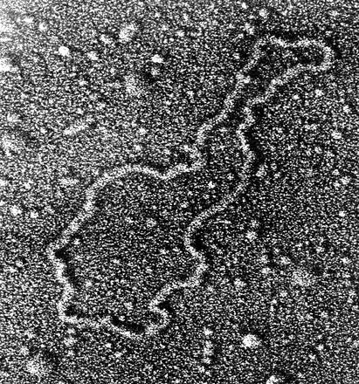
Plasmids
Contain ‘SPECIAL’ genes that are not needed for every day life purposes
e.g. Antibiotic resistance genes
Not copied at the same time as chromosome so some bacterium have multiple of a particular plasmid and some have none

Slide 6
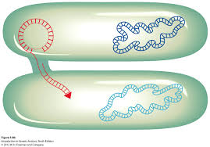
Plasmids
Plasmids can be transferred from one cell to another, allowing genes to spread rapidly through population –
Why could this be dangerous?
Plasmids are also used in GM to transfer genes between species
conjugation
Notes:
One species containing plasmid dies – absorbed by another species

Slide 7
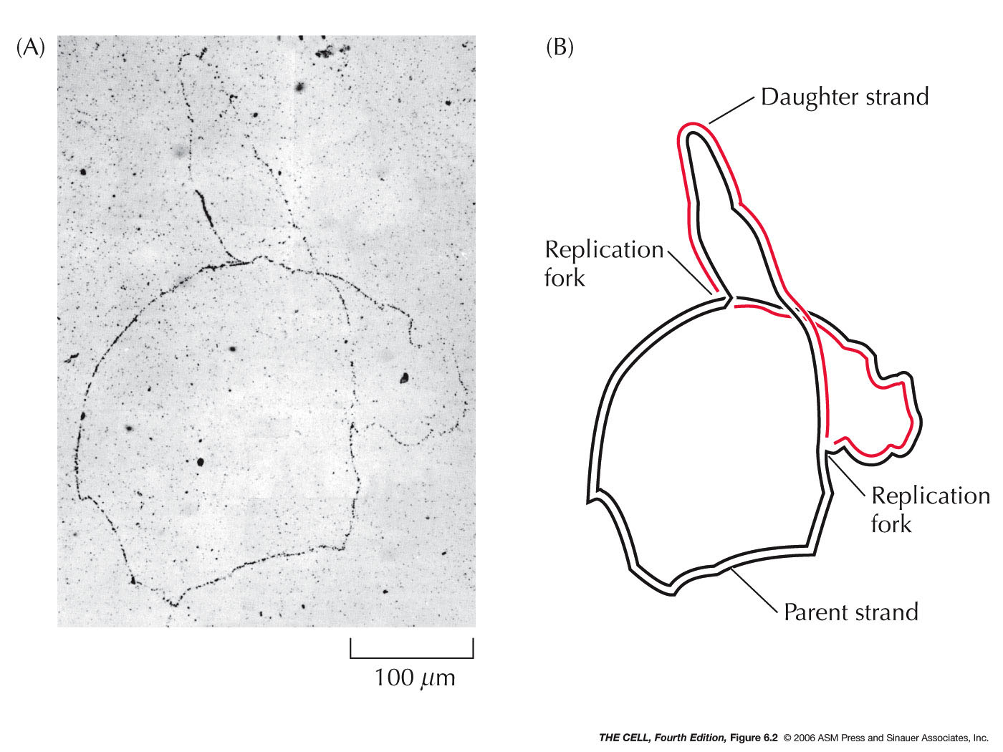
Measuring the length of DNA
Summarise Cairn’s technique using diagrams and <30 words
Read through this section in Kognity and answer the two checkpoint questions
Pg 151

Slide 8
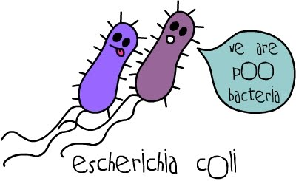
Measuring DNA length
Cairn’s technique
Grow E.coli cells for 2 generations in a medium with tritiated thymidine.
Thymidine contains base Thymine linked to deoxyribose – used by E.coli to make nucleotides in DNA replication
Tritiated = contains tritium – a radioactive isotope of hydrogen. E.coli produced radioactively labeled DNA

Slide 9
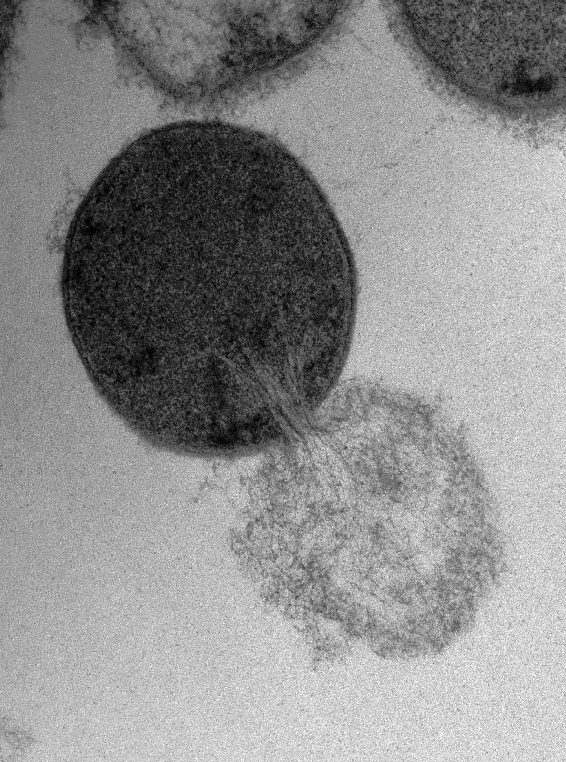
Measuring DNA length
Cairn’s technique
Cells placed onto dialysis membrane – cell walls digested using enzyme lysozyme
Cells gently burst to release DNA onto surface of dialysis membrane

Slide 10
Measuring DNA length
Cairn’s technique
Photographic emulsion applied to surface and left in darkness for 2 months
Tritium emits high energy electrons which react with the film
After 2 months the film is developed and examined with a microscope
Dark grains where tritium decayed – indicating the position of the DNA

Slide 11
Measuring DNA length
Cairn’s technique
Showed a single circular DNA molecule with a length of 1,100 um.
Notes:
Micrometre

Slide 12
3.2 Chromosomes
Applications:
Cairns’s technique for measuring the length of DNA molecules by autoradiography
Comparison of genome size in T2 phages
Comparison of diploid chromosome numbers
Use of karyotyes to deduce sex and diagnose Down Syndrome in humans
Understanding:
Prokaryotes have one chromosome consisting of a circular DNA molecule
Some prokaryotes also have plasmids but eukaryotes do not
Eukaryote chromosomes are linear DNA molecules associated with histone proteins
In a eukaryote species there are different chromosomes that carry different genes
Homologous chromosomes carry the same sequence of genes but not necessarily the same alleles of those genes
Diploid nuclei have pairs of homologous chromosomes
Haploid nuclei have one chromosome of each pair
The number of chromosomes is a characteristic feature of members of a species
A karyogram shows the chromosomes of an organism in homologous pairs of decreasing length
Sex is determined by sex chromosomes and autosomes are chromosomes that do not determine sex
Skills:
Use of online databases to identify the locus of a human gene and its protein product
Nature of science:
Developments in scientific research follow improvements in techniques: autoradiography was used to establish the length of DNA molecules in chromosomes

Slide 13
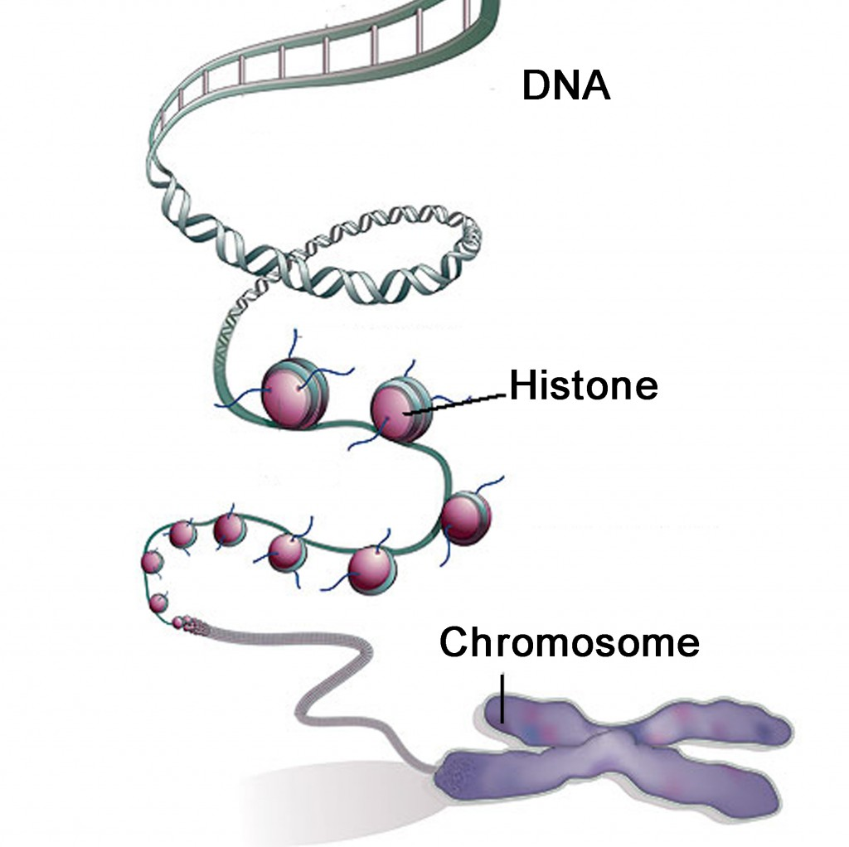
Eukaryotes
How are eukaryotic chromosomes different?
Linear DNA molecules
Associated with histone proteins
(DNA winds around histones)

Slide 14
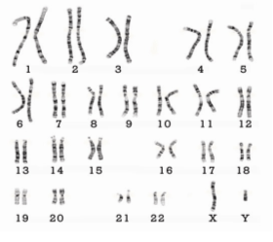
Chromosomes
In eukaryotes there are different chromosomes carrying different genes.
A gene occupies a specific ………..
How do they differ?
Humans have 23 pairs
Length
Position of centromere
(not visible here. When will it be visible?)

Slide 15
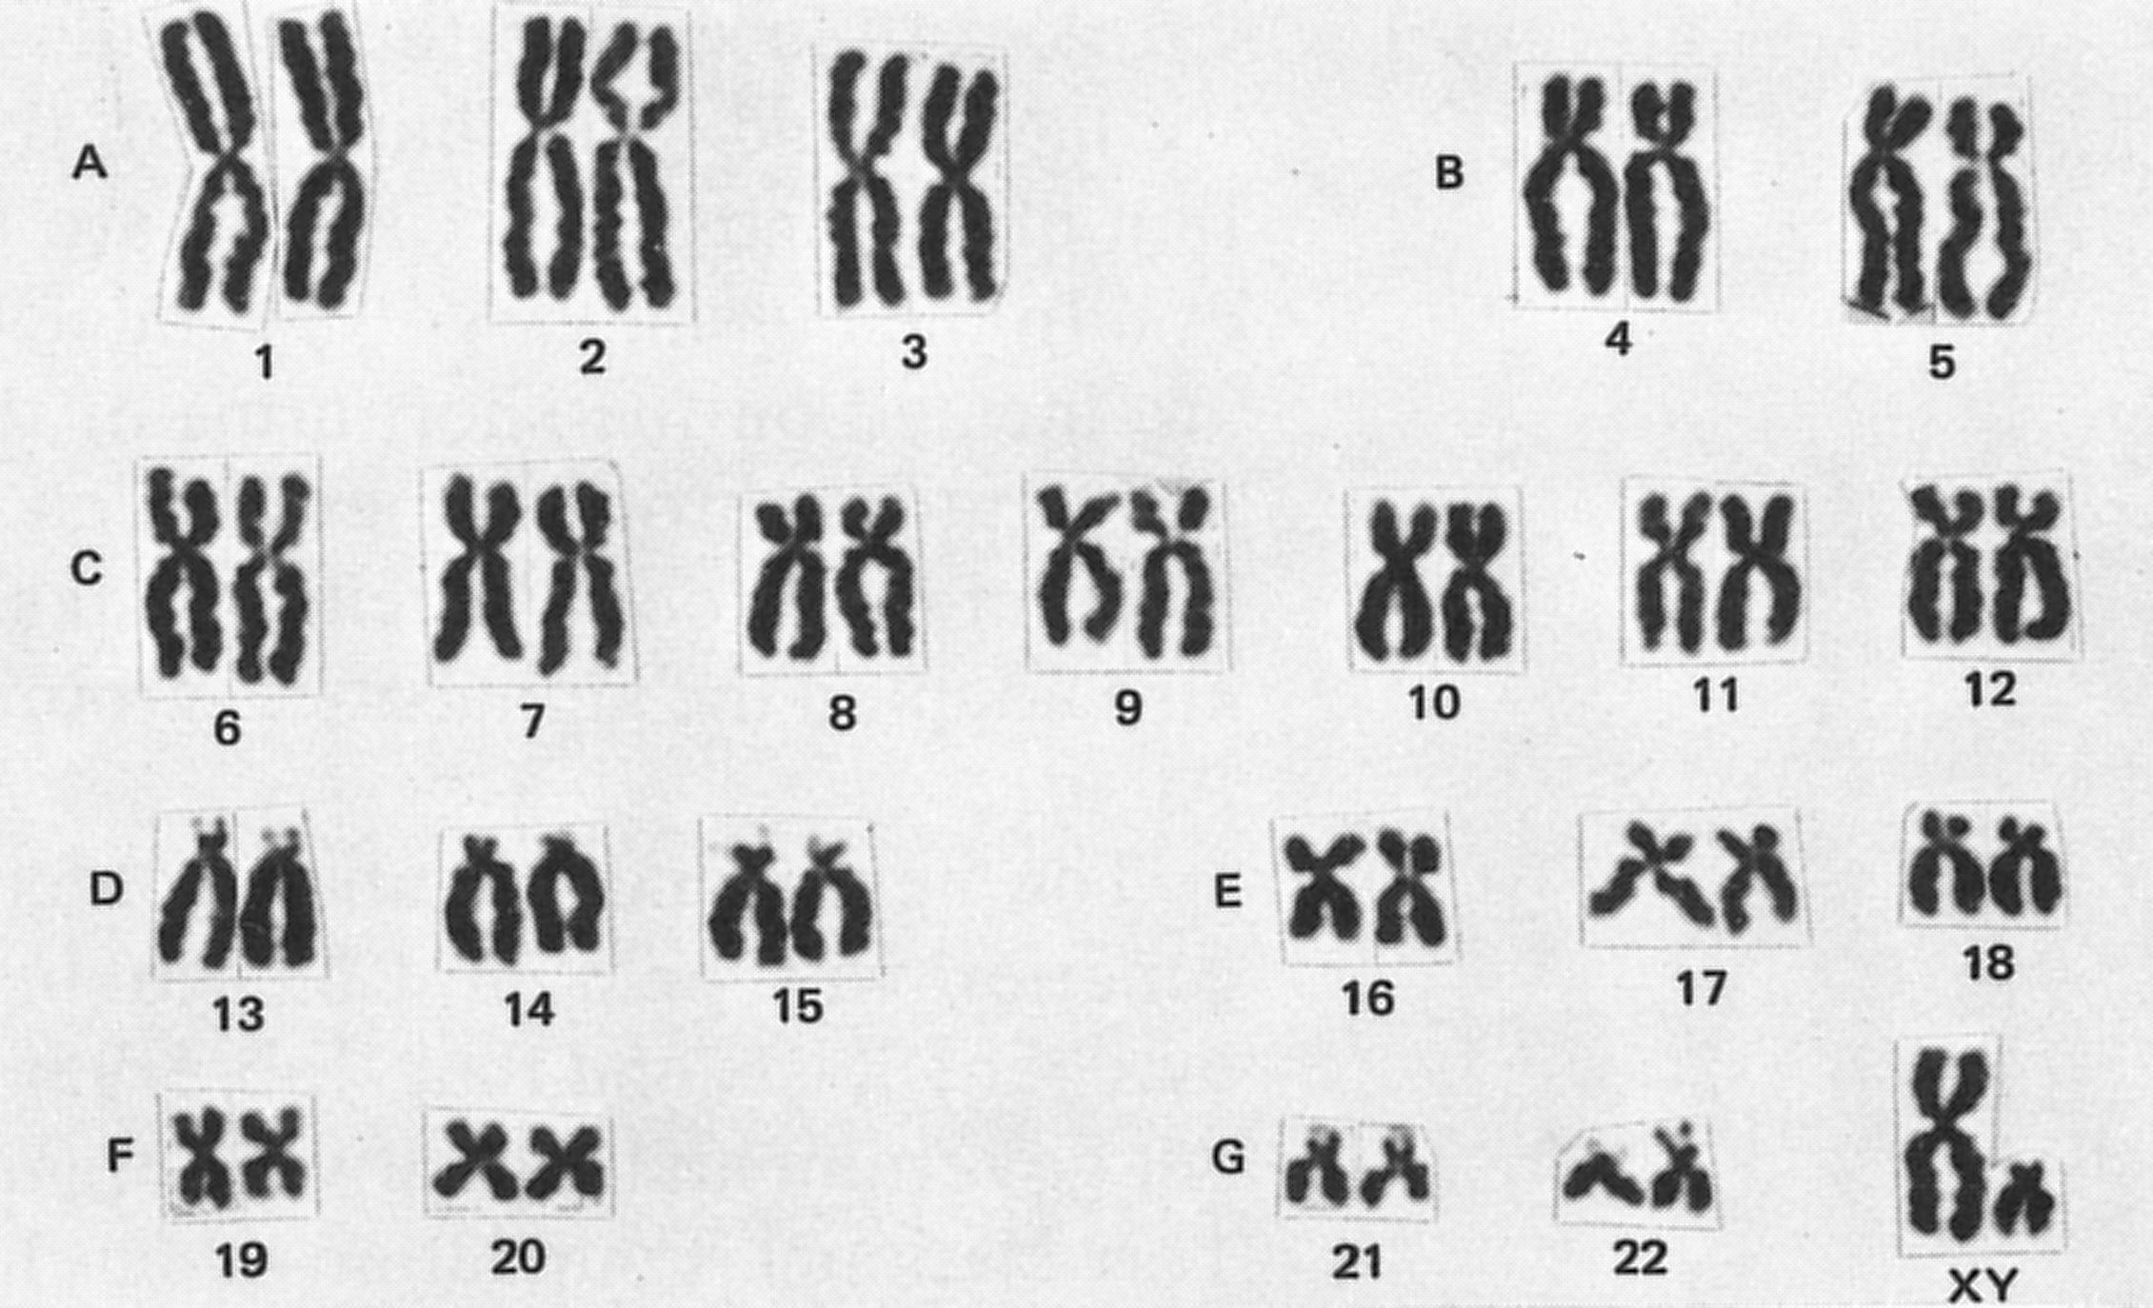
Chromosomes
During mitosis and meiosis chromosomes supercoil. They appear as X shaped after DNA replication during interphase (S).
Position of centromere visible connecting two sister chromatids.

Slide 16
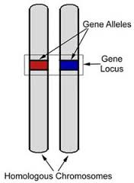
Homologous Chromosomes
Two chromosomes with same sequence of genes. Are they identical?
No…….as they may have different alleles
E.g. Both chromosomes have hair colour genes. Each codes for a different colour

Slide 17
Database – finding the loci of human genes
Online data bases can find the exact locus of a gene.
Follow the instructions on page 154 to search for different gene loci

Slide 18
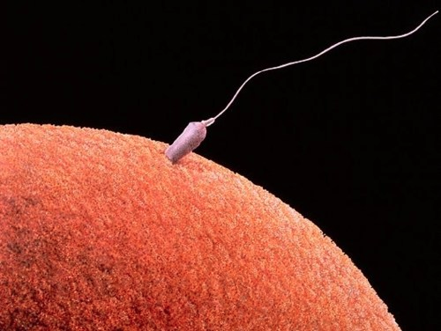
Haploid Nuclei
Has one chromosome of each type
Humans: 23 chromosomes
Gametes (egg and sperm)
Not all eggs/sperm have the same chromosome as meiosis increases variation
Notes:
Alleles are different in each egg and sperm
Gets more complicated than that later

Slide 19
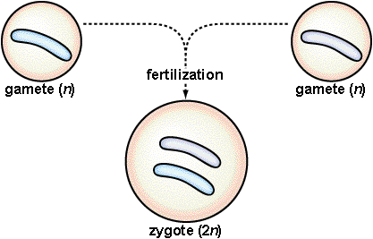
Diploid nuclei
Has two chromosomes of each type
Humans: 46 chromosomes (23 pairs)
Haploid cells fuse together during fertilisation producing a diploid zygote.

Slide 20
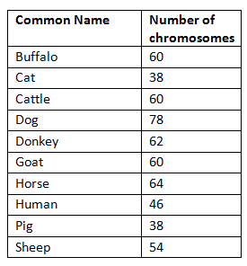
Number of chromosomes
Fundamental characteristic of an organism
Different numbers of chromosomes = unlikely to interbreed
Chromosome numbers can change in a species and cause speciation. Chromosomes can split or fuse.

Slide 21
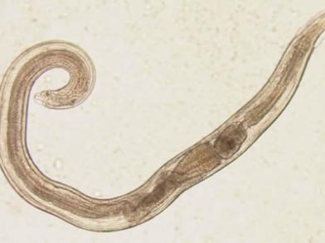
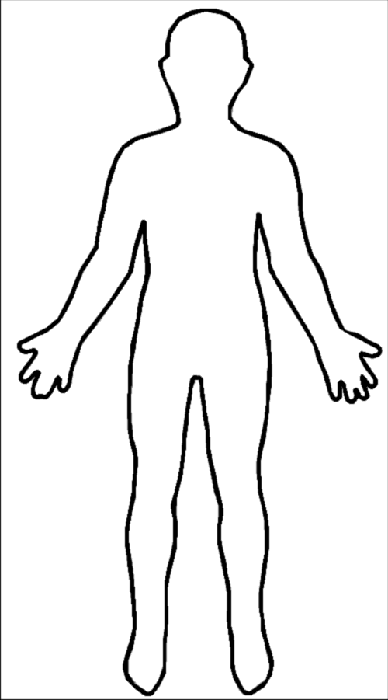
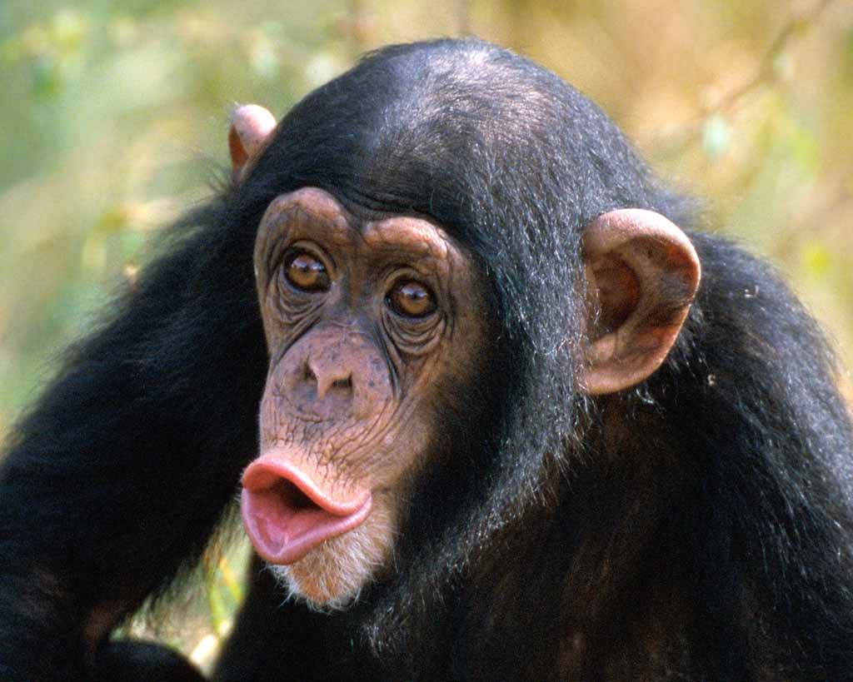
Number of chromosomes
Organism | Number of chromosomes
Threadworm | 4
Humans | 46
Chimp | 48
Dog | 78

Slide 22
Determining sex
In mammals, males have two different sex chromosomes (X and Y) and females have two similar sex chromosomes (X and X). However, in birds males have two similar sex chromosomes (Z and Z), while females have two different sex chromosomes (Z and W).
Complete a genetic cross diagram to show how sex is inherited in birds.

Slide 23
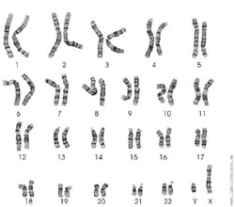
Determining sex
Autosomes = chromosomes that do not determine sex
Sex chromosomes = determine sex
How many autosomes do you have?

Slide 24
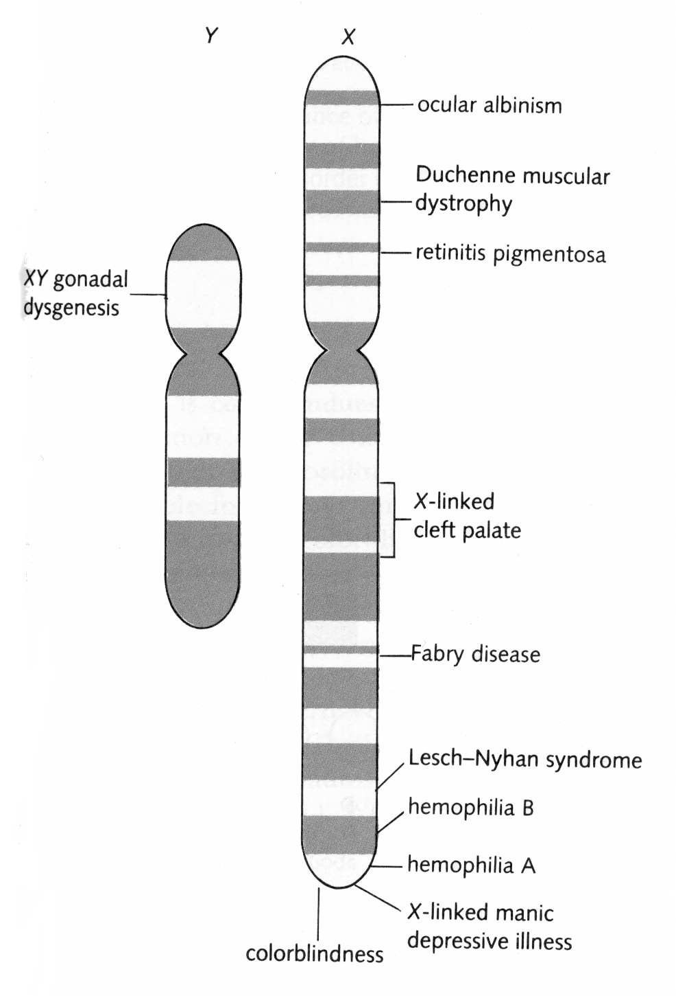
Determining sex
All humans have at least one X chromosome
Y chromosome contains genes that are not needed for female development

Slide 25
Y chromosome
Contains TDF/SRY gene which induces the development of male features
Testes
Testosterone
If no TDF/SRY gene (no Y) – ovaries develop and a female is produced
Testis-determining factor (TDF), also known as sex-determining region Y (SRY)

Slide 26
Karyogram & karyotype
Karyogram
Image of chromosomes arranged in size order
Karyotype
Property of an organism – number and type of chromosomes
Description of the karyogram
23 pairs of chromosomes
Homologous pairs
X and Y chromosomes
Male

Slide 27
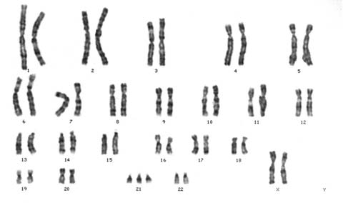
Karyogram
23 pairs of chromosomes
3 x chromosome 21 (trisomy 21)
Down sydrome
Female
Karyotype?

Slide 28
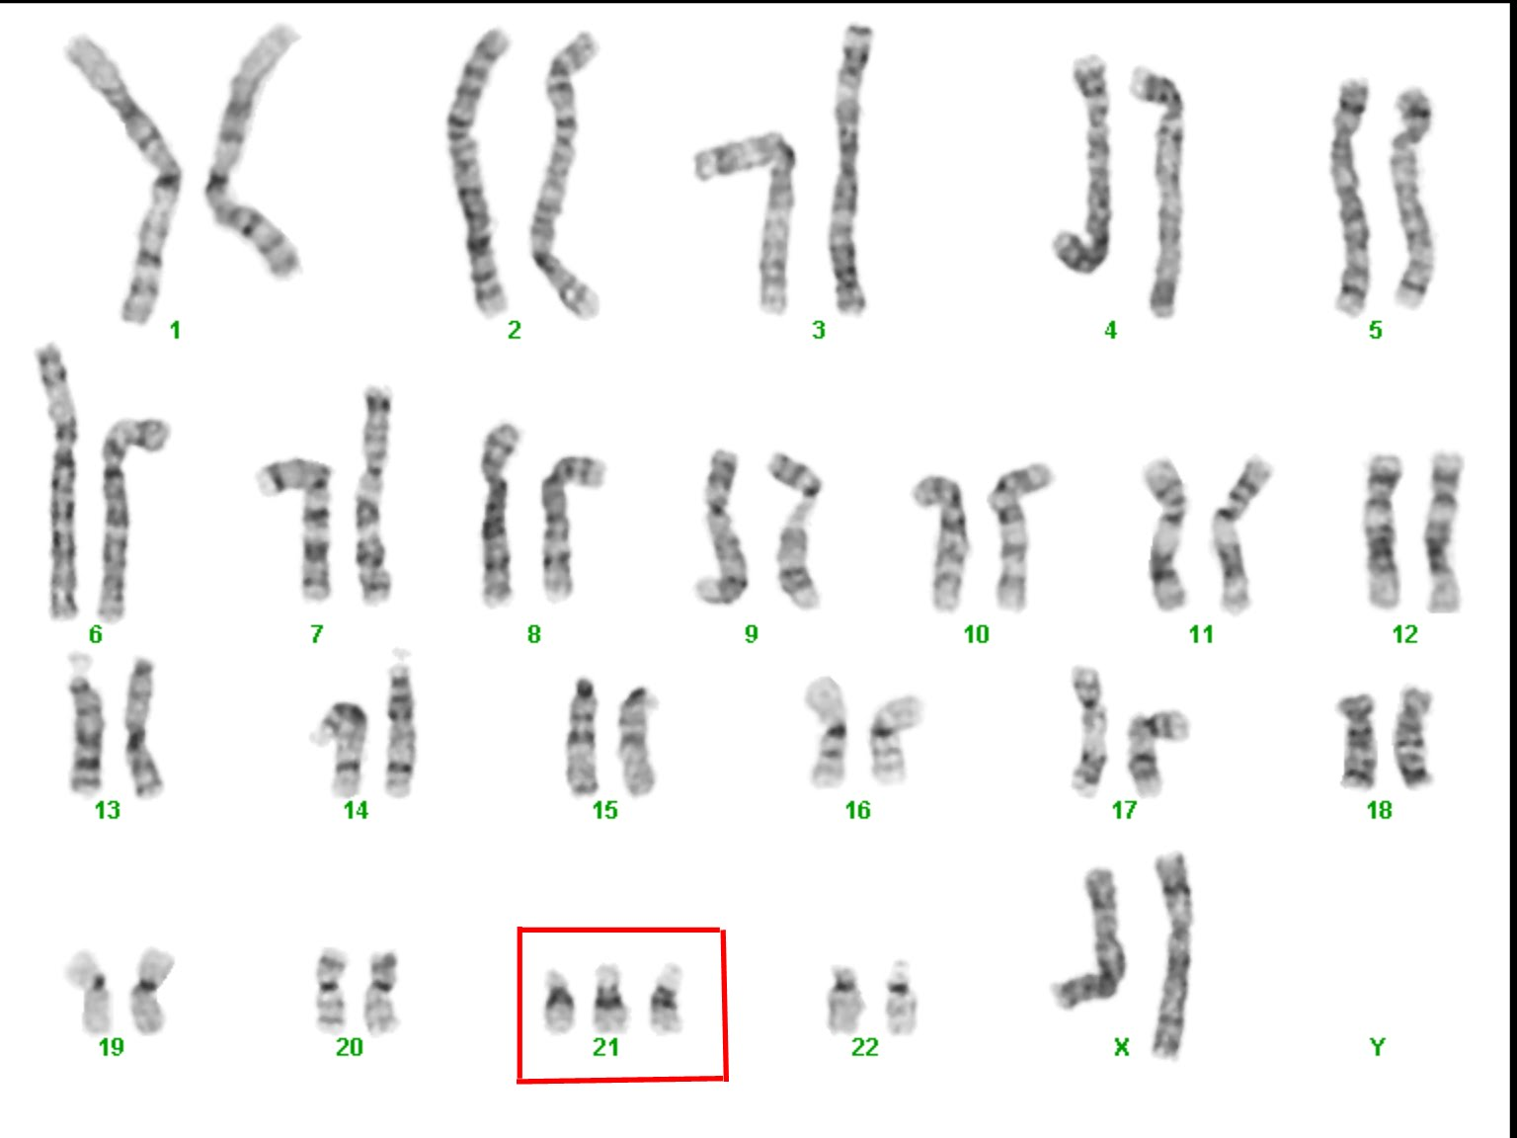
Pre-natal testing
Before-birth
To test of a baby has a genetic disorder (such as Down Syndrome) cells are collected and a karyogram is produced

Slide 29
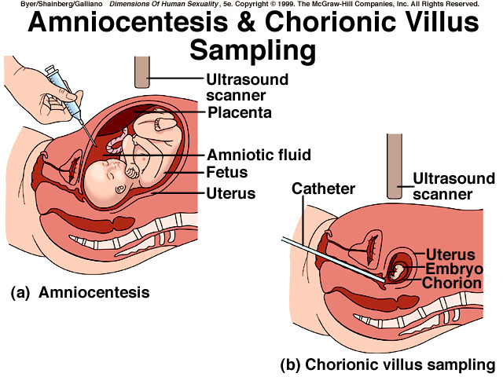

Slide 30
Cells from a foetus for a karyotype
Amniocentesis
Needle passes through mother’s abdomen wall
Ultrasound guides the needle
Needle withdraws a sample of amniotic fluid containing fetal cells
Risk of miscarriage 1%
2. Chorionic villus sampling
Tool enters the vagina and obtains cells from the chorion (part of the placenta)
Can be done earlier
Risk of miscarriage 2%

Slide 31
