Slide 1
What has happened?
Substitution mutation
1. What would be the consequence of this mutation?
2. How does this mutation affect the final structure of a protein?
3. Will all substitution mutations lead to a change in protein structure?
Why? Why not?
What is a gene?

Slide 2
3.1 Genes
Applications:
The causes of sickle cell anemia, including a base substitution mutation, a change to the base sequence of mRNA transcribed from it and a change to the sequence of a polypeptide in hemoglobin
Comparison of the number of genes in humans with other species
Understanding:
A gene is a heritable factor that consists of a length of DNA and influences a specific characteristic
A gene occupies a specific position on one type of chromosome
The various specific forms of a gene are alleles
Alleles differ from each other by one or a few bases only
New alleles are formed by mutation
The genome is the whole of the genetic information of an organism
The entire base sequence of human genes was sequenced in the Human Genome Project
Skills:
Use of a database to determine differences in the base sequence of a gene in two species
Nature of science:
Developments in scientific research follow improvements in technology: gene sequencers, essentially lasers and optical detectors, are used for the sequencing of genes
International mindedness
Single nucleotide polymorphisms are responsible for human global diversity

Slide 3
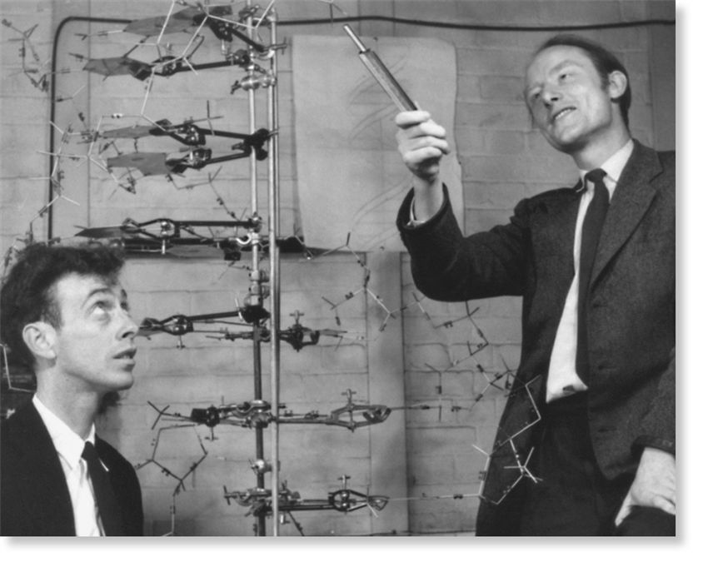
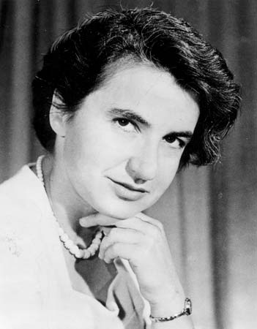
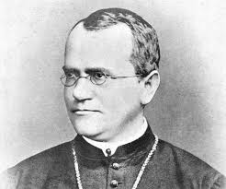
Topic 3 - Genetics
Genetics is a branch of biology concerning the storage of information. The term was used before DNA was known about.
Genetics comes from the word ‘genesis’ (meaning ‘origins’)

Slide 4
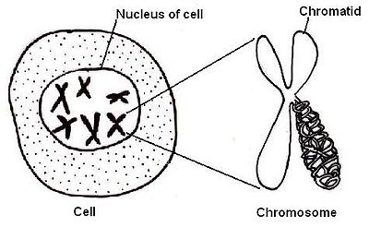
A Gene
Heritable factor that consists of a length of DNA and influences a specific characteristic
What do they code for?
PROTEINS
gene

Slide 6
Genes
A gene occupies a position on a chromosome (locus) (plural – loci)
Genes are physically linked in groups. These groups form chromosomes.
Humans have 23 groups of linked genes (and therefore 23 chromosomes)*
*there are 2 copies of each chromosome so 46 in total

Slide 7
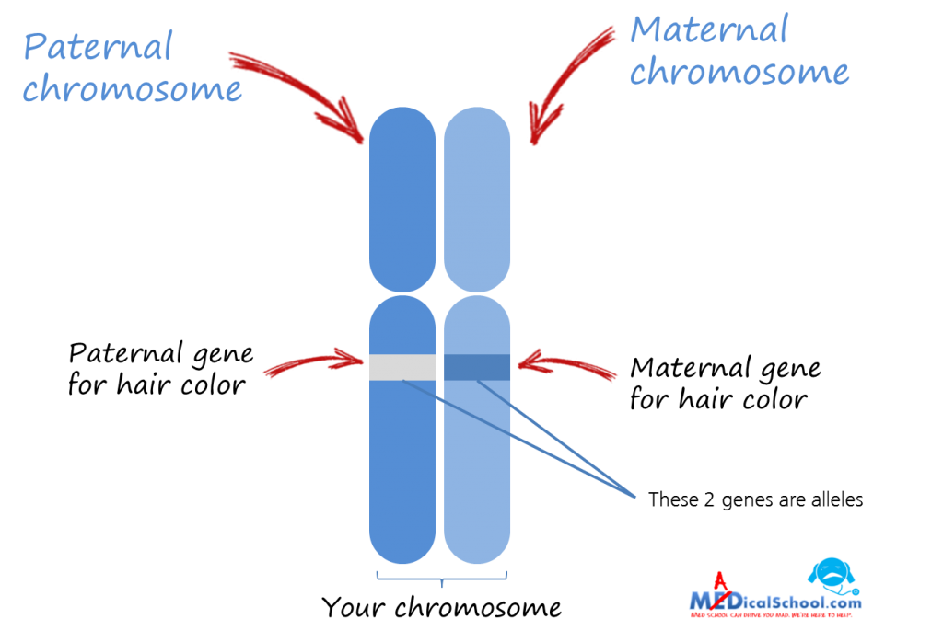
Alleles
Various forms of the same gene
Slight variations in base sequences
Some alleles are dominant over others (recessive)
There may be more than two alleles of a gene (ABO blood groups)

Slide 8
Why is there variation in the human species?

Slide 9
Differences between alleles can be very slight.
Positions on a gene where there may be more than one base presents are called single nucleotide polymorphisms (SNPs)

Slide 10
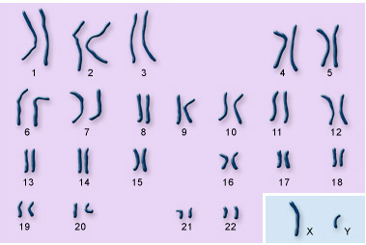
Genome
All of the genetic information of an organism
What about prokaryotic cells?
Humans:
Chromosomes
DNA in mitochondria
Plants:
Chromosomes
DNA in mitochondria and chloroplasts

Slide 11
Human Genome Project
Entire base sequence of human genes sequenced
Started: 1990
Complete sequence: 2003
Read page 147
- List 3 things that were discovered by the Human Genome Project.
- There are more proteins than genes. How?
A human genome not THE human genome

Slide 12
Mutations
New alleles formed from other alleles (random)
Why would a mutation cause a change in characteristics?
Can a mutation get passed on to the next generation??
When a mutation occurs in a somatic cell that mutation disappears when that organism dies.
BUT
If a mutation occurs in a gamete that mutation can be passed on to the next generation

Slide 13
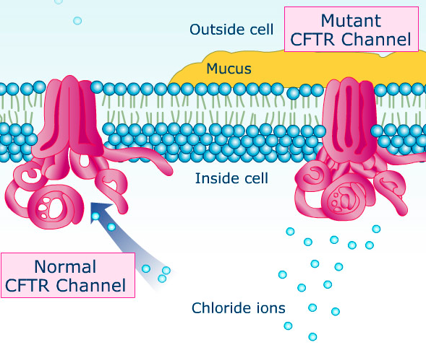
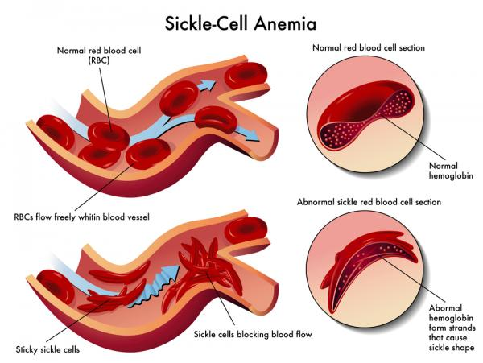
Mutations can cause genetic diseases
Cystic fibrosis
HW – notes on sickle cell (146).
I will be testing you on this next lesson.
There are 2 mistakes on this page. Can you find them?

Slide 14
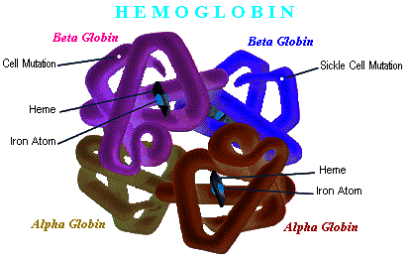
Sickle cell anemia
Most common genetic disease in the world
Mutation in the gene (Hb) that codes for the beta-globin polypeptide in haemoglobin
Most humans have the allele Hb^{A}
If a base substitution occurs on the 6th codon of the gene and changes CAC to CTC, a new allele is formed (Hb^{s})

Slide 15
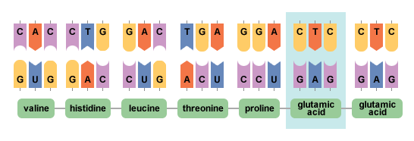
Hb^{A}
Normal DNA
MRNA
Mutation produces valine instead of glutamic acid
Causes haemoglobin to stick together in low oxygen levels
This deforms the shape of the red blood cell

Slide 16
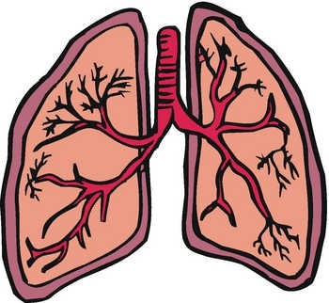
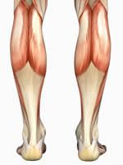
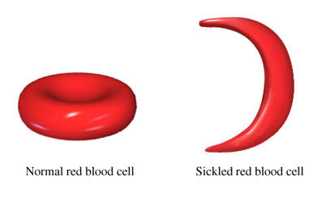
Lungs
High oxygen levels = normal RBC
Tissues/muscles
Low oxygen levels = sickle cell shape
The result:
Block blood flow
RBCs die quickly – cannot be reproduced quick enough = anemia

Slide 17
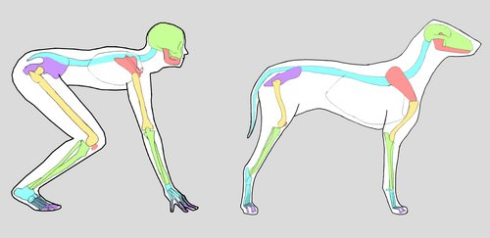
Comparing genes
Kognity 3.1.5
Use the database to determine differences in base sequences of two species
Complete the 3 checkpoint Questions

