Slide 2
6.5 Neurons and Synapses
Applications:
Secretion and reabsorption of acetylcholine by neurons at synapses
Blocking of synaptic transmission at cholinergic synapses in insects by binding of neonicotinoid pesticides to acetylcholine receptors
Understanding:
Neurons transmit electrical impulses
The myelination of nerve fibers allows for salutatory conduction
Neurons pump sodium and potassium ions across their membranes to generate a resting potential
An action potential consists of depolarisation and repolarisation of the neurons
Propagation of nerve impulses is the result of local crrents that cause each successive part of the axon to reach the threshold potential
Synapses are junctions between neurons and between neurons and receptor on effector cells
When pre-synaptic neurons are depolarised they release a neurotransmitter into the synapse
A nerve impulse is only initiated if the threshold potential is reached
Nature of science:
Cooperation and collaboration between groups of scientists: biologists are contributing to research into memory and learning.
Skills:
Analysis of oscilloscope traces showing resting potentials and action potentials.

Slide 3
Resting Potential in a Neuron
State the resting potential of a neuron
Explain how pumps and channels in the cell membrane sets up a potential difference

Slide 4
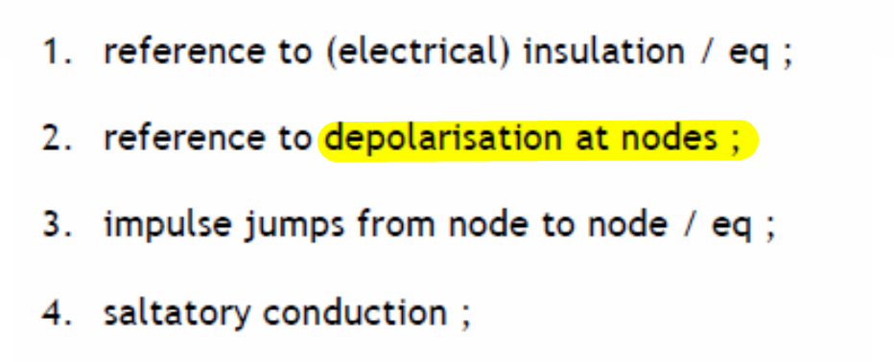

Slide 5
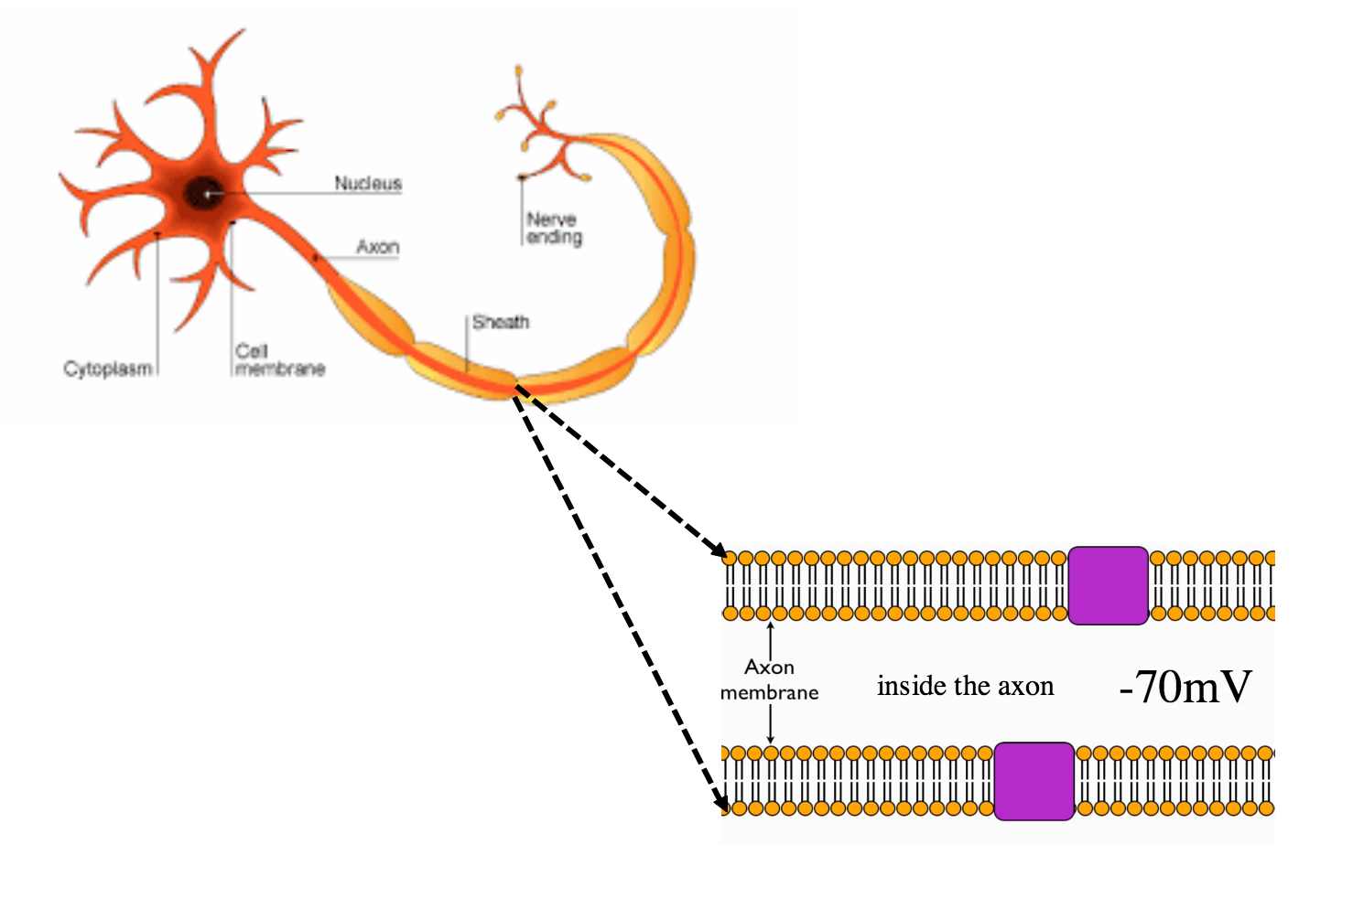

Slide 6
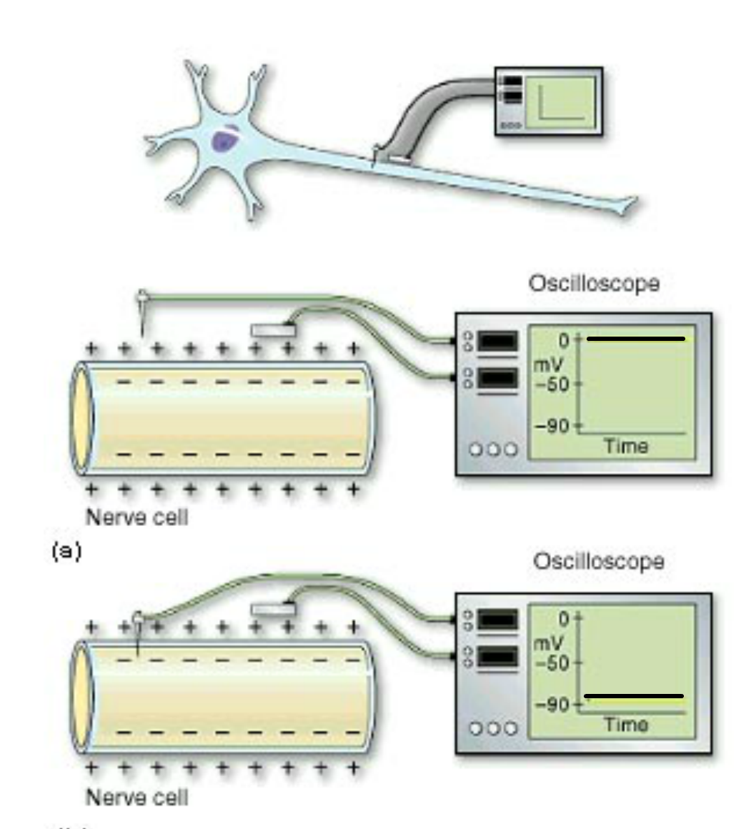
Squid axon

Slide 7
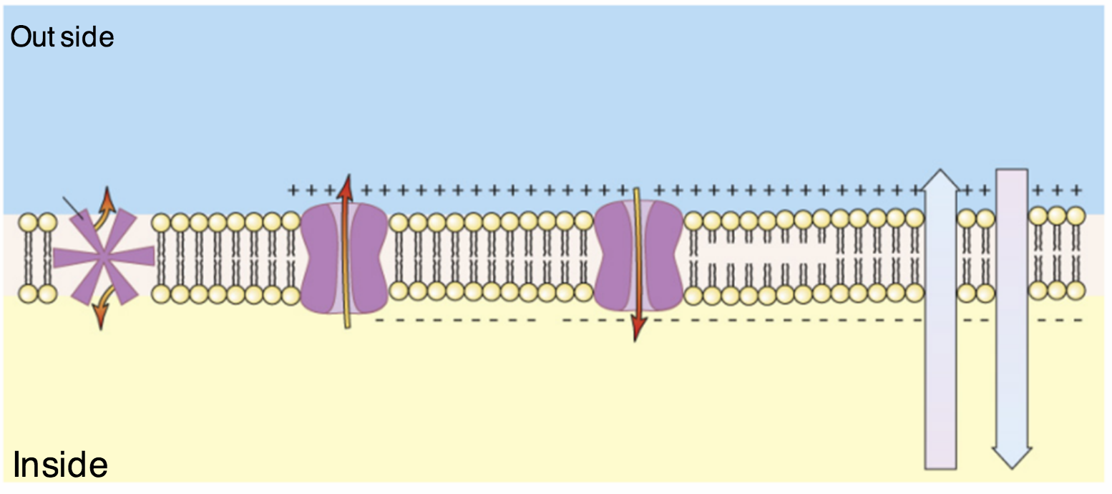
K⁺
-70mV

Slide 8
An electrical gradient pulls K⁺ back into the axon
Na⁺ channel is closed
This creates concentration gradients for Na⁺ and K⁺
K⁺ will diffuse out of the axon making the outside positive and the inside negative
K⁺
Na⁺/K⁺ pump pumps 3 x Na⁺ out and 2 x K⁺ in to the axon
2 x K⁺
K⁺ channel
3 x Na⁺
K⁺ channel
The chemical and electrical gradients will balance at -70mV
-70mV

Slide 9
Na⁺/K⁺ pump pumps 3 x Na⁺ out and 2 x K⁺ in to the axon
K⁺ will diffuse out of the axon making the outside positive and the inside negative
The chemical and electrical gradients will balance at -70mV
3 x Na⁺
K⁺
K⁺ channel
Na⁺ channel is closed
2 x K⁺
K⁺ channel
This creates concentration gradients for Na⁺ and K⁺
An electrical gradient pulls K⁺ back into the axon
-70mV

Slide 10
Why don’t sodium ions diffuse in and out?
Sodium channels are voltage dependent (we will look at these when we talk about action potentials)
VOLTAGE DEPENDEDNT – they only open at certain voltages

