Slide 1
Variation, Natural Selection, Evolution and Speciation
Describe how some organisms are better adapted to their environment
Describe how selection pressures lead to some organisms being selected
Apply natural selection to short term examples of evolution

Slide 2
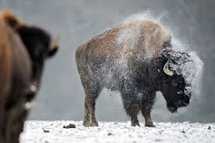
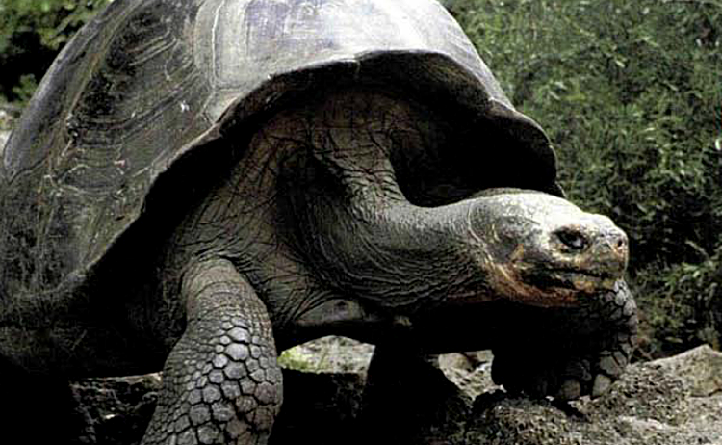
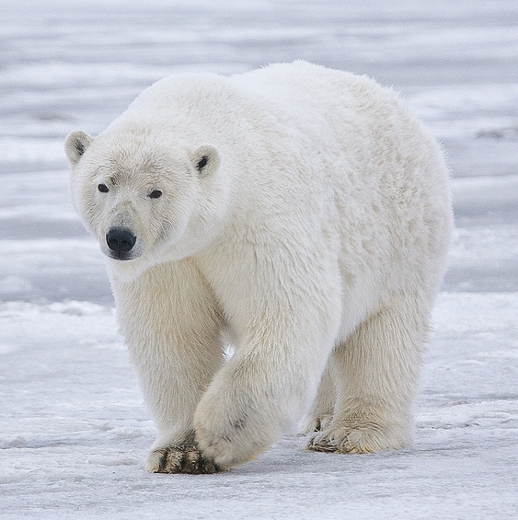
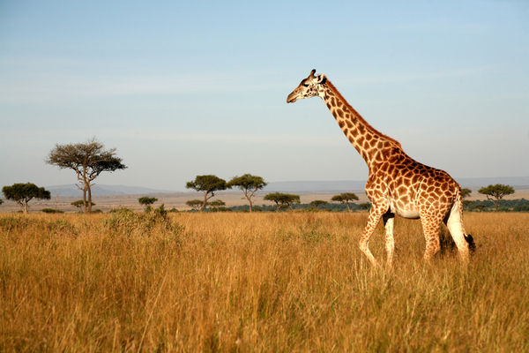
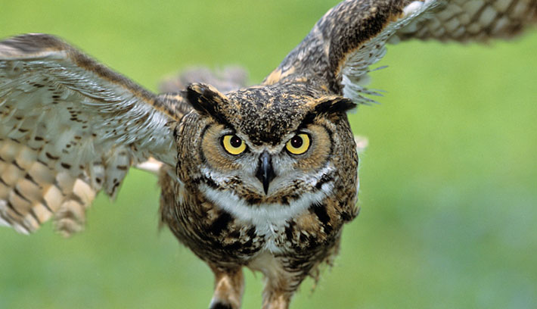
Adaptations
Giraffe neck

Slide 3
Most species over-produce. Some offspring live and some die.
Which ones survive?
What factors prevent organisms surviving? – Selection pressures

Slide 4
Selection Pressures
Affect survival and reproduction
Competition – food, water, shelter, mates
Predation – being eaten, disease and parasites
Environmental – heat, cold, drought, fire, floods, UV, etc

Slide 5
- The better adapted members of the species are more likely to survive and reproduce - This is called differential survival
Some are better ADAPTED than others

Slide 6
Pre-industrial
Peppered 70%
Melanic 30%
Post-industrial
Peppered 20%
Melanic 80%
melanistic

Slide 7
Natural Selection
New variations caused by mutations
A population has variation within the species. Some individuals are better adapted than others
A change in the environment causes a selection pressure
The organisms that are better adapted will survive
The organisms that survive will reproduce
They will pass on their favourable alleles to their offspring (inheritance)
These alleles (and characteristics) become more common in the population (increase in allele frequency.
Over many, many generations the species can change. This is evolution by natural selection.

Slide 8
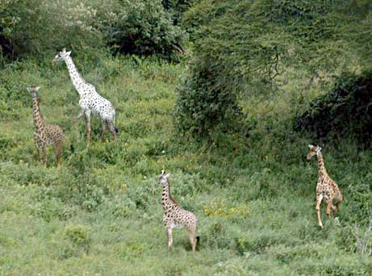
Why are there not many albino giraffes in the wild?
Rats are troublesome pests. A poison called warfarin was developed to kill rats. At first the poison was successful but now populations of warfarin resistant ‘super-rats’ have developed. Suggest how

Slide 9
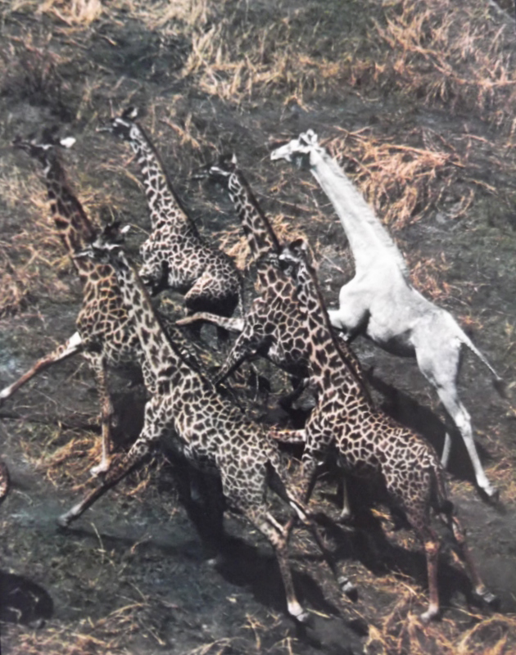
So…
Natural selection increases the frequency of alleles/characteristics that make individuals better adapted.
Evolution by natural selection

Slide 10
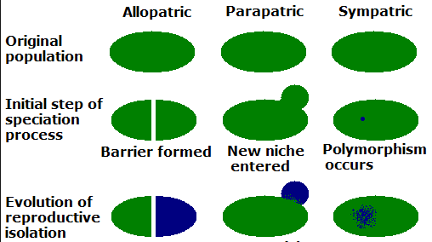
Speciation
Speciation
Populations of a species can gradually diverge into separate species by evolution

Slide 11
Geographical split
Temporal – mate or flower in different season
Behavioural – differ in courtship behaviours
Different selection pressures leads to different evolution until the populations can no longer reproduce. They are then different species.

Slide 12
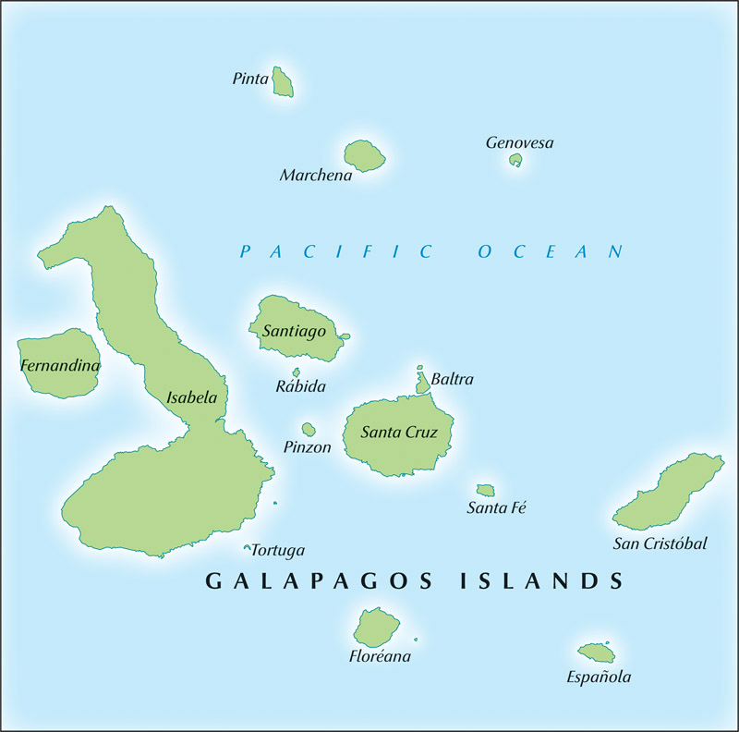
Darwin’s Finches
Changes in beaks of finches on Daphne Major

Slide 13
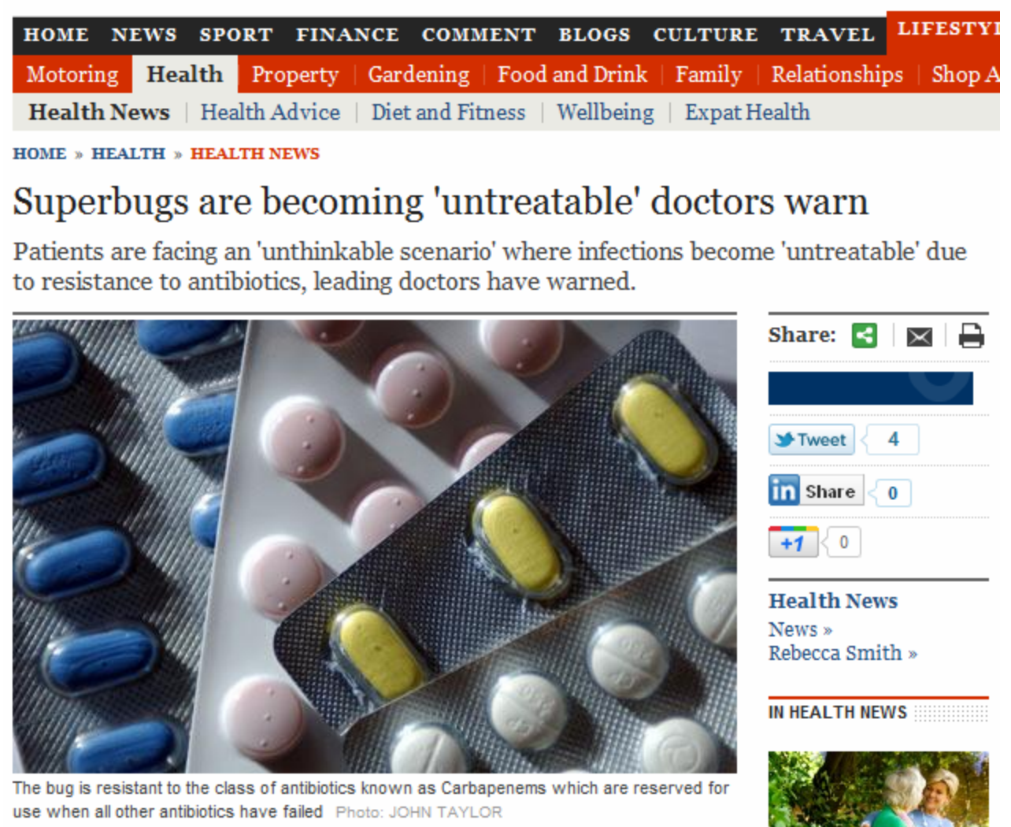

Slide 14
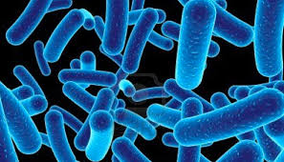
Antibiotic Resistance
Antibiotics are drugs that given to kill bacteria.
Antibiotics provide a selection pressure.
What might happen?

Slide 15
Antibiotic Resistance
SUPERBUGS
Watch the video:
1. How can bacteria evolve to become resistant to antibiotics?
2. What are the dangers of over use of antibiotics?
3. Why does the doctor tell you to finish the whole course of antibiotics?
Antibiotic Resistance

