Slide 2
Observing and Drawing Cells
Label a diagram of a light microscope
Make a slide to view under a microscope.
Practice drawing cells from microscope images

Slide 3
Rules when drawing cells
Sharp pencil
Draw single lines not sketches
No shading
Label each structure with a straight line
Include a title
Include the magnification

Slide 5
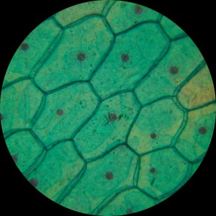
Animal cell
Plant Cell

Slide 6
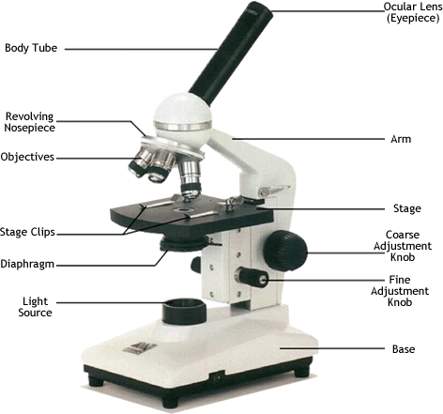

Slide 7
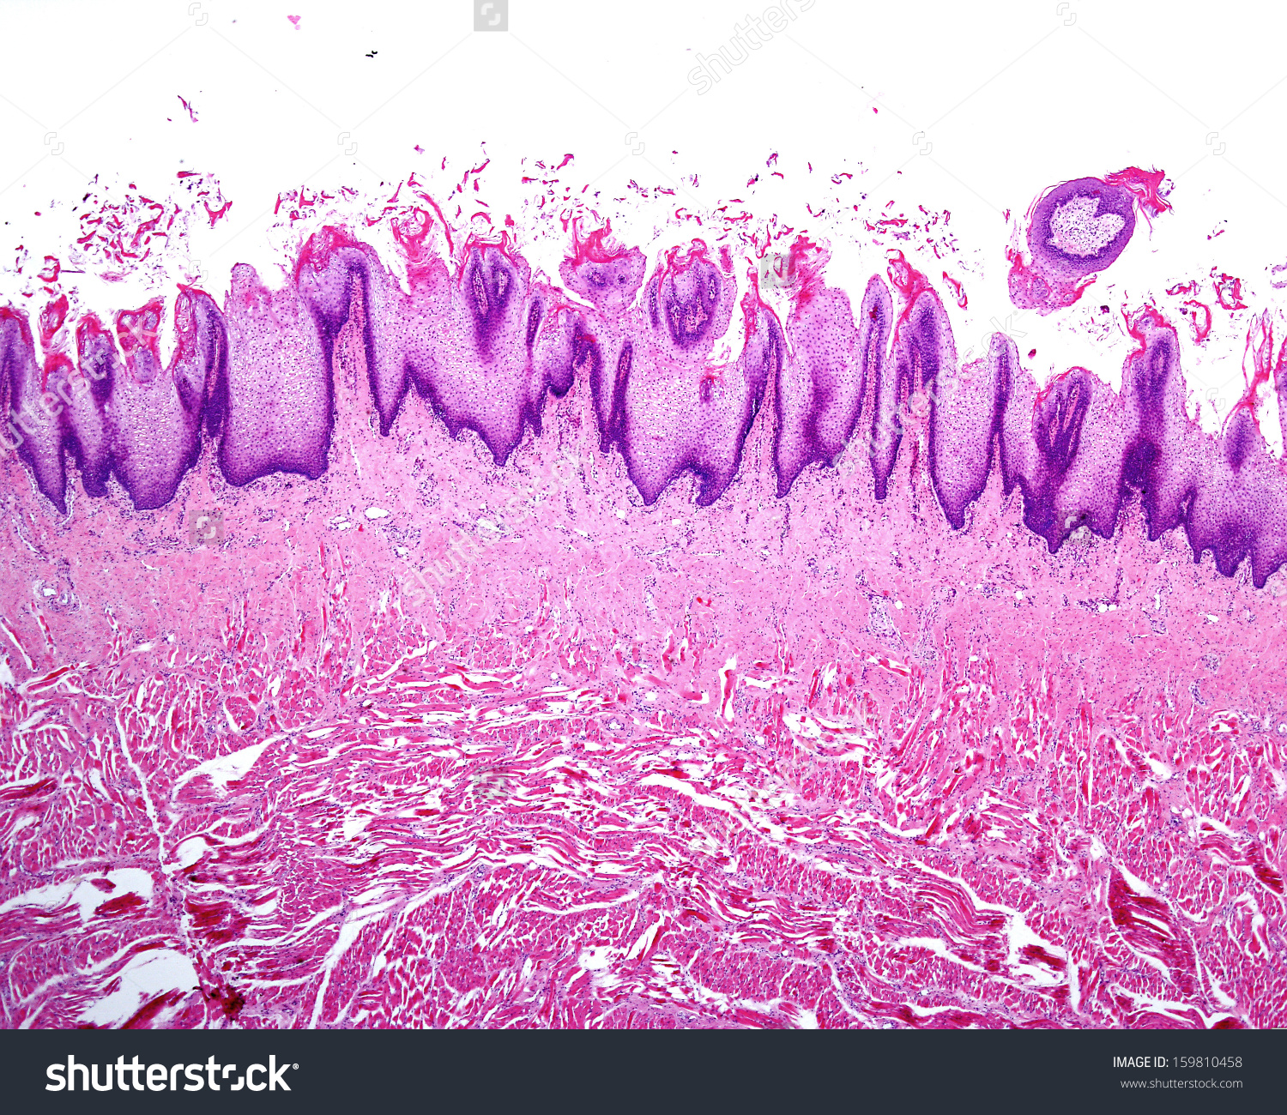
Light Microscope
Microscopes

