Slide 1
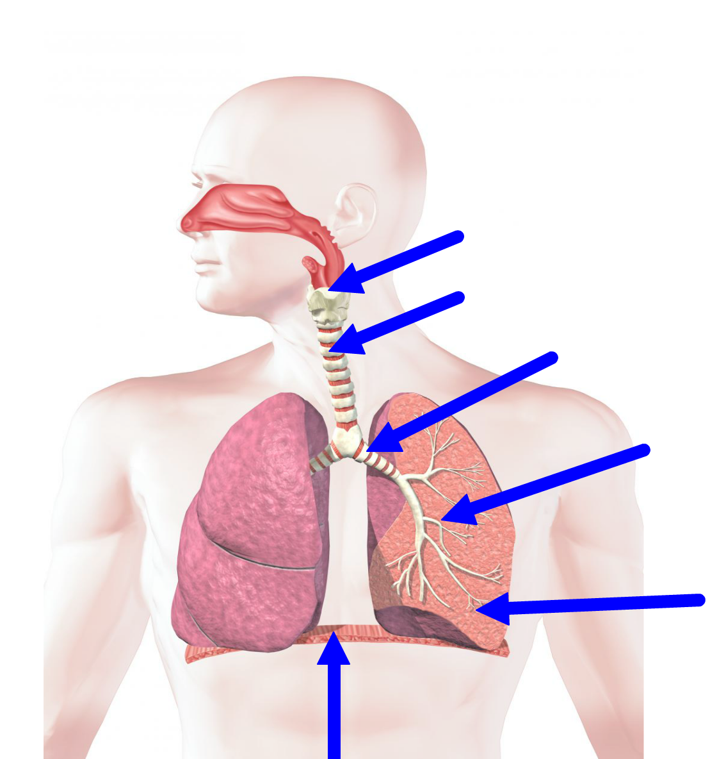
Lungs
A
B
C
D
E

Slide 2
Gas Exchange at the Alveoli
Describe the structure of the alveoili
Describe the functions of type I and type II pneumocytes
Explain how the alveoli are adapted for efficient gas exchange

Slide 3
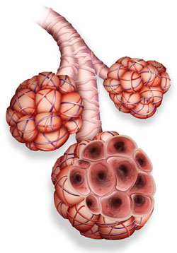
Alveoli
Site where gas exchange happens
Increase surface area
Thin walls – short diffusion pathway
Two types of cells:
Type I pneumocytes
Type II pneumocytes

Slide 4
Label the diagram
Explain how the two types of pneumocytes are adapted for their function

Slide 5
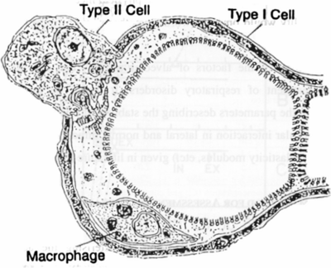
Type I pneumocytes
Extremely thin alveolar cells
Make up most of epithelial cells of alveoli
Flat cells
0.15um thick
Adjacent capillary also very thin
Very small diffusion space

Slide 6
Type II pneumocytes
Rounded cells
Occupy 5% of alveolar surface area
Secrete a fluid which coats the inner surface of the alveoli
Allows oxygen to dissolve before diffusing to the blood
Also prevents the capillary walls from sticking together and collapsing

