Slide 1
11.4 Sexual Reproduction Gametogenesis
Spermatogenesis and oogenesis both involve mitosis, cell growth, two divisions of meiosis and differentiation.
Processes in spermatogenesis and oogenesis result in different numbers of gametes with different amounts of cytoplasm

Slide 2
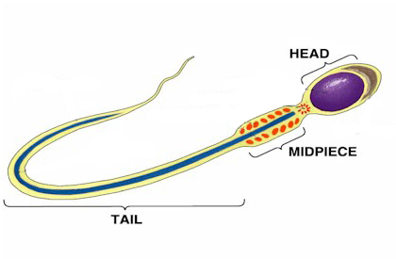

Slide 3
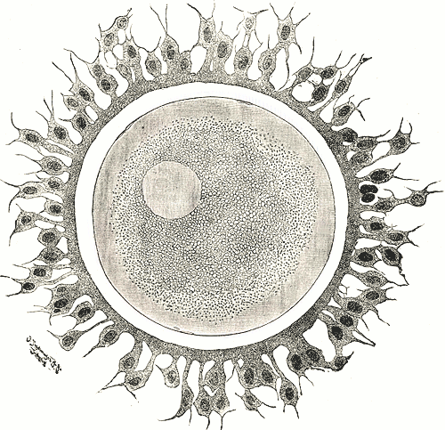

Slide 4
Annotate your cells
EGG CELL
Centrioles
Polar cell
Plasma membrane
Follicle cells
Zona pellucida
Cortical granules
Cytoplasm
Haploid nucleus
SPERM CELL
Haploid nucleus
Acrosome
Plasma membrane
Centriole
Mitochondria
Microtubules
Protein fibres in tail

Slide 5
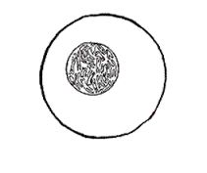
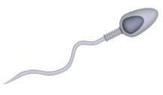
Gametogenesis – formation of gametes
Oogenesis
Production of egg cells in the ovaries
Spermatogenesis
Production of sperm in the testes

Slide 7
When does oogenesis start?
When the female is still a fetus!!
Although I was born in 198something, the egg that I came from was created in my grandmother’s womb–in Scotland, in 1952.
Want to calculate the vintage of the egg you came from? Take your mother’s date of birth and subtract about 20 weeks.
That’s true because unlike males, who constantly generate sperm after they hit puberty, girls are born with their one and only lifetime supply of eggs (immature eggs)

Slide 8
Oogenesis

Slide 9
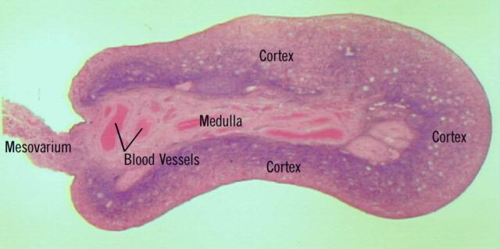
Oogenesis
Whilst a fetus
Diploid germ cells (oogonia) divide by mitosis in the developing fetus. These will distribute themselves throughout the cortex of the ovary

Slide 10
Oogenesis
Month 4: These cells start to grow and then start to divide by meiosis. Pause at prophase I.
Month 7: Still in first division of meiosis, follicle cells form around these cells (oocytes). The oocyte that has started to divide by meiosis and the follicle cells together, is called a primary follicle
A fetus has around 400,000 primary follicles at birth
No further development until after puberty

Slide 11
Oogenesis
At puberty
At the start of each menstrual cycle a small number of primary follicles (containing primary oocytes) are stimulated to develop by Follicle Stimulating Hormone (FSH)
The primary oocyte completes the first stage of meiosis and forms the secondary oocyte (together with the follicle cells: secondary/Graafian follicle). The follicle cells proliferate.
The second phase of meiosis starts but pauses
Mature/secondary oocyte released at ovulation

Slide 12
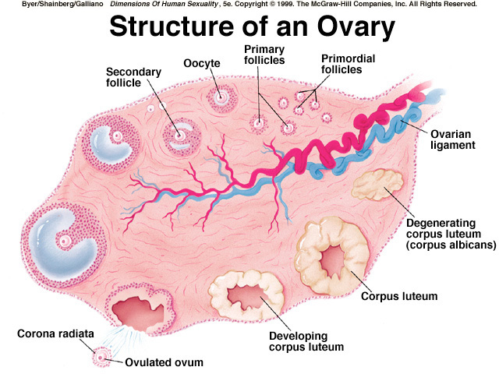
Annotate your diagram. Show when…
Mitosis
Cell growth
Meiosis I (starts and completes)
Meiosis II (starts)
oogenesis

Slide 13
Secondary oocyte
n
n
n
2n
n
2n
1st polar body – later degenerates
n
In ovary

Slide 14
True or False
An ovum (egg cell) is released during ovulation

Slide 15
Oogenesis
Germ cells (oogonia) in fetal ovary divide by mitosis
At 4 months, these cells grow and start meiosis I
At 7 months they are stuck in prophase I and follicle cells surround primary oocyte (together: primary follicle)
Start of menstrual cycle (stimulated by FSH) oocyte completes meiosis I and becomes a secondary oocyte. Follicle cells proliferate (together: secondary follicle)
Meiosis II starts
Ovulation of mature follicle containing the secondary oocyte
Meiosis II is completed at fertilisation
oogenesis

Slide 16
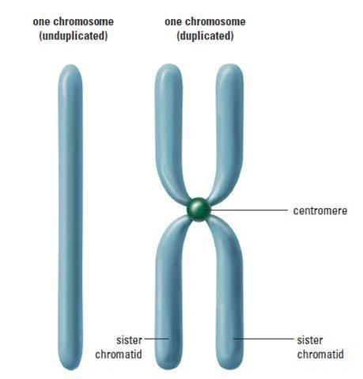
n
n

Slide 17
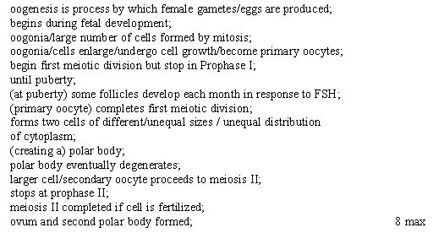
Outline the process involved in oogenesis in the human ovary [8 marks]

Slide 18
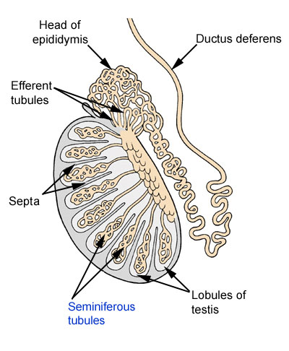
Spermatogenesis
Happens in the testes
Testes have a mass of narrow tubes called the seminiferous tubules

Slide 19
Between (not in) the tubules. Sometimes called Leydig cells
Cross section through a seminiferous tubule

Slide 20
Outside layer of seminiferous tubule

Slide 21
Spermatogenesis
Cells have various stages of sperm production
Most mature cells are closest to the fluid filled centre of the seminiferous tubule.
Cells that have developed a tail are spermatozoa (abbreviated to sperm)

Slide 22
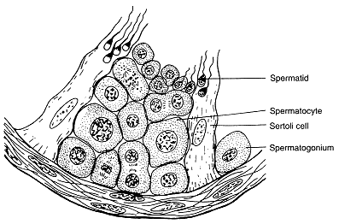
Annotate the seminiferous tubule
Primary spermatocyte
Secondary spermatocyte
Spermatogonium
Spermatids
Basement membrane

Slide 23
Spermatogenesis
Germinal epithelium cells divide endlessly by mitosis to make more diploid cells
Diploid cells grow larger and are then called primary spermatocytes (2n)
Each primary spermatocyte carries out first division of meiosis to produce two secondary spermatocytes (n)

Slide 24
Spermatogenesis
4. Each secondary spermatocyte (n) carries out second division of meiosis to produce two spermatids (n)
5. Spermatids become associated with nurse cells, called sertoli cells which help the spermatids to develop into spermatozoa (sperm cells) – differentiation
6. Sperm detach from sertoli cells and eventually are carried out of the testis by the fluid in the centre of the seminiferous tubule

Slide 25
Secondary oocyte
n
n
n
2n
n
2n
1st polar body – later degenerates
n
In ovary

Slide 28
Compare oogenesis and spermatogenesis
(5 marks)

Slide 29
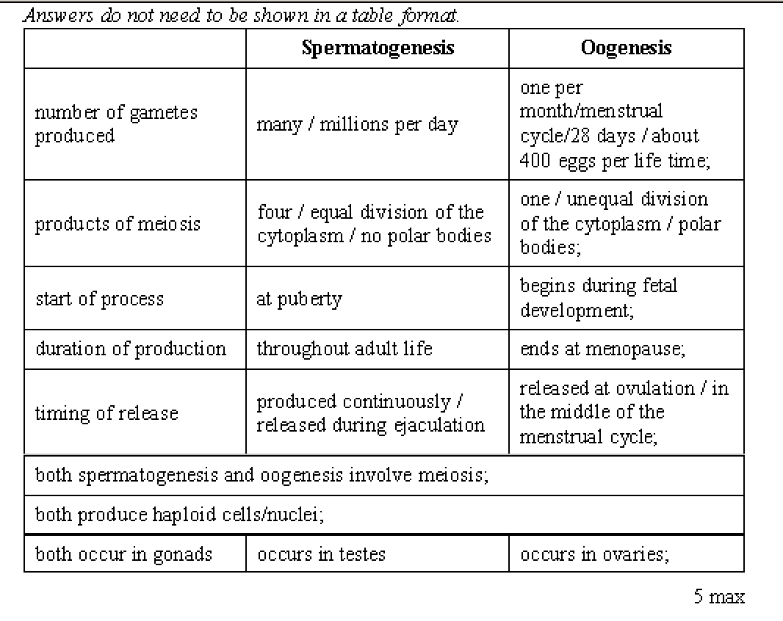

Slide 31
Similarities
Both require
Mitosis
Cell growth
Two divisions of meiosis
Differentiation

