Slide 1
Implantation and Placenta
Describe the stages between fertilisation and implantation
Describe the role of hCG
Outline the structure and function of the placenta

Slide 2
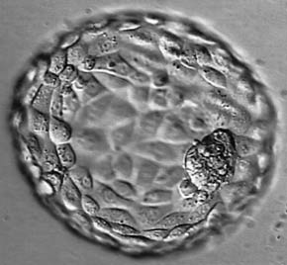
Implantation
After fertilisation
Ovum divides to form a 2 cell embryo
After 48 hours it becomes a 4 cell embryo
Following this there are unequal divisions and migration of cells giving the embryo the shape of a hollow ball: blastocyst

Slide 4
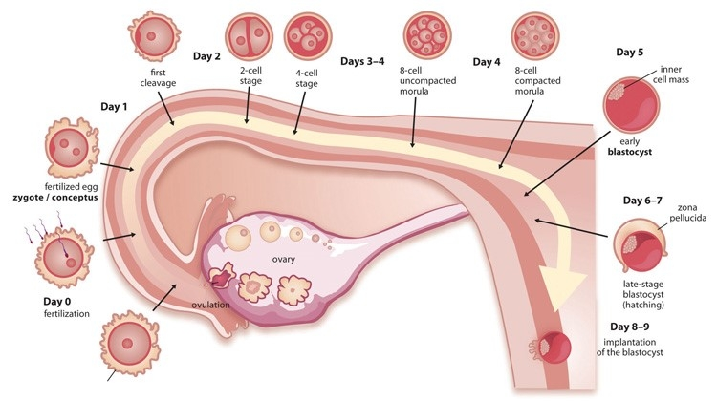
Read pages 507/508
Annotate your diagram to describe the events from fertilisation to implantation

Slide 5
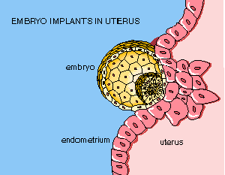
Implantation
At 7 days old the blastocyst reaches the uterus from the oviduct
The zona pelludica breaks down.
The blastocyst has used up the reserves of the egg cell and needs an external supply of food
Sinks into the uterus lining: Implantation

Slide 6
Implantation
Outer layer of the blastocyst develops finger-like projections allowing the blastocyst to penetrate the uterus lining.
Exchange of materials from mother’s blood
At 8 weeks it forms bone tissue and is called a fetus

Slide 7
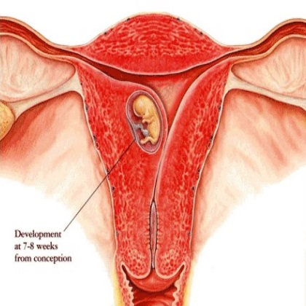
Role of hCG hormone
Produced early in the pregnancy by the embryo/placenta
Stimulates the corpus luteum in the ovary to continue secreting progesterone and estrogen. It prevents the corpus luteum from degenerating
This ensures the continued development of the uterus wall, which supplies the embryo with everything it needs.

Slide 9
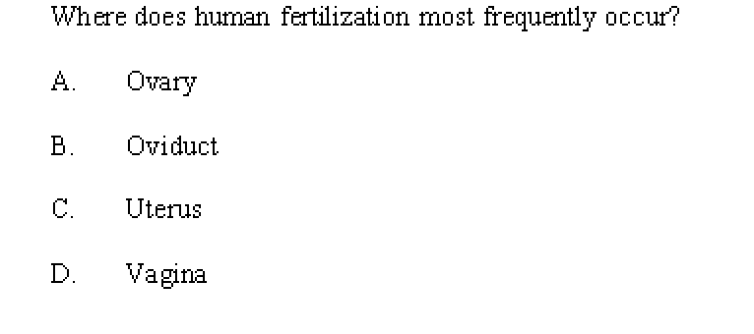
B

Slide 10
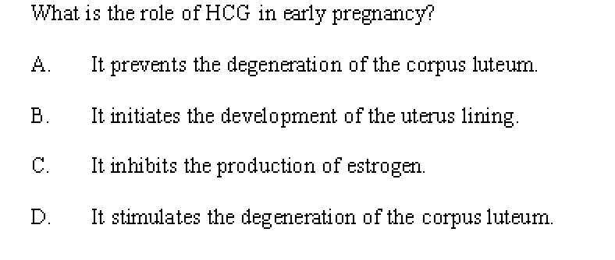
A

Slide 11
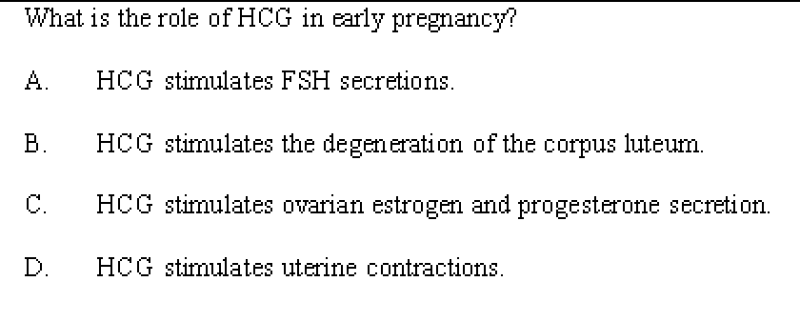
C

Slide 12
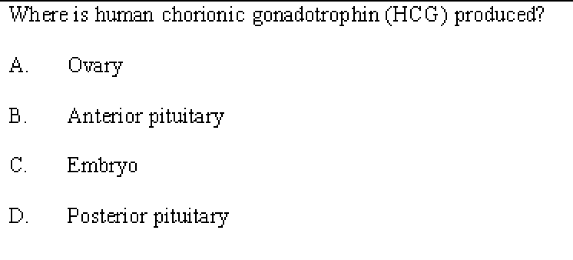
C

Slide 13
D

Slide 14
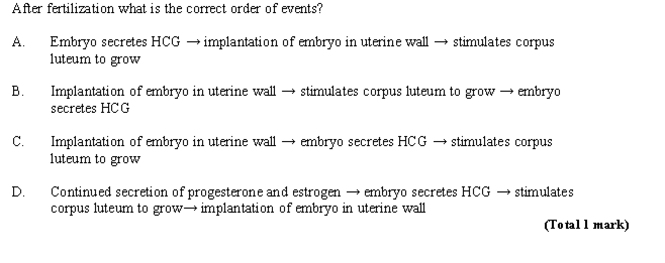
C

Slide 15
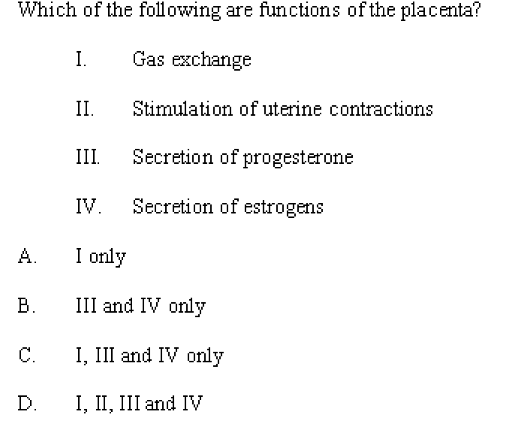

Slide 16
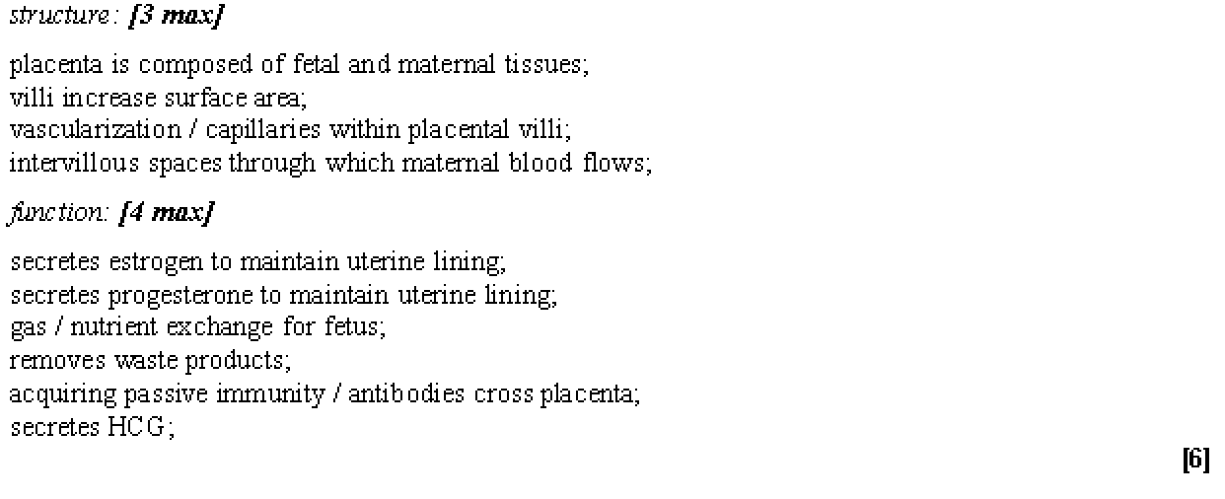

Slide 17
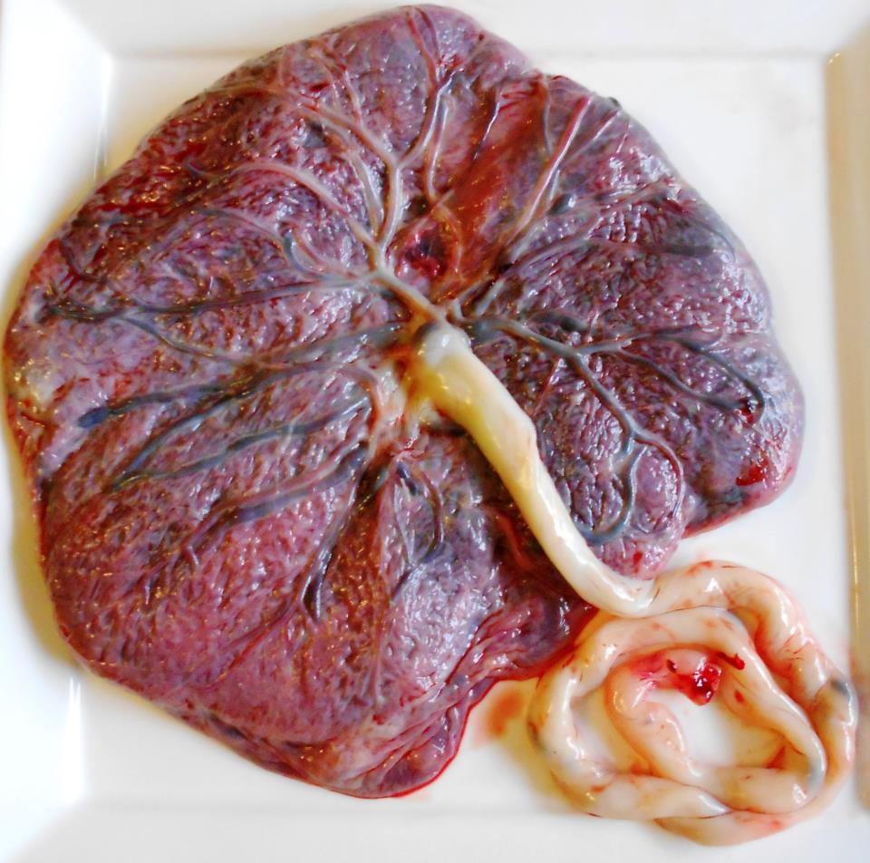

Slide 18
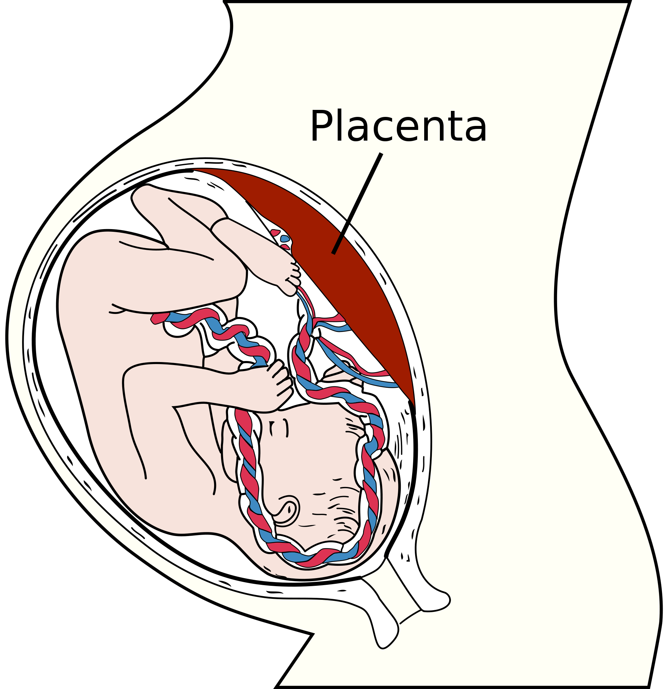
The placenta
Allows the fetus to remain in the uterus for longer
Body surface area to volume ratio becomes smaller as the fetus grows (hard to absorb nutrients)

Slide 19
The placenta
Made of fetal and maternal tissues
In contact with maternal tissues in the uterus wall (endometrium)
Amniotic sac also develops from fetal tissues
Contains amniotic fluid which protects and supports the fetus

Slide 22
The placenta
The placenta contains many finger-like placental villi
Increase in number during pregnancy to help supply growing demands of the fetus
Maternal blood flows in the inter-villous spaces around the villi
Fetal blood circulates in capillaries close to the surface of the villus
Very small distance between fetal and maternal blood
Placental barrier separates maternal and fetal blood (5μm)
Selectively permeable to allow some substances to pass through

Slide 23
The placenta
From maternal blood to fetal blood
Glucose
Oxygen
Antibodies
Water
From fetal to maternal
Carbon dioxide
Urea

Slide 24
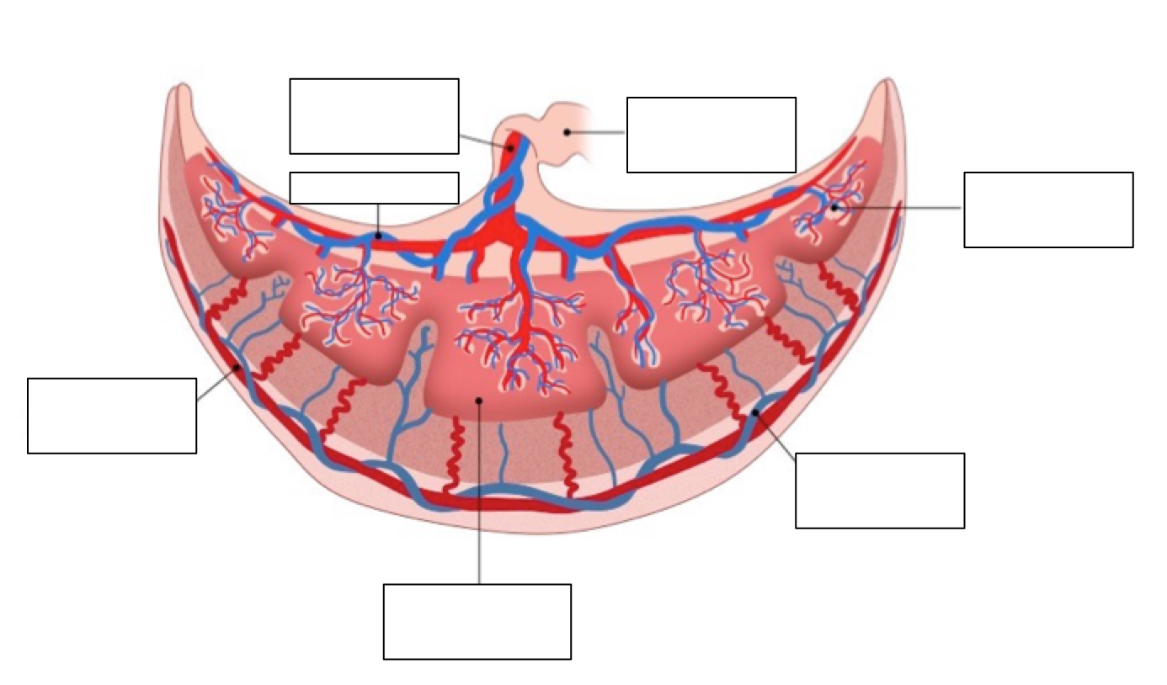

Slide 25
Inter-villous space
endocytosis
Placental/chorionic villus
urea
Carbon dioxide
Fetal vein
Maternal vein
Maternal artery
diffusion
oxygen
water
Facilitated diffusion
antibodies
osmosis
glucose
Fetal artery
Umbilical cord

Slide 26
Water Water

Slide 28
Hormones
Before week 9: What secreted estrogen and progesterone?
Week 9: Placenta starts to secrete estrogen and progesterone
Corpus luteum no longer needed so starts to degenerate
Danger of miscarriage if this switch over fails
Progesterone inhibits
Oxytocin secretions by pituitary gland
Muscle contractions in uterine wall

Slide 29
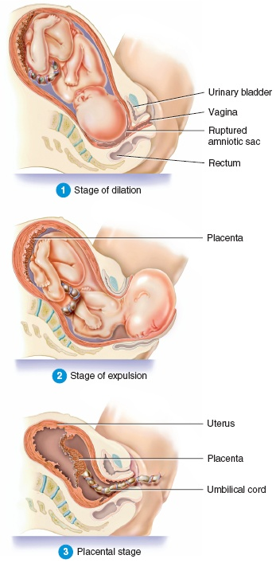
Parturition – ‘childbirth’
At the end of the pregnancy the fetus produces hormones to stop the placenta secreting progesterone.
Oxytocin is then secreted

Slide 30
Parturition
Oxytocin stimulates contractions of the muscle fibres in the outer uterus wall (myometrium).
Contractions detected by stretch receptors.
This causes more oxytocin to be secreted
Which means more contractions (frequent and vigorous)
Which means more oxytocin secretions

Slide 31
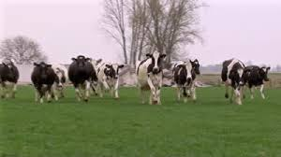
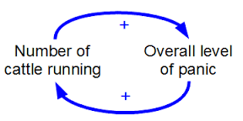
Positive feedback

Slide 32
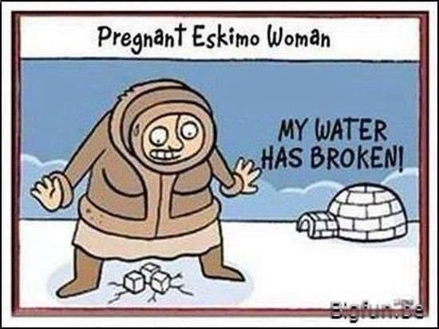
Parturition
Muscles in the cervix relax and start to dilate
Uterine contraction causes the amniotic sac to burst letting the amniotic fluid leak out (water breaking)

Slide 33
Parturition
Hours of uterine contractions later the baby is finally pushed out of the cervix and vagina
Umbilical cord is broken and the baby takes its first breath – being independent from its mother.

Slide 34
Create a flow diagram to describe what happens during parturition.
Frequent
Amniotic fluid
Oxytocin
Secretion
Cervix
Amniotic sac
Vagina
Umbilical cord
Independence
Dilate
Progesterone
Contractions
Positive feedback
Uterus wall
Vigorous
Relaxation

Slide 35
Data Q page 509

Slide 36
Gestation times
Mammals have different growth and development strategies
Altricial
Precocial
What are they?
What size are the animals usually?
Do they have a longer or shorter gestation time?
Give an example of each

Slide 37
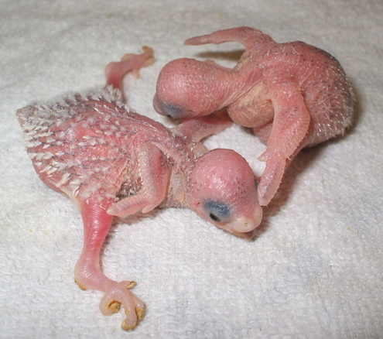
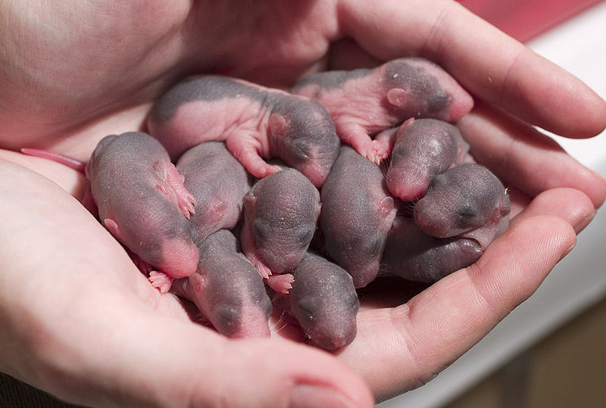
Altricial
Helpless
Incompletely developed offspring
Relatively immobile
No hair
Cannot obtain food themselves

Slide 38
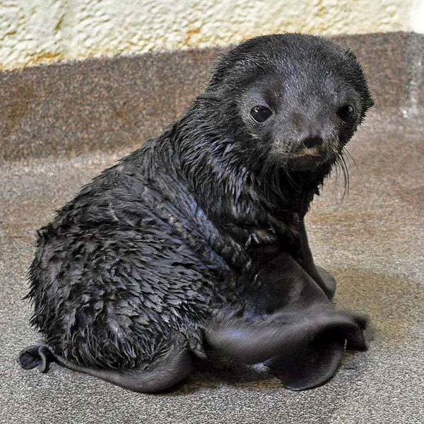
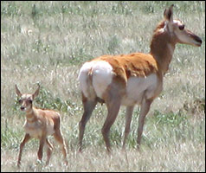
Precocial
Open eyes
Hair
Immediately mobile
Able to defend for themselves somewhat
Larger mammals
Longer gestation period

Slide 39
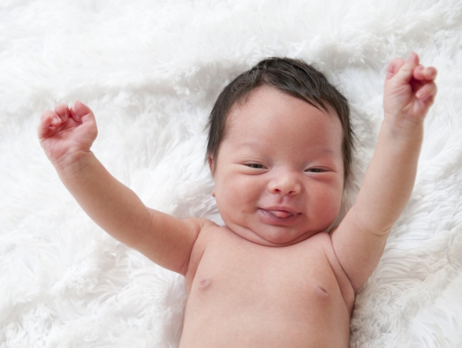
What are we?
Open eyes
Some hair
Not mobile
Can’t defend for ourselves
Cannot obtain food for ourselves

Slide 40
Intermediate
Open eyes
Some hair
Not mobile
Can’t defend for ourselves
Cannot obtain food for ourselves

