Slide 1
Ferilisation

Slide 2
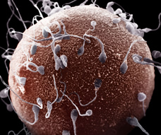
Fertilisation
Union of a sperm and egg cell to form a zygote
Sperm membranes have receptors to detect chemicals released by the egg.
This allows directional swimming.
Multiple sperm will arrive at the egg at the same time.

Slide 3
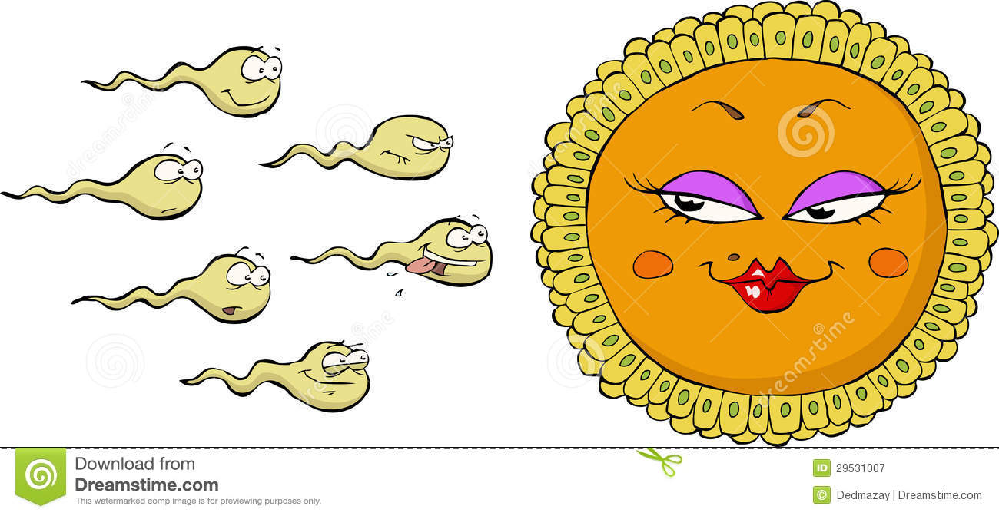
Preventing polyspermy
Meaning?
Acrosome reaction
Penetration of egg membrane
Cortical retraction

Slide 6
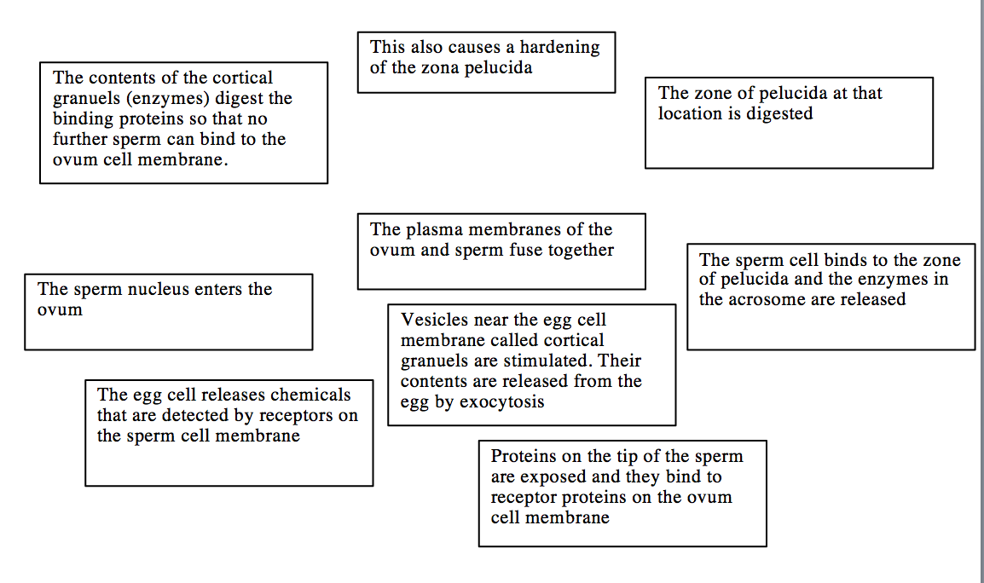

Slide 7
Acrosome reaction
Zona pellucida is a coat of glycoproteins around the egg
Acrosome is a large membrane bound sac of enzymes in the head of the sperm
Sperm binds to zona pellucida and the contents of the acrosome are released – including enzymes that digest the zona pellucida

Slide 8
Penetration of the egg membrane
An area of the membrane on the tip of the sperm is now exposed.
Proteins here that can bind with the egg membrane
First sperm membrane binds with egg membrane
Sperm nucleus enters the egg cell (fertilisation).

Slide 9
Cortical reaction
Sperm causes the activation of the egg
Affects cortical granules first (vesicles located near the egg membrane)
Contents released by exocytosis
Results in the digestion of binding proteins so that no further sperm can bind
General hardening of the zona pellucida

Slide 11
Types of fertilisation
Internal
Terrestrial animals
Gametes otherwise at risk of drying out
Ensures gametes are in close proximity to each other
Protection inside female
External
Release gametes into water directly
Susceptible to predation and environmental conditions
(temperature, pH, pollution)

