Slide 1
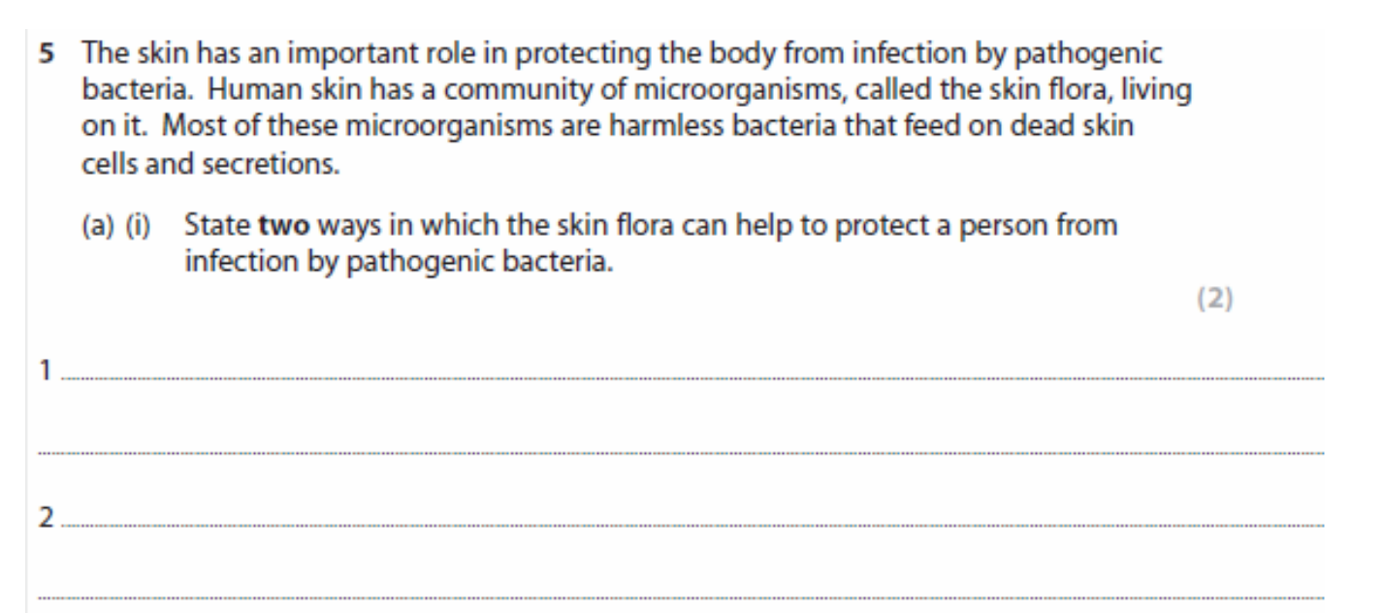
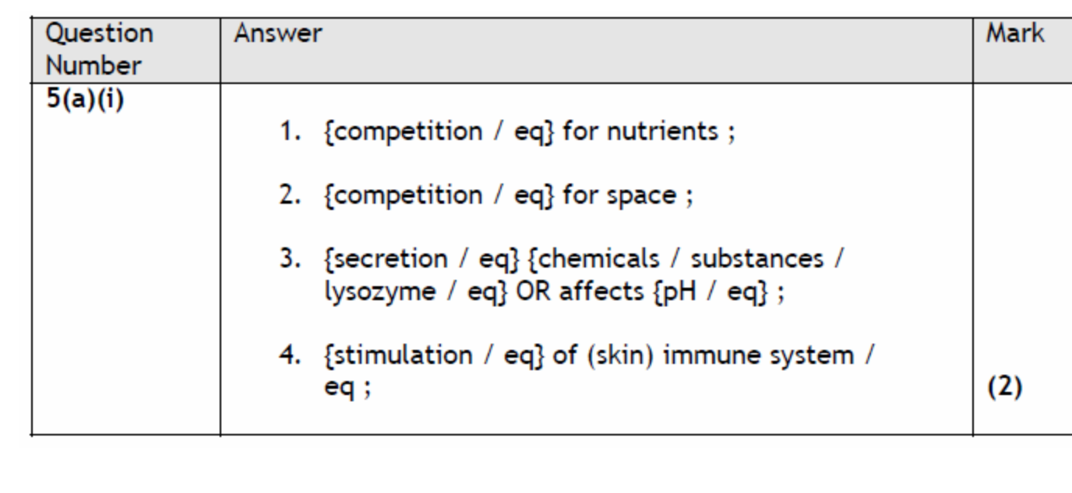

Slide 2
11 – Animal Physiology (HL) 11.1 – Antibody Production and Vaccination
Describe how T and B cells are involved in the specific immune response
Describe the role of antibodies in attacking pathogens

Slide 3
Non Specific Immune Response
Cell type?
Macrophages are Phagocytes.
If a ‘foreign’ cell enters the body the macrophage recognises it as ‘non-self’

Slide 4
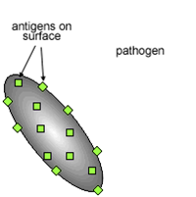
Antigens
All cells have markers on their surface made from protein.
Most cells have antigens.
Not just pathogens

Slide 6
Red blood cells have antigens. That determines your blood group:
A – A antigens
B – B antigens
AB – Both A and B antigens
O – Neither A or B antigens
There are also antigens called Rhesus antigens (Rh)
Rh positive – Has Rh antigen
Rh negative – Does not have Rh antigen
Why is O negative known as the universal donor?

Slide 7
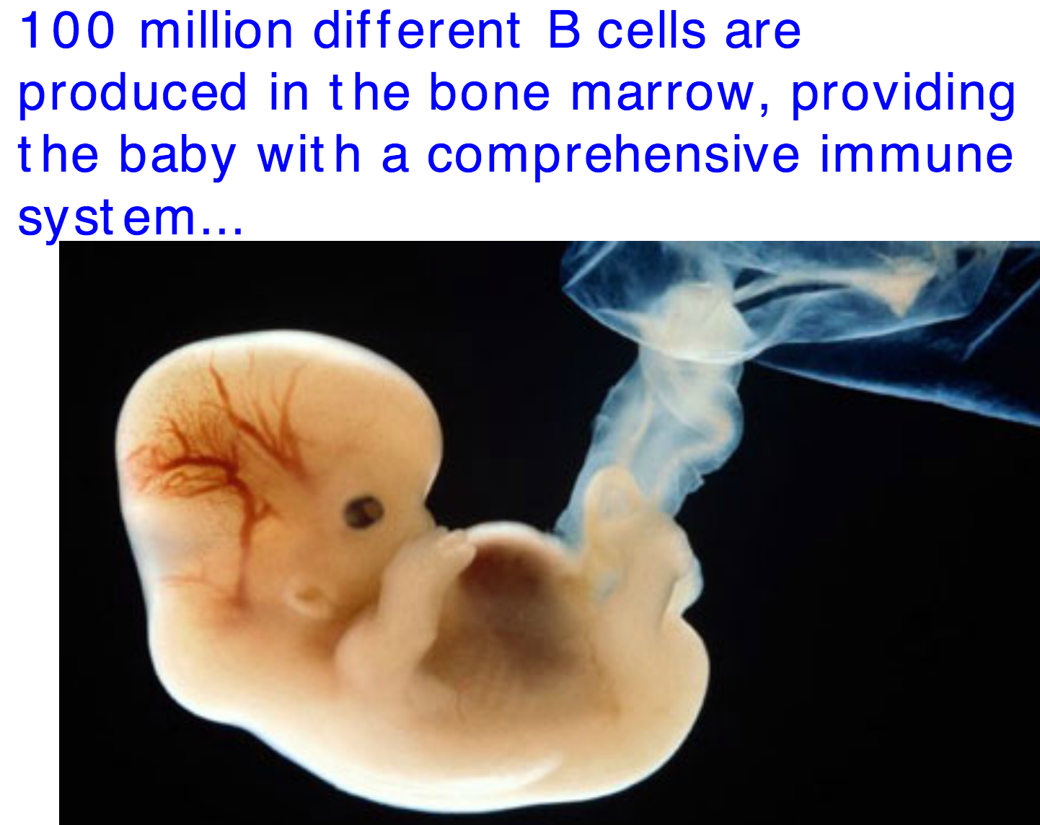
T cells and B cells
These are lymphocytes and are involved with the specific immune response
There are not many of each type though!

Slide 8
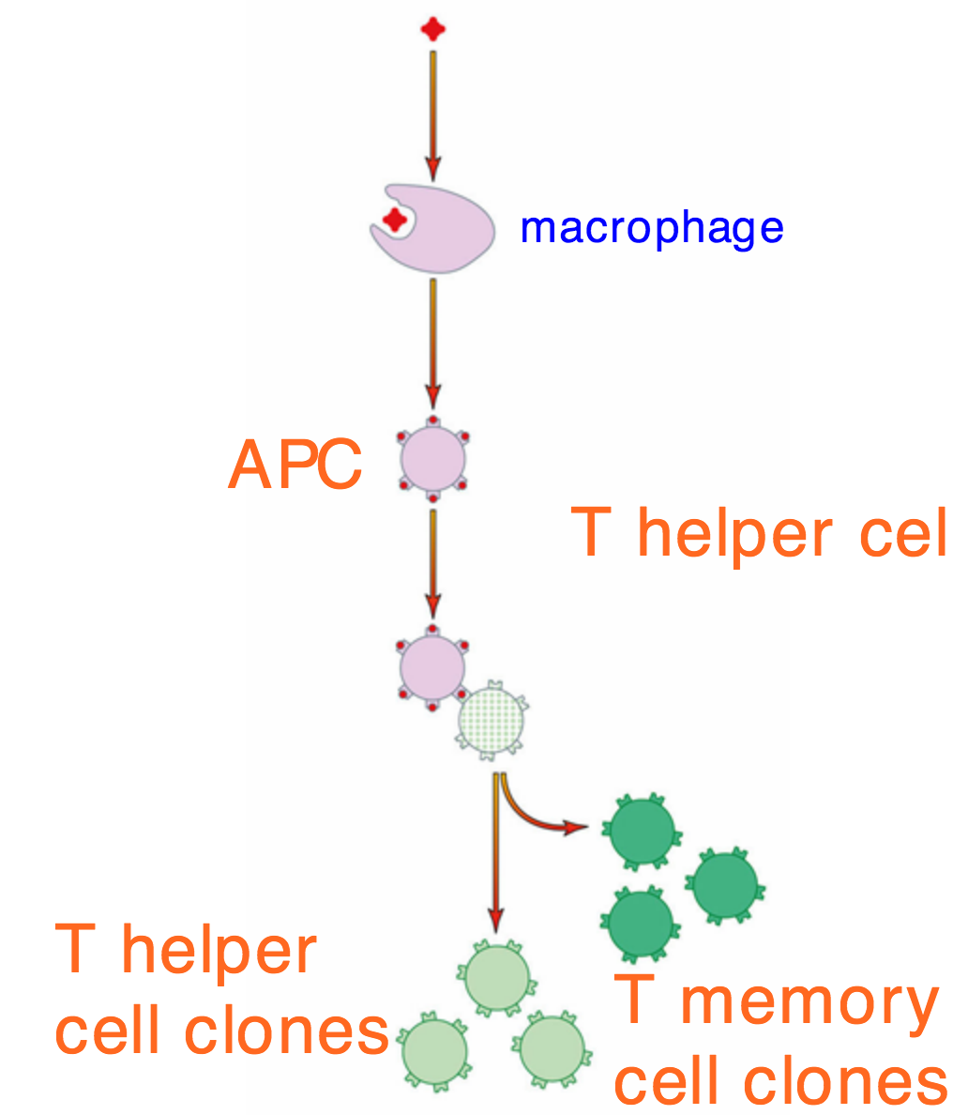

Slide 10
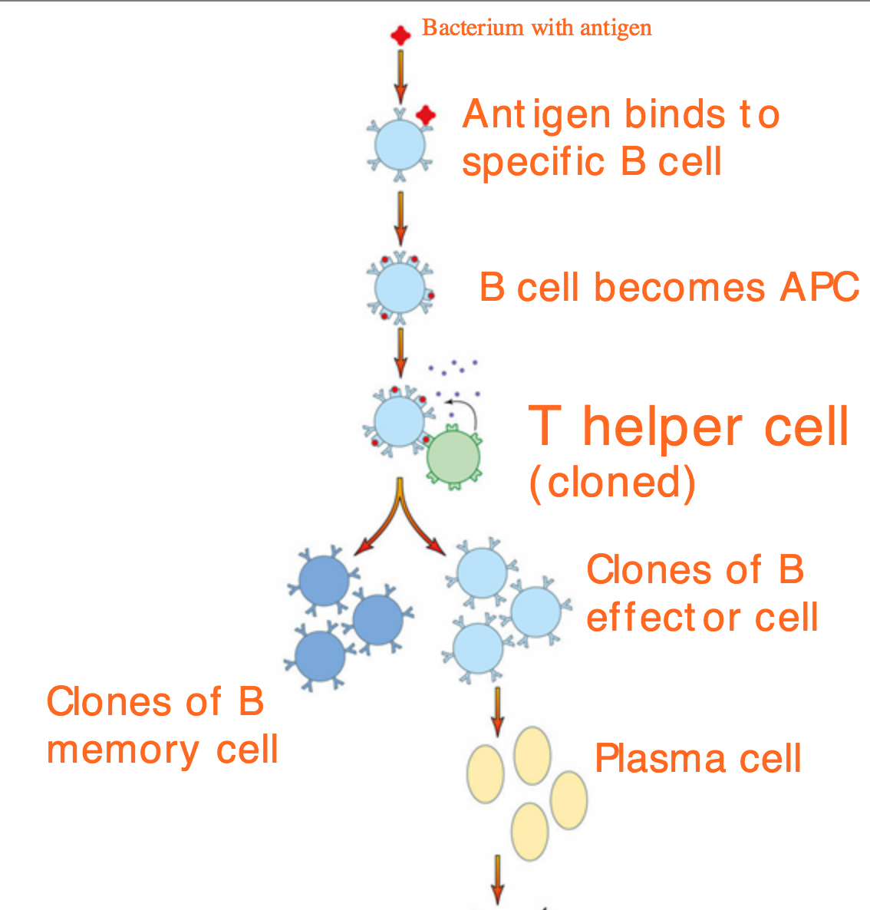

Slide 11
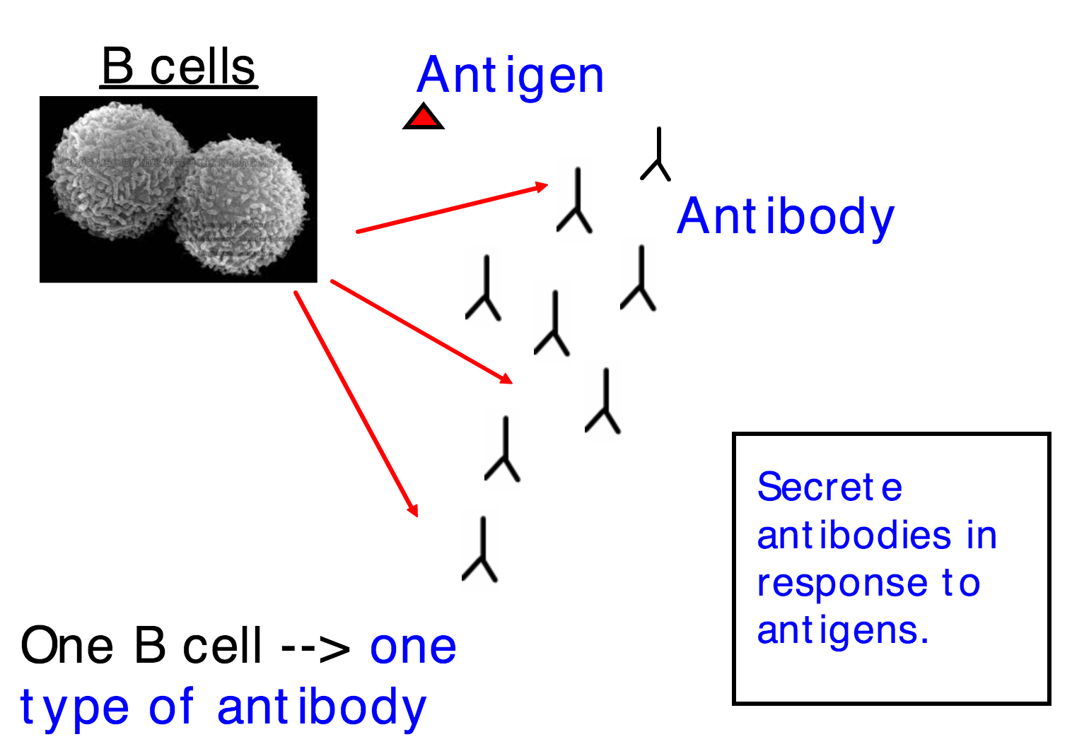

Slide 12
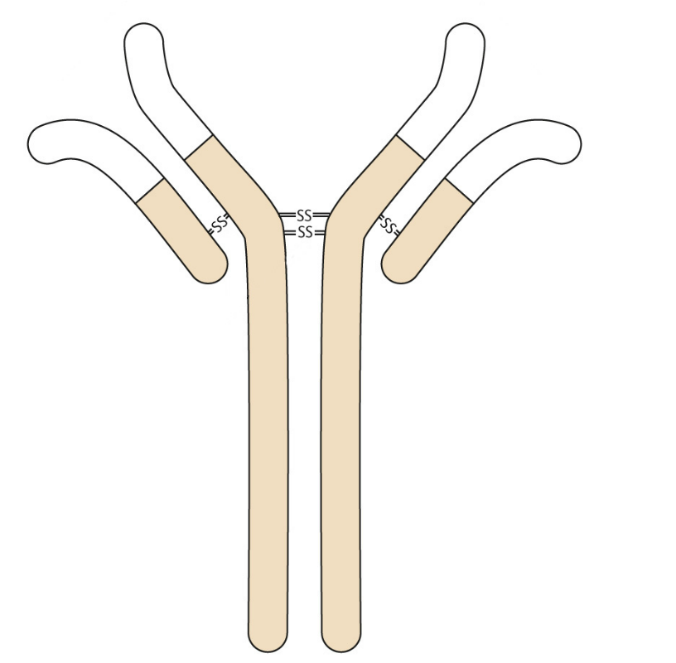
What do antibodies actually do to pathogens?
Represent in pictures
Antibodies

