Slide 1
10.3 Gene Pools and Speciation
Skills:
Comparison of allele frequencies of geographically isolated populations
Understanding:
A gene pool consists of all the genes and their different alleles, present in an interbreeding population
Evolution requires that allele frequencies change with time in populations
Reproductive isolation of populations can be temporal, behavioral or geographic
Speciation due to divergence of isolated populations can be gradual
Speciation can occur abruptly
Nature of science:
Looking for patterns, trends and discrepancies: patterns of chromosome number in some genera can be explained by speciation due to polyploidy
Applications:
Identifying examples of directional, stabilizing and disruptive
Speciation in the genus Allium by polyploidy
Evolution

Slide 2
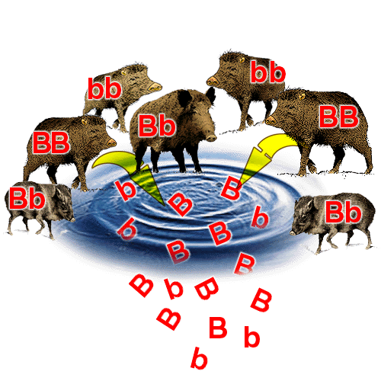
Gene pool
All genes and their alleles present in an interbreeding population
Populations that can interbreed are of the same species
Individuals that reproduce contribute to the gene pool of the next generation

Slide 3
Evolution
The changes don’t get reset every generation
“The cumulative change in the heritable characteristics of a population over time”

Slide 4
Evolution
Requires allele frequency to change with time in populations
Mutations
Selection pressures favouring certain alleles/characteristics will effect allele frequency
The two peppered moths still have the a same genes but allele frequency has changed
Where do new alleles come from?

Slide 5
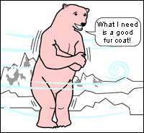
Natural Selection
Fitness of a genotype = likelihood that the genotype/phenotype will appear in the next generation.
Pressures include:
Stabilizing selection
Disruptive selection
Directional selection

Slide 6
Types of selection
Slide 1-What is meant by your type of selection?
Slide 2 – An example
Disruptive (Maggie/Cherrie)(Kelly/Charlotte)
Directional (Jason/Nicole)(Tiffany/Ingrid)
Stabilizing (Daniel/Bobo)(Wai Lam/Jessica)
Present start of lesson monday

Slide 7
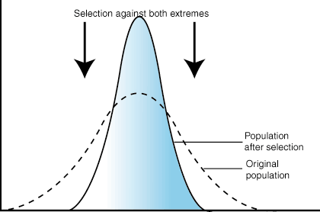
Stabilizing selection
Remove extreme varieties
Number of eggs a bird produces
Too many eggs – resources not available to keep them all alive
Too few eggs – risk none survive

Slide 8
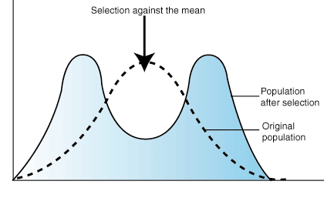
Disruptive selection
Extremes favoured

Slide 9
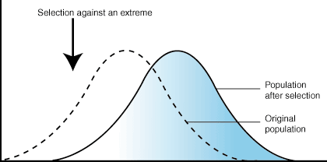
Directional selection
Select against one of the extremes
Evolution of African elephant tusk length – would the graph look the same?

Slide 10
Pg 456 - 458 Data Questions

Slide 12
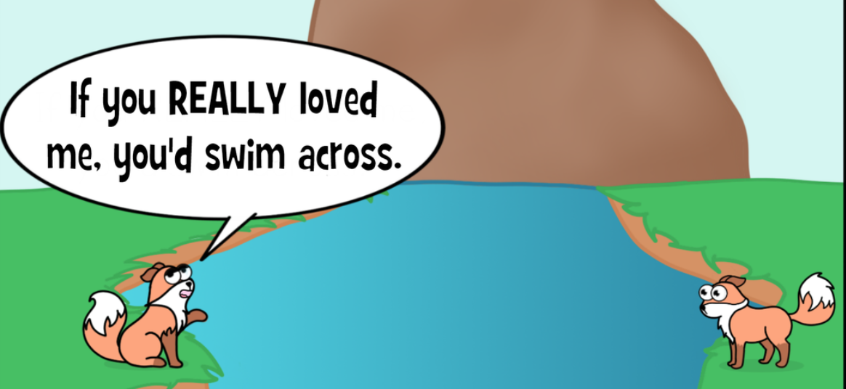
Speciation
Formation of a new species by the splitting of an existing population
Barriers to gene flow emerging between populations
Speciation is the result of reproductive isolation – Members of the same species no longer mate with each other

Slide 13
Speciation by Reproductive Isolation
Why might some members of a population become reproductively isolated?
Allopatric speciation – geographically separated
Sympatric speciation – changes in same geographic area
Temporal speciation – Mating times may change
Behavioural speciation – Behaviour changes
Speciation

Slide 14
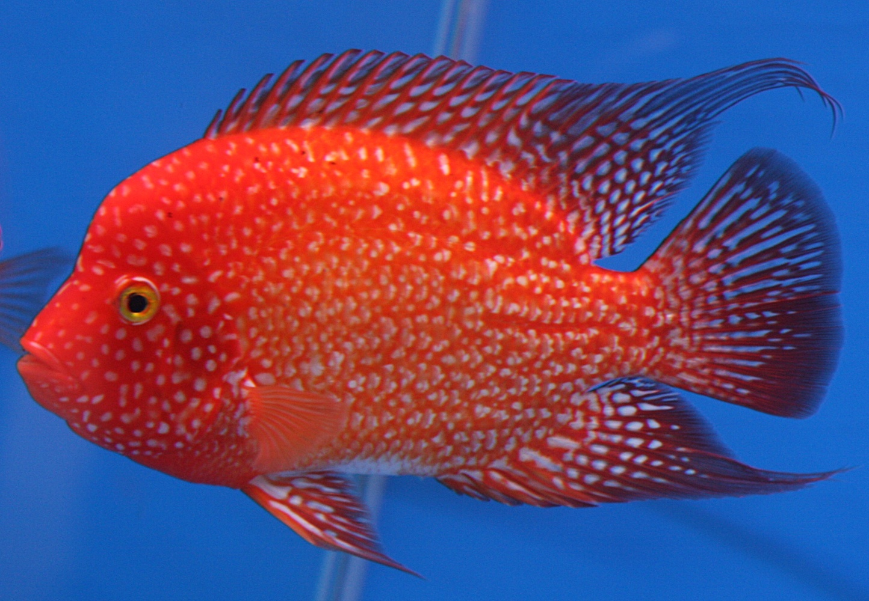
Reproductive Isolation
Allopatric speciation: Geographical separation of populations leading to speciation
Cichlids

Slide 15
Cichlids
In East African lakes:
Lake Victoria
Lake Tanganyika
Lake Malawi
Fluctuations in water levels = isolation of populations that are then subject to different selection pressures
Populations recombined when rainy season comes but they are reproductively isolated

Slide 16
Reproductive Isolation
Sympatric speciation: Isolation of gene pools in the same geographic area leading to speciation
Behaviour changes: differing courtship behaviour – only able to attract members of their own population
Temporal changes: populations may mate/flower in different seasons

Slide 17
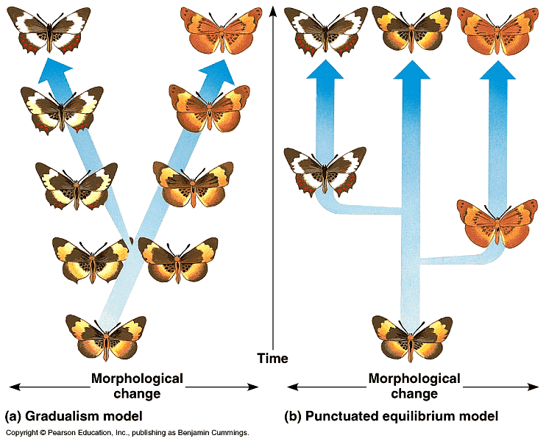
Gradualism vs Punctuated equilibrium
Gradualism
Species slowly change through a series of continuous intermediate forms

Slide 18
Gradualism vs Punctuated equilibrium
Punctuated equilibrium
Long periods of relative stability punctuated by periods of rapid evolution

Slide 19
Evidence?
Gradualism
Fossil record shows many gradually changing forms as species change
Punctuated equilibrium
‘Gaps’ in fossil record
Geographic isolation can lead to rapid speciation

Slide 20
Polyploidy
Organism with more than two sets of homologous chromosomes
Chromosomes duplicate in preparation for meiosis but then meiosis doesn’t occur – results in a diploid gamete. The diploid gamete can then fuse with a haploid gamete and produce fertile offspring
Polyploid plants can self pollinate so these are more common than animals
This can then lead to sympatric speciation

