Slide 1
Suggest why mice with white fur are rarely found in the wild

Slide 2
Variation, Natural Selection, Evolution and Speciation
Describe how some organisms are better adapted to their environment
Describe how selection pressures lead to some organisms being selected
Apply natural selection to short term examples of evolution

Slide 3
The Origin of Species - 1859

Slide 4
Variation

Slide 5
VARIATION
How would you define variation?

Slide 6
Variation?

Slide 7
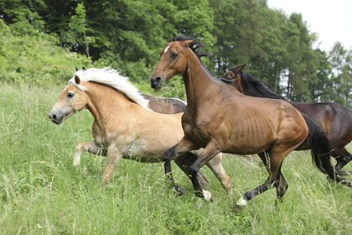
Keyword
VARIATION
Organisms of the same species with different characteristics
Variation can be affected by the environment or genes
(or both!)

Slide 8
Sources of Variation
Mutations
New alleles are formed from gene mutations
Meiosis
Meiosis produces new combinations of alleles through independent assortment and crossing over
Sexual Reproduction
Fusion of male and female gametes so offspring inherit inherit different combinations of alleles

