Slide 1
What are you worth?

Slide 2
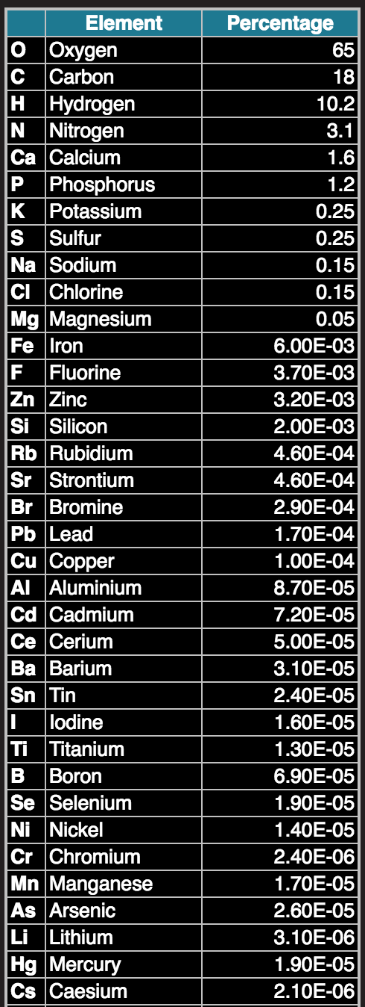

Slide 3
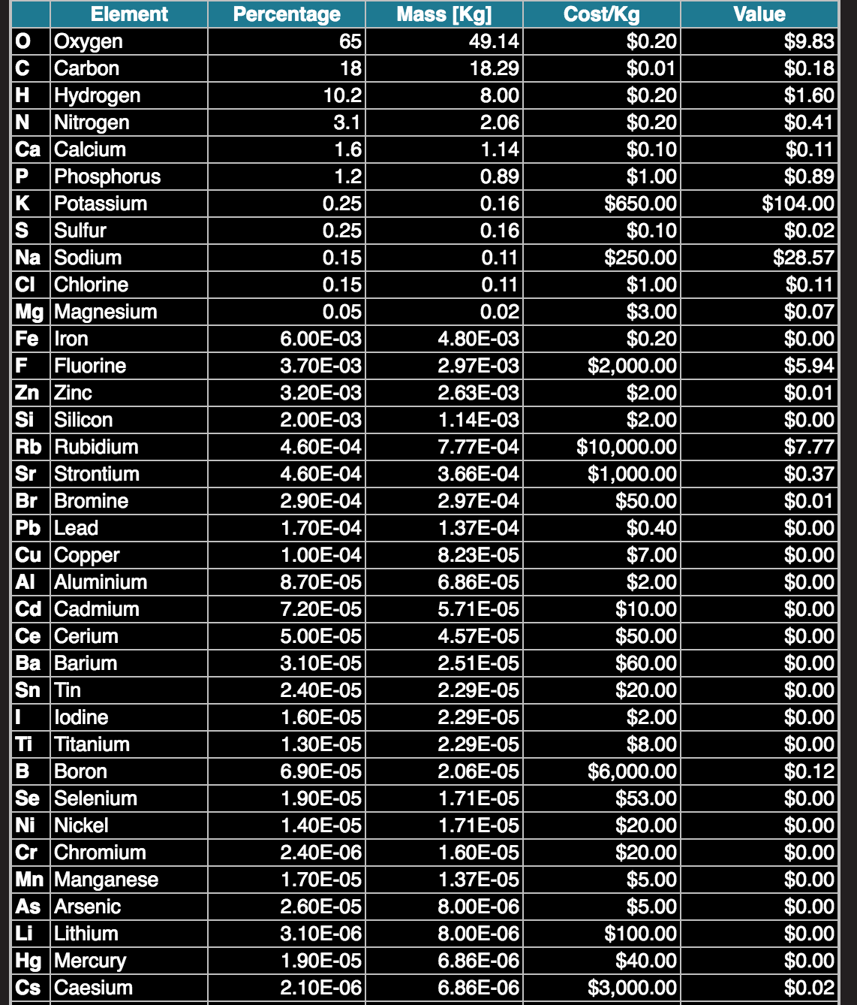
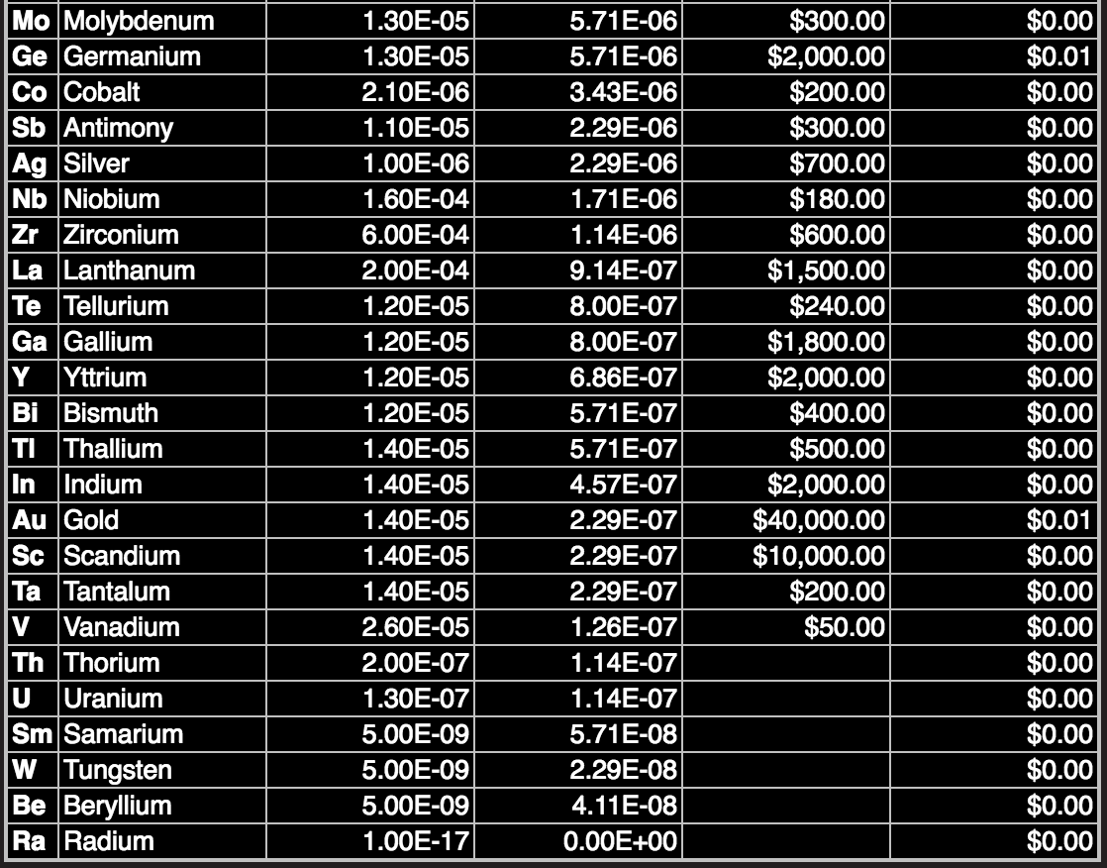

Slide 4
What are YOU worth?
$160
HKD 1251.03

Slide 5
2.1 Molecules to Metabolism
State the four most common elements found in living organisms
Describe the difference between organic and inorganic molecules
Describe examples of carbon compounds
Define metabolism
Describe how macromolecules are both built and broken down

Slide 6
Four most common elements in living organisms
C
H
O
N

Slide 7
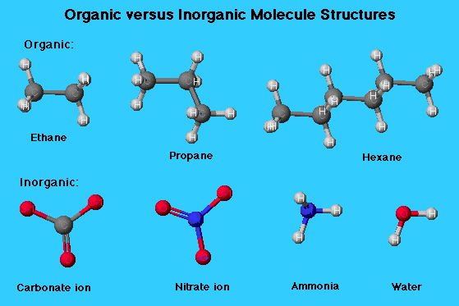
Inorganic or organic?
Organic compounds = carbon, contain C-H bonds
Inorganic compounds = no carbon, no C-H bonds
Exceptions…
Carbon dioxide – has carbon but is inorganic (no C-H bond)
Urea – has no C-H bond but is organic

Slide 8
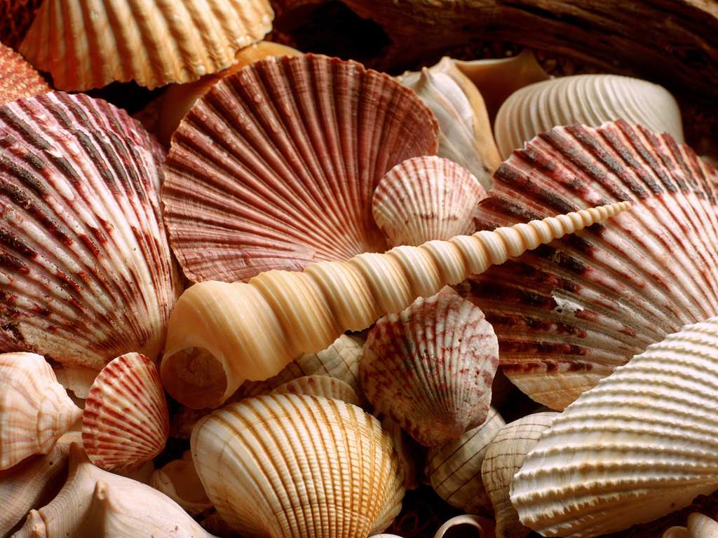
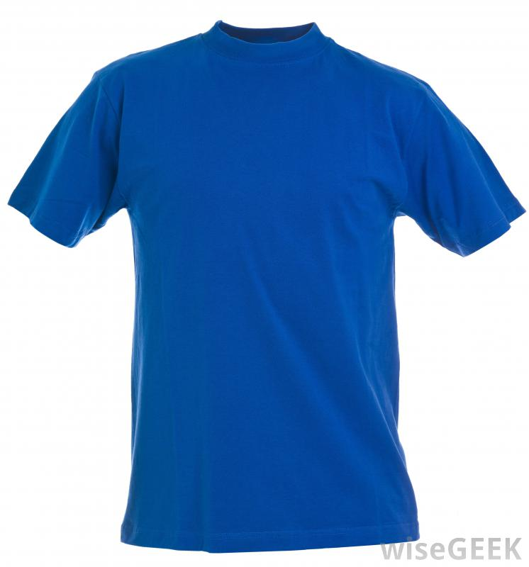
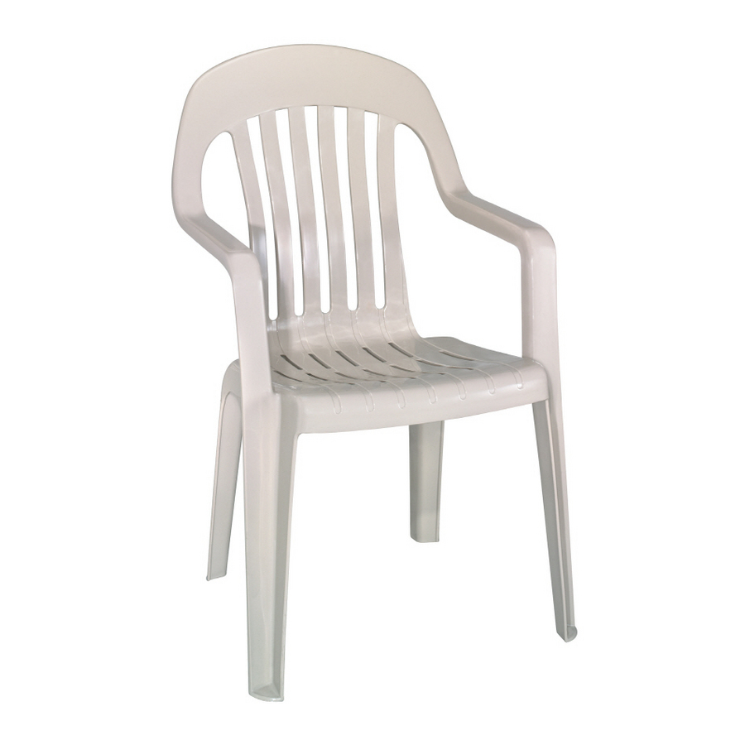

Slide 9
Life is based on carbon compounds

Slide 10
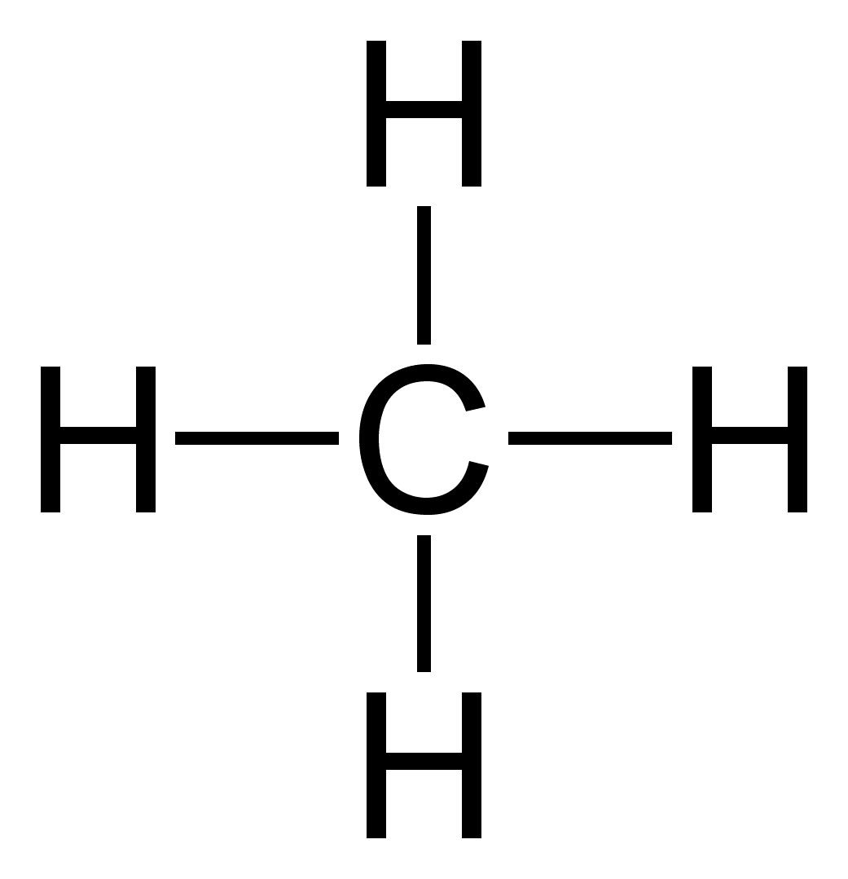
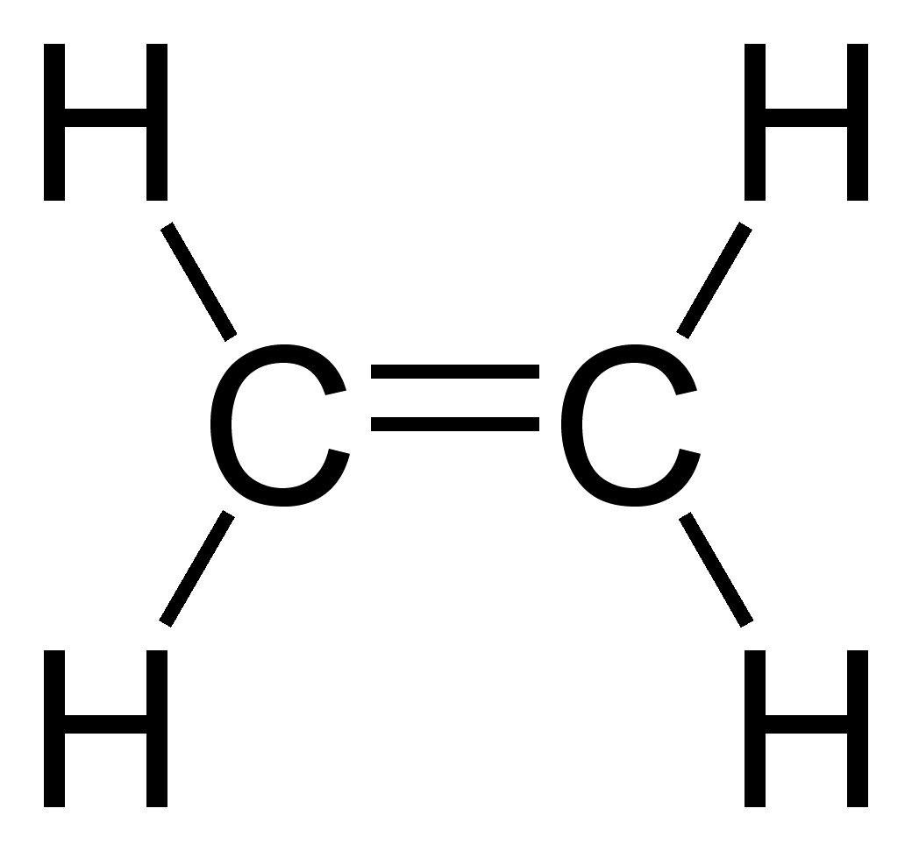
Carbon compounds
Other elements can be added to carbon to make complex 3D molecules
Rules?
Carbon has 4 covalent bonds

Slide 11
Carbon compounds
Carbohydrates
Lipids
Proteins
Nucleic acids

Slide 12
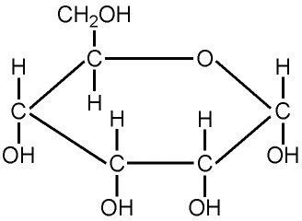
Carbohydrates
Carbon
Hydrogen
Oxygen
2 hydrogen:1 oxygen
These sugars can form pairs or long chains
Some sugars join other molecules (e,g. deoxyribose)

Slide 13
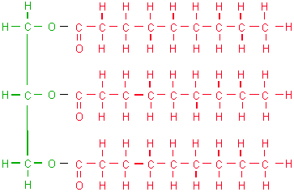
Lipids
Fatty acid tail
Carbon
Hydrogen
Oxygen

Slide 14
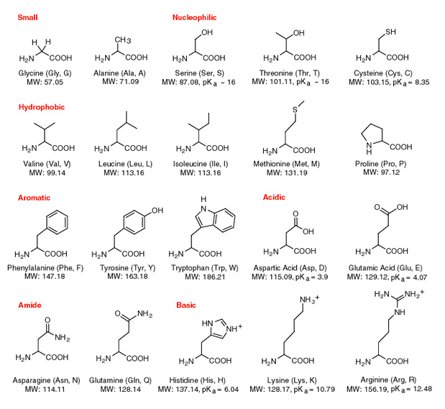
Proteins
Chain of amino acids (there are 20)
Contain: carbon
hydrogen oxygen nitrogen
Some contain: sulphur

Slide 15
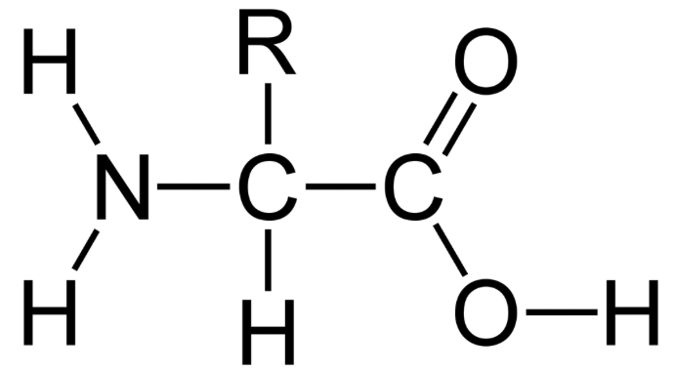
General structure of an amino acid

Slide 16
Nucleic acids
Chains of nucleotides
Carbon
Hydrogen
Oxygen
Nitrogen
Phosphorus
e.g.
RNA
DNA

Slide 17
“Drawing molecular diagrams of glucose, ribose, a saturated fatty acid and a generalised amino acid”
20 seconds to look
Draw using pencil
Correct any mistakes

Slide 18
Glucose

Slide 19
Ribose

Slide 20
Saturated Fatty Acid

Slide 21
Amino Acid

Slide 22
Functional Groups
Draw the structure of the functional groups on page 65

Slide 23
Identify the molecule
Are the molecules amino acids, lipids or carbohydrates?
Highlight any functional groups you can find Complete the worksheet

Slide 24
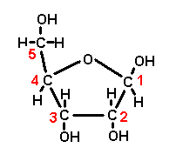
Identify the molecule
Carbohydrate
(Ribose)

Slide 25
Identify the molecule
Lipid
(Stearic acid)

Slide 26
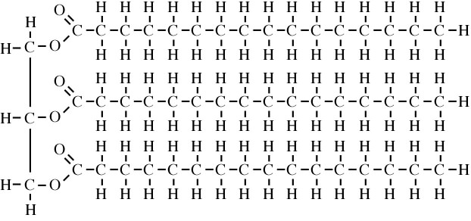
Identify the molecule
Lipid
(Triglyceride)

Slide 27
Identify the molecule
Amino acid

Slide 28
Type of metabolism | What is it? | What happens to the energy?
Anabolism
Catabolism
Page 67

Slide 29
Metabolism
Sum of all enzyme catalysed reactions in an organism (both intra and extracellular)
A number of pathways – one molecule is transformed into another in a series of small steps
Anabolism
Catabolism

Slide 30
Anabolism
Build up larger molecules from smaller ones
Require energy (ATP)
Form macromolecules from monomers

Slide 31
Catabolism
Larger molecules broken down into smaller ones
Release energy – re-used in the cell
Macromolecules into monomers

