Slide 1
How do you get bigger?

Slide 2
Type of cell division

Slide 3
1.6 Cell Division Mitosis
Describe events during interphase
Draw the stage of mitosis
Recognise the stages of mitosis from diagrams an micrographs

Slide 4
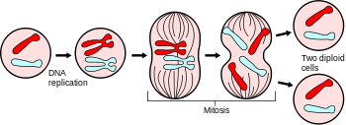
Mitosis
Cell division for growth and repair
Produces two genetically identical nuclei. The cell then divides.

Slide 5
46
46
46

Slide 6
The Cell Cycle
G1 – Cells organelles duplicate
S – All the DNA is replicated
G2 – Cell repairs any damage to DNA. Produces all enzymes required for cell division
During interphase all of the DNA in the cell is copied. Why?
G0 – Sometimes cells don’t go on to divide right away. They can remain in G0 phase.
G0

Slide 7
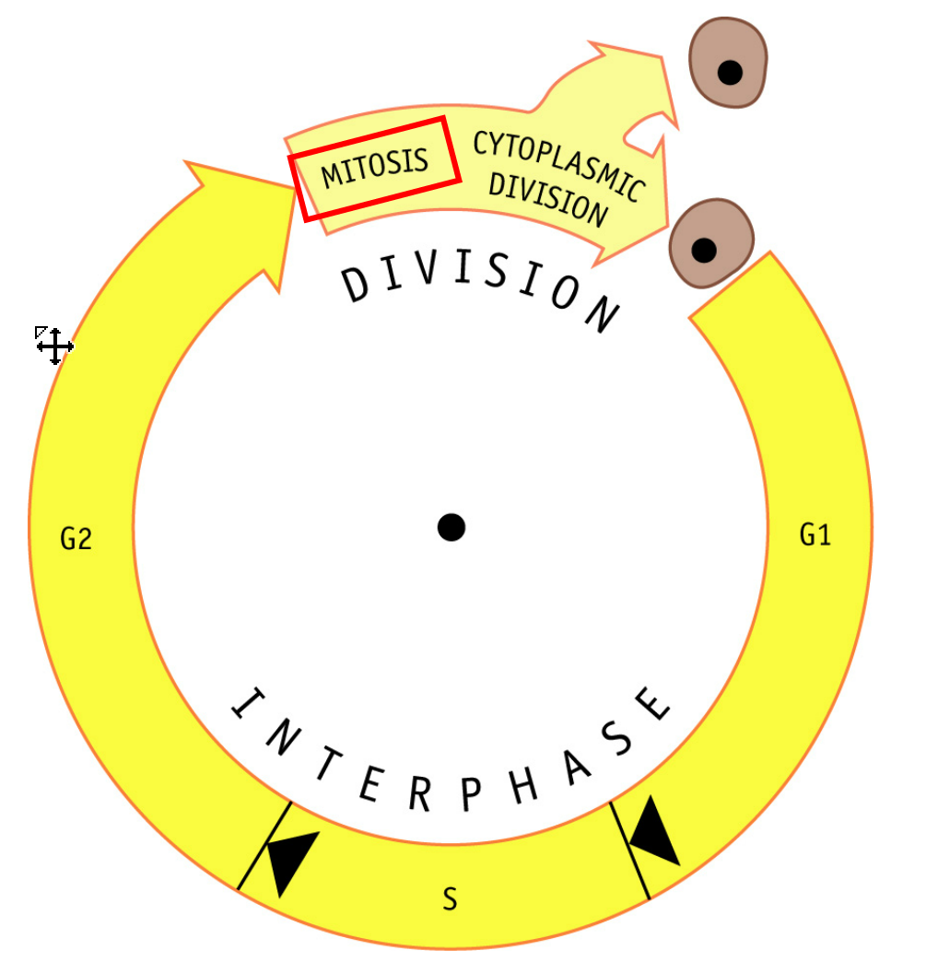
Cyclins and control of the cell cycle
Cyclin D – tells cell to move from G0 to G1 to S
Cyclin E – prepares the cell for DNA replication
Cyclin A – Activated DNA replication
Cyclin B – Prepares spindles and other tasks in the cytoplasm ready for mitosis.
On your cell cycle diagram indicate where you think these cyclins will peak

Slide 9
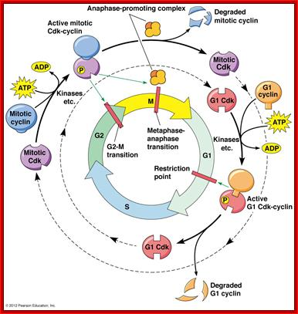
Cyclins are proteins.
They attach to cyclin dependent kinases (CDKs) which allows them to act as enzymes.
These enzymes control the cell cycle

Slide 11
Supercoiling of Chromosomes
DNA is very long. Each chromosome has around 5cm DNA. You have 46 Chromosomes all packaged into a tiny nucleus.
Chromosomes need to be moved around during cell division so they are condensed (made shorter)

Slide 13
Interphase

Slide 14
from microtubules

Slide 17
The two daughter cells now enter interphase

Slide 18
Mitosis

Slide 19
Cytokinesis

Slide 23
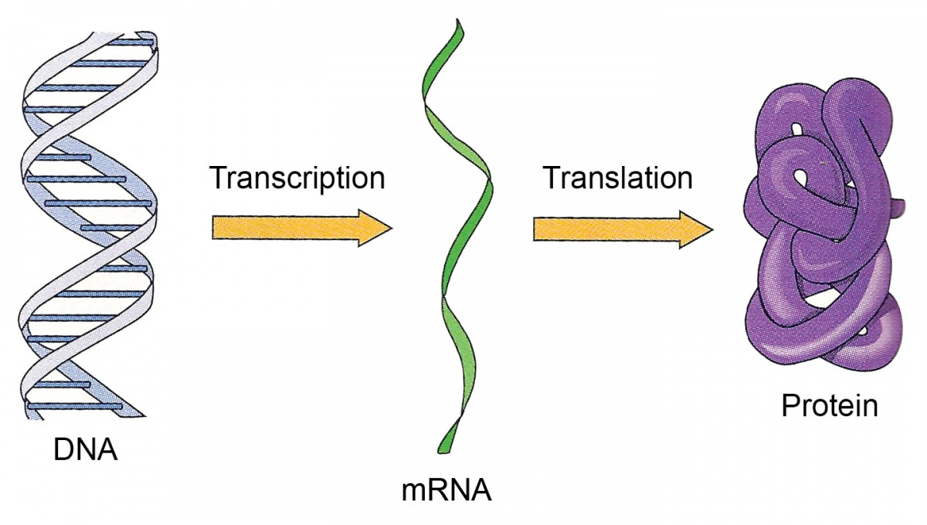
Tumours and Cancer
What do you think would happen if cyclin or cyclin dependent kinases’ production/function was changed?

Slide 24
What is a tumour?
When cells divide uncontrollably they form a group of cells – Tumour
These cells often stick to each other and do not travel to other parts of the body – Benign
A tumour where cells can detach is called a primary tumour and are malignant
When cells from primary tumours travel to other parts of the body this is called metastasis
Diseases caused by malignant tumours are called cancers

Slide 25
Mutations
What is a mutation?
Random changes in the base sequence of genes
How are mutations linked to the cell cycle and cancer?
Genes that are cancer causing if mutated are called oncogenes.
What can cause mutations?
Things that cause mutations are called carcinogens
X-ray, UV, chemicals in cigarettes….

Slide 27
