Slide 1
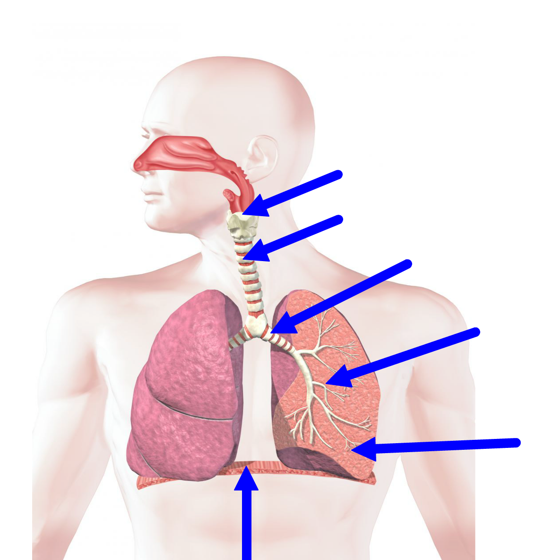
Lungs
A
B
C
D
E

Slide 2
6.4 Gas Exchange Lungs and Ventilation
Label the structures in the respiratory system
Describe how antagonistic muscle action and pressure changes bring about ventilation

Slide 3
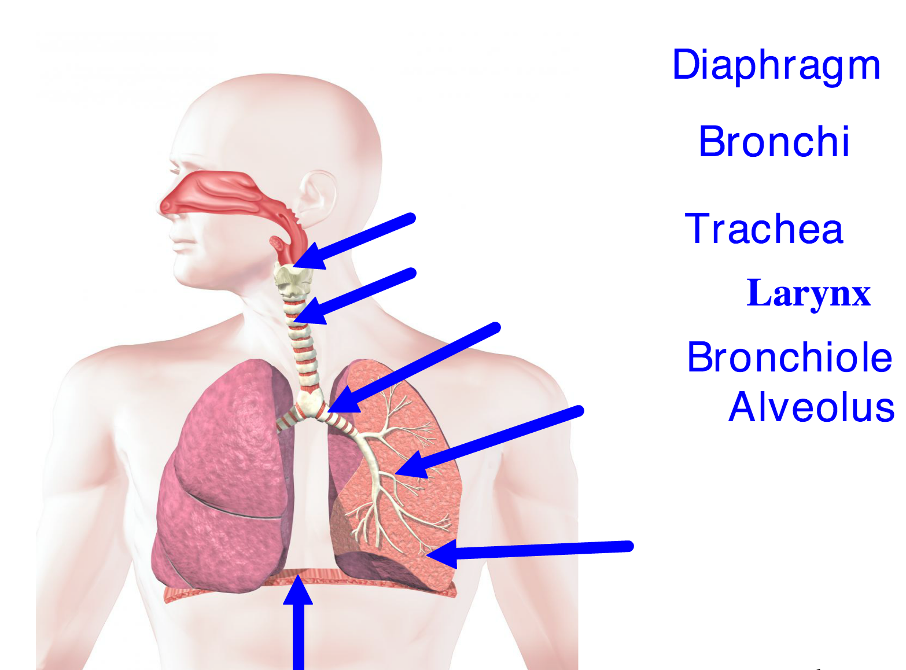

Slide 4
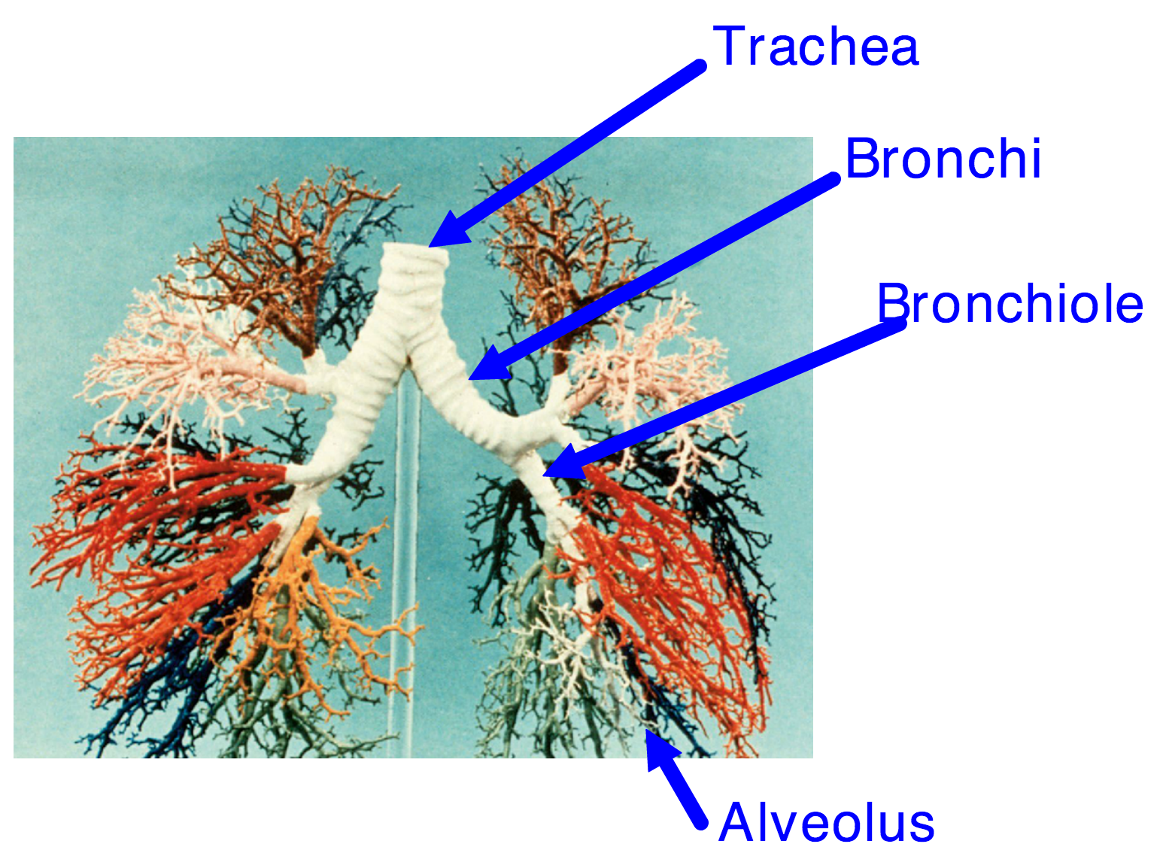

Slide 5
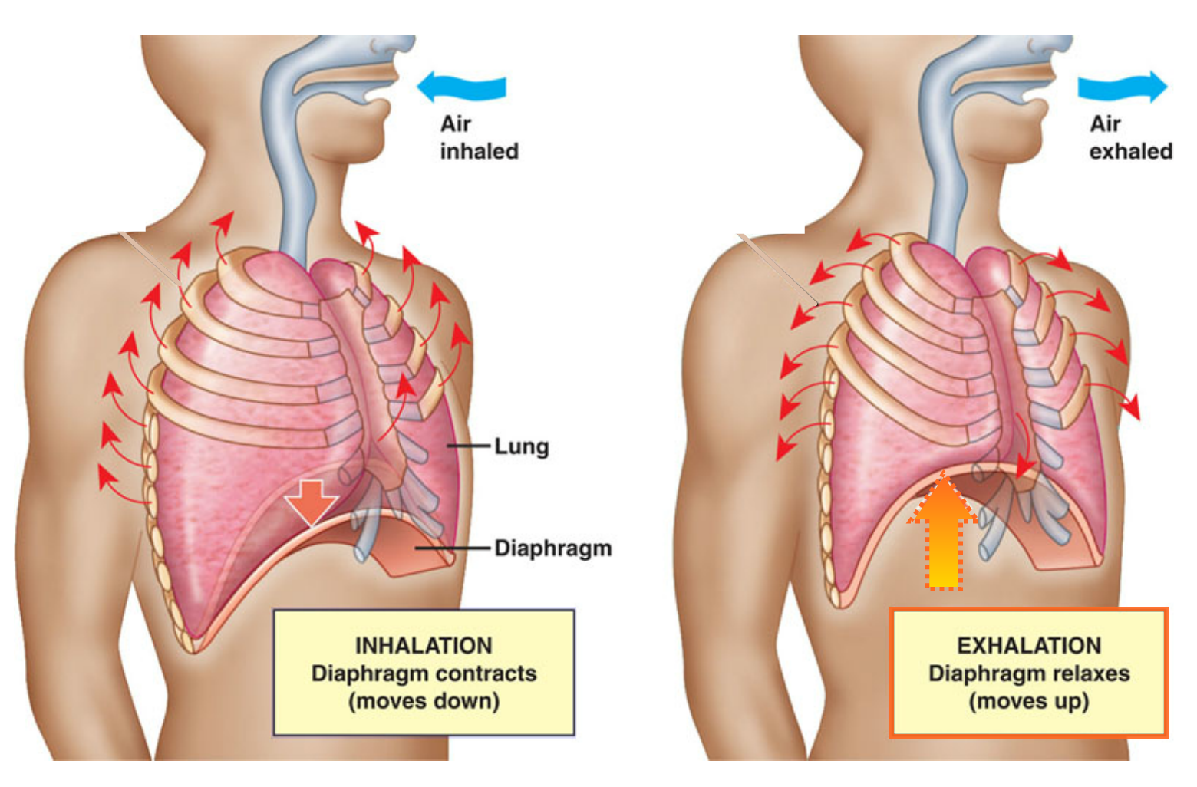
Ventilation

Slide 6
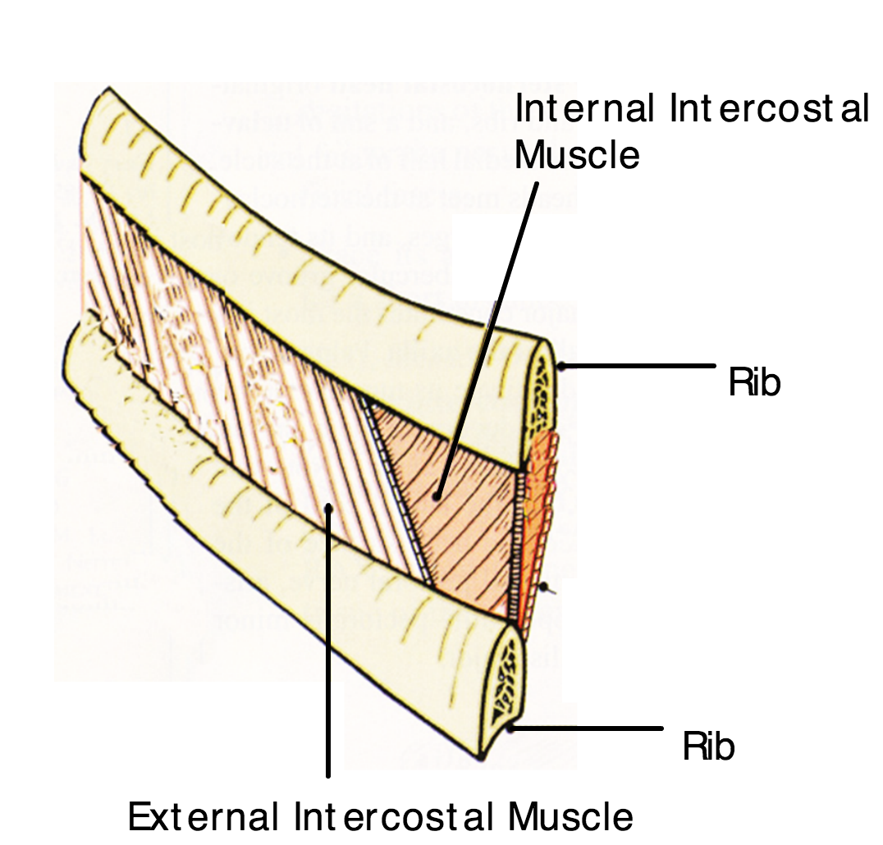
Muscles work antagonistically
Internal an external intercostal muscles work antagonistically..
The diaphragm and the abdominal muscles work antagonistically

Slide 7
Muscles in the abdomen wall relax
The external intercostal muscles relax
External intercostal muscles contract, pulling the ribcage upwards and outwards
The diaphragm relaxes and moves upwards
The diaphragm contracts and moves down
Muscles in the abdomen wall contract pushing the diaphragm upwards
The pressure in the thorax decreases
The volume of the thorax increases
The volume in the thorax decreases
The internal intercostal muscles relax
Air is taken in
The internal intercostal muscles contract, pulling the ribcage inwards and downwards.
Air is forced out
The pressure in the thorax increases

