Slide 1
Which one is alive? Why?

Slide 2
Eukaryotes
Prokaryotes
you
Prokaryotes = Singled celled with no nucleus (bacteria)
Eukaryotes – Single and multicellular with nucleus (protists, plants, animals, fungi)

Slide 3
1.1 Introduction to cells
Applications:
Questioning the cell theory using atypical examples, including striated muscle, giant algae and aseptate fungal hyphae.
Investigation of functions of life in Paramecium and one named photosynthetic unicellular organism.
Use of stem cells to treat Stargardt’s disease and one other named condition.
Ethics of the therapeutic use of stem cells from specially created embryos, from the umbilical cord blood of a new-born baby and from an adult’s own tissues.
Understanding:
According to the cell theory, living organisms are composed of cells.
Organisms consisting of only one cell carry out all functions of life in that cell.
Surface area to volume ratio is important in the limitation of cell size.
Multicellular organisms have properties that emerge from the interaction of their cellular components.
Specialized tissues can develop by cell differentiation in multicellular organisms.
Differentiation involves the expression of some genes and not others in a cell’s genome.
The capacity of stem cells to divide and differentiate along different pathways is necessary in embryonic development.
Skills:
Use of a light microscope to investigate the structure of cells and tissues, with drawing of cells. Calculation of the magnification of drawings and the actual size of structures and ultrastructures shown in drawings or micrographs. (Practical 1)
Nature of science:
Looking for trends and discrepancies—although most organisms conform to cell theory, there are exceptions. (3.1)
Ethical implications of research—research involving stem cells is growing in importance and raises ethical issues. (4.5)

Slide 4
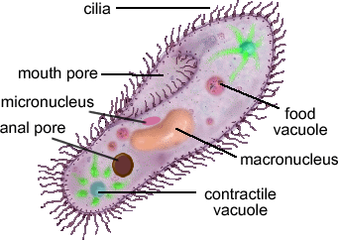
Life
Metabolism
Chemical reactions
Growth/Development
Increase in size
Reproduction
Producing offspring
Response
React to changes in the environment
Homeostasis
Maintaining internal conditions
Nutrition
Feeding to provide energy
Excretion
Getting rid of waste products
Paramecium
”Life has the ability to reproduce and maintain its own complexity”
Max Tegmark

Slide 5
Is a virus alive?
ebola

Slide 6
Topic 1: Cell Biology
1.1 Introduction to cells
Cell Theory
1. Identify the characteristics of life
2. Define 'cell theory'
2. Discuss what is a 'typical' cell
3. Identify 'atypical' aspects of some cells

Slide 7
Weebly – Video: The wacky history of cell theory
What are three aspects of cell theory?
Who was the first person to see bacterial cells?
What did he call them?
Who first used the word ’cell’?
Who suggested ‘cell theory’?
Do cells just ‘appear’?

Slide 8
Cell Theory:
Define ‘theory’
A scientific theory is a well-substantiated explanation of some aspect of the natural world, based on a body of facts that have been repeatedly confirmed through observation and experiment.
All organisms are made up of one or more cells
Cells are the smallest units of life
All cells come from pre-existing cells
Cells vary in size and shape but they share common features (usually)
Cells are relatively small in size
Cell surrounded by a membrane
Contain genetic information
Cells have an energy release system
How big is a cell?

Slide 9
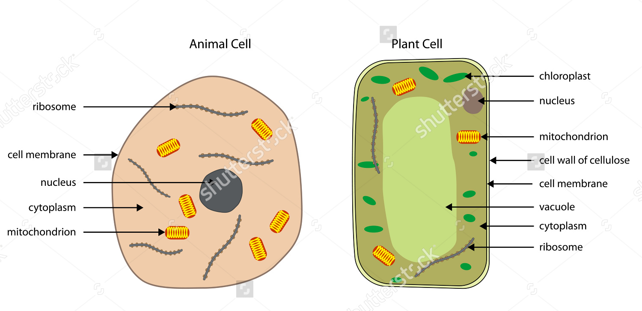
‘Typical Cells’
Draw an animal cell and a plant cell
0.03 mm
In what way are giant algae, hyphae and muscle cells not ‘typical’? Pg 8/9

Slide 10
Muscle Cells
Very long (average of 30mm)
Many nuclei without membranes dividing
30mm

Slide 11
Fungal hyphae
Very long
Many nuclei without membranes dividing

Slide 12
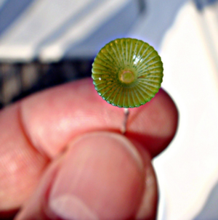
Acetabulgaria – Giant Algae
100 mm
Massive – Can grow up to 10cm even though it’s a single cell with one nuclei

Slide 13
Great documentary on the discovery of cells
https://vimeo.com/70860703 - Cells

